Slide 1
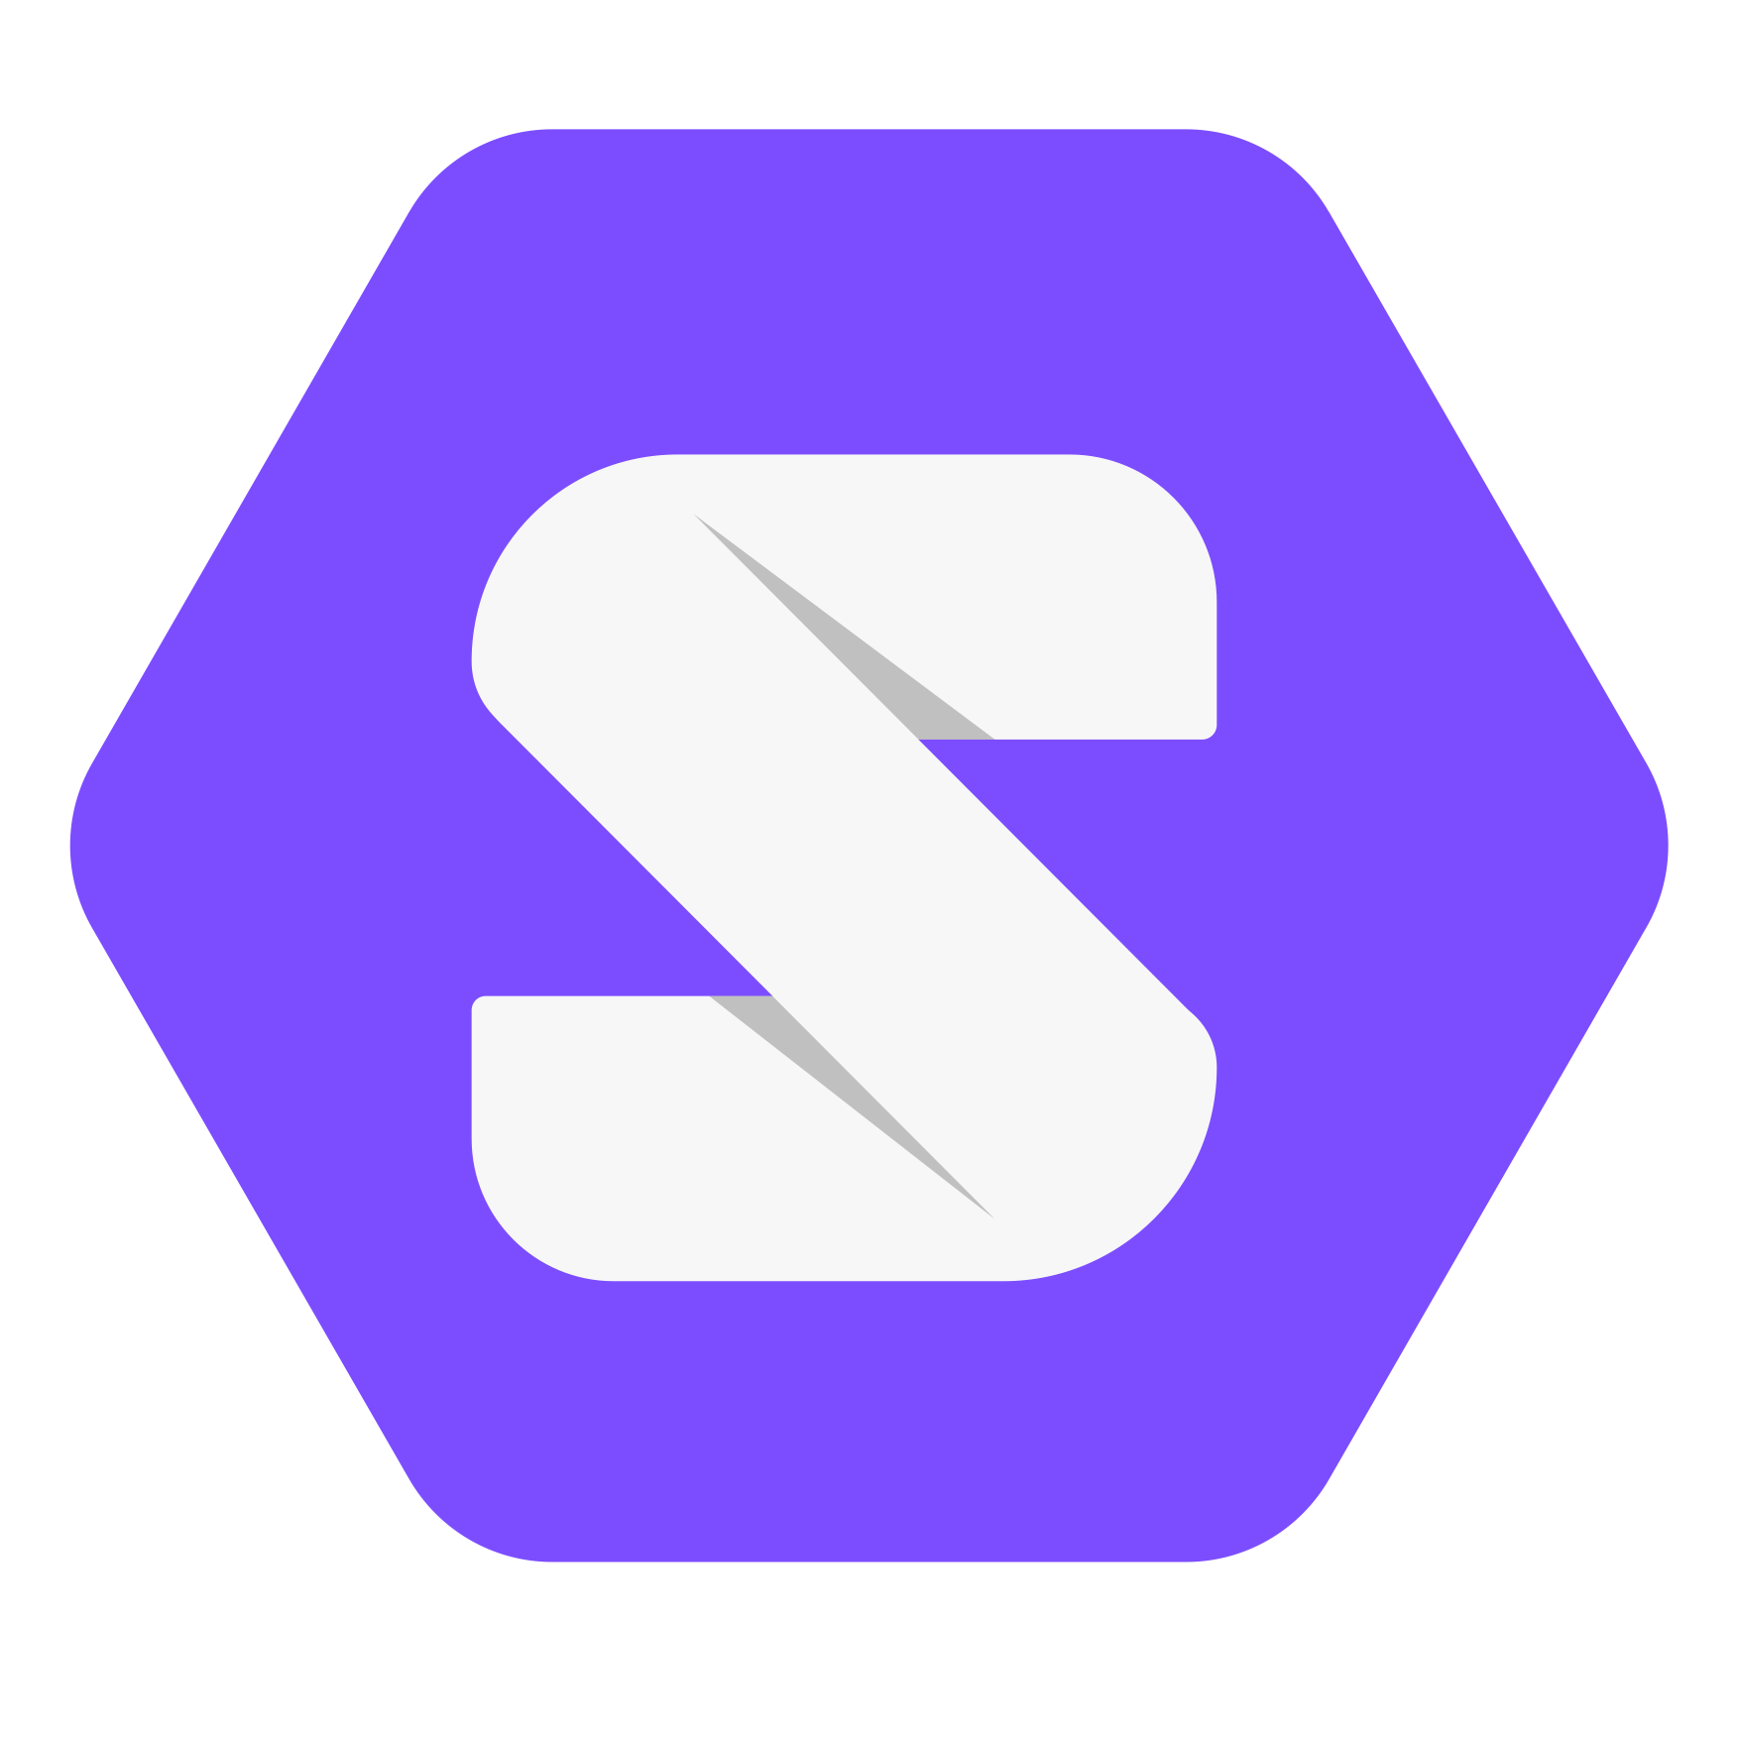
SoLiD Web Infrastructure
Re-decentralizing the web, for Privacy and Innovation
Osama I. Al-Dosary, May 23, 2024, dosary@yahoo.com
This presentation is a derivative of “Solid: taking back the Web through decentralization” by Ruben Verborgh used and relicensed under Creative Commons Attribution 4.0.

Slide 2
Disclaimer
Not a developer
I’m here as a concerned netizen

Slide 3
“The power of the Web is in its universality.”
-- Tim Berners-Lee, W3C Director and inventor of the World Wide Web
Freedom to access…
Any OS, browser, hardware, desktop, phone, tablet …
Freedom to innovate…
anyone can build for the Web and interoperate using open standards
Independence and decentralized…
creation can be anywhere and independent of external control/limitations

Slide 4
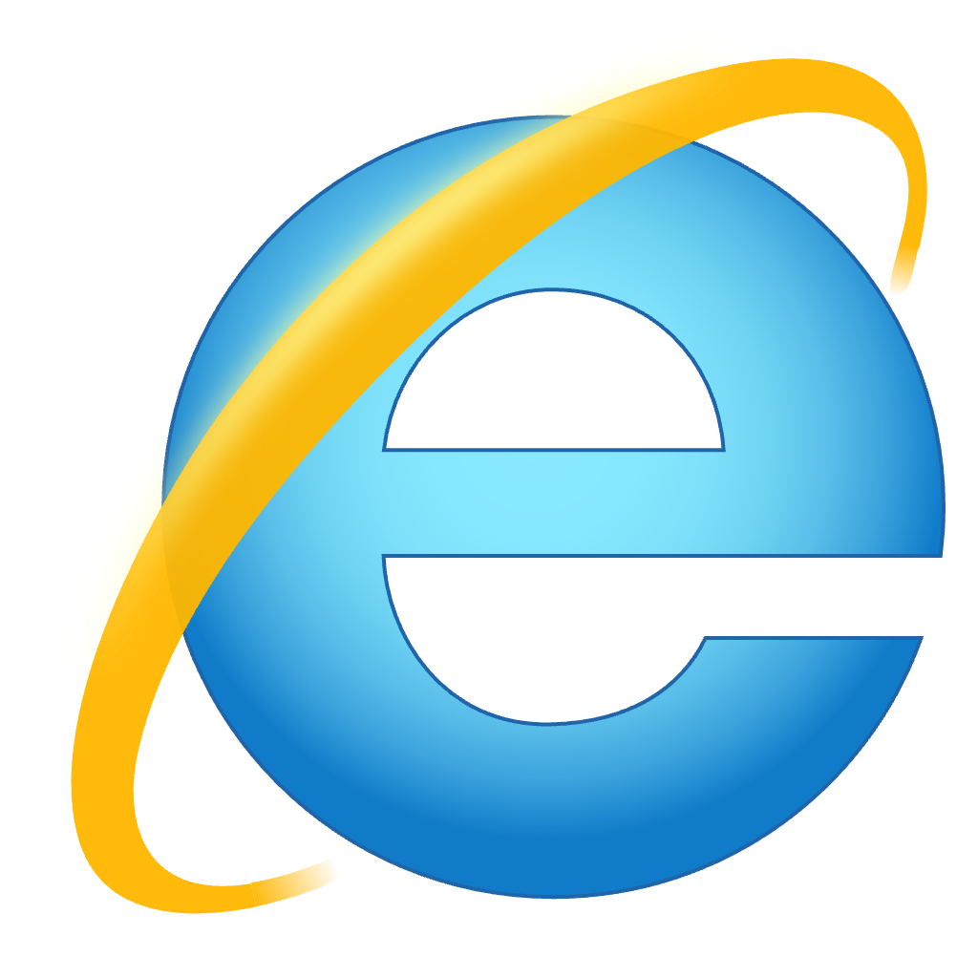
Challenges to the Web’s Universality
browser wars
people needed a certain computer
developers depended on browser’s pace
platform wars
you either compete for innovation with {insert social platform}, or depend on it

Slide 5
Platform Monetization
A platform’s success came down to its monetization of its users and their personal info
“If you’re not paying for a product, you are the product” -- Adage made famous by Tim O’Reilly
Result:
Walled gardens of personal data centralized in a handful of platforms

Slide 6
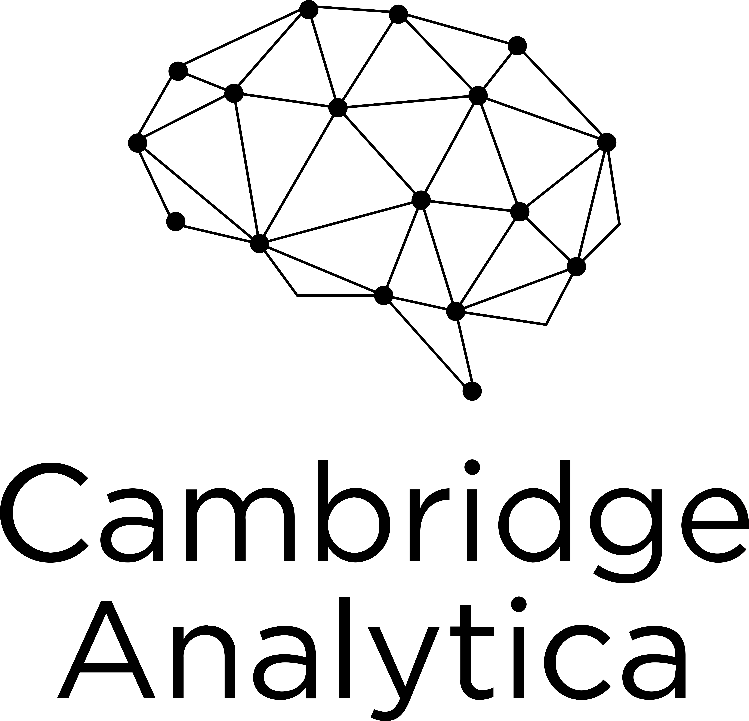
In the 2010s, personal data belonging to millions of Facebook users was collected without their consent by British consulting firm Cambridge Analytica, to be used mainly for political advertising.
In 2019, Facebook was fined $5 billion by the Federal Trade Commission due to its privacy violations. They also agreed to pay £500,000 to the UK Information Commissioner's Office, in 2019.
Sources: https://en.wikipedia.org/wiki/Facebook%E2%80%93Cambridge_Analytica_data_scandal
https://web.archive.org/web/20191031072141/https://www.bbc.com/news/technology-50234141
Notes:
Cambridge Analytica's high-profile clients include the Trump presidential campaign and the UK's Leave.EU campaign
psychological targeting

Slide 7
Massive centralized hurts diversity, innovation, and choice
Developers are at the mercy of centralized platforms
for permission to access data and identity
… “with us or against us” relationship with platforms
People at the mercy of centralized platforms
for control of their data and cannot switch to other apps
users locked-in and cannot easily switch to new innovative apps
Far-reaching consequences for privacy
Lack visibility into what is being retained
Little control over how it is used, or who is using it.
Personal data scattered
can’t be easily used as a cohesive unit

Slide 8
Introducing Solid (SOcial LInked Data)
Conventions for building decentralized applications, Restoring choice on the Web by Decoupling data and apps
True Data Ownership
Modular Design
Extensible
W3C Standards based
Reuse Existing Data

Slide 9
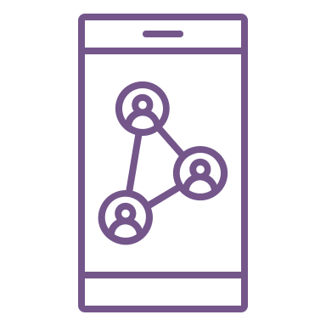
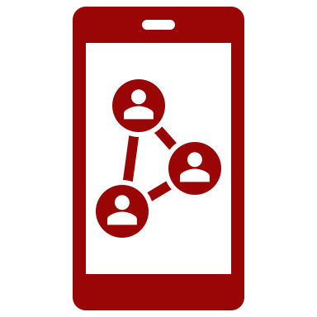
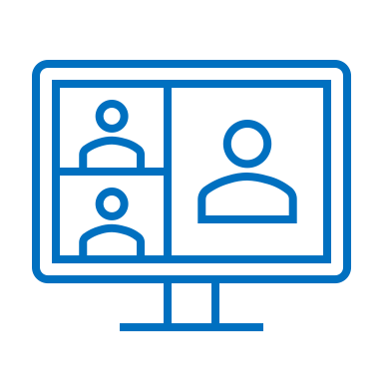
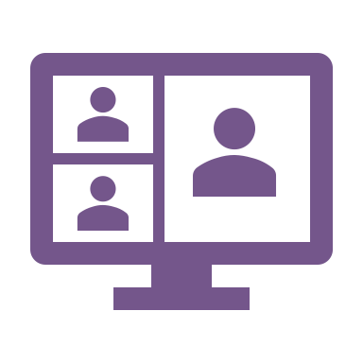
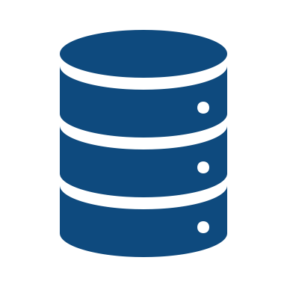
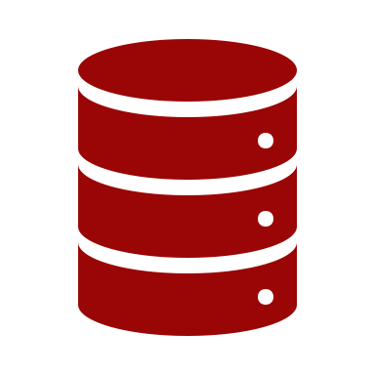
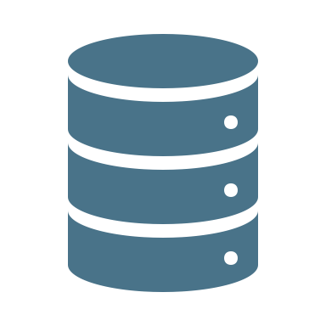
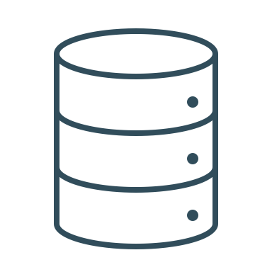
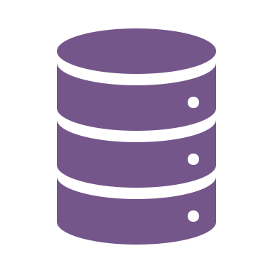
SOLID Decouples Data and App Using data Pods and Web Interfaces
Draft standard reusing W3C standards: HTTP, LDP, LDN, etc.
A Pod is a Web server
With support of access control and Linked Data
Data and App Agnostic
Works with any app like a website
Works with any data
Decentralized
Apps
…
Data
Pods
Posts
Contacts
Photos
Schedule
Medical
Notes:
Standardization process started in 2018
We can imagine the purple as a social media app needing access to the posts, contacts, and photos
Blue as a health app, needing access to medical and schedule data

Slide 10
SOLID Enhances the Internet Ecosystem
Interoperability and Collaboration
Privacy and Control
Innovation and Sustainability
Notes:
”Course Correction”

Slide 11
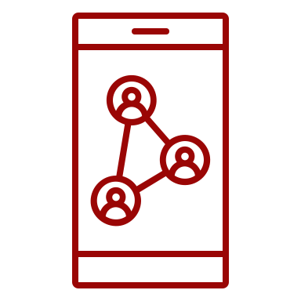
Open Interoperability and Collaboration
Allows data access across different applications and platforms, enabling seamless sharing of data between users and applications.
Enhanced User Experience by enabling personalized and context-aware experiences.
Decentralized Apps
New App Easily Introduced
…
Posts
Contacts
Photos
Schedule
Medical
Data Pods

Slide 12
Enhances Privacy and Control
Empowers individuals to own and control their data, which enhances privacy and autonomy for users and fosters greater trust in online interactions.
Helps application providers with Data Sovereignty Compliance and regulations by enabling users to store their data within specific jurisdictions or regions.
Reduced risk of wide-scale data breaches and unauthorized access, due to distributed nature or data.
Decentralized
Apps
Access Control
…
Data
Pods
Posts
Contacts
Photos
Schedule
Medical

Slide 13
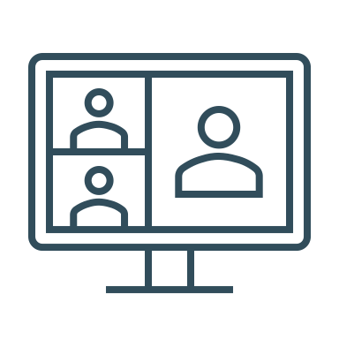
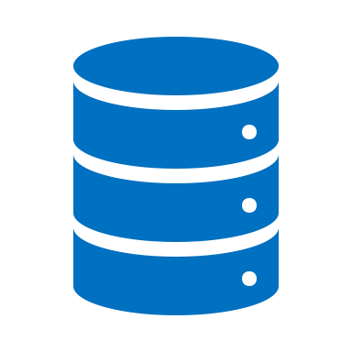
Driving Innovation and Sustainability
Competition Based on
Data Ownership
Competition Based on Quality
Decentralized
Apps
Failed App
Centralized Apps
App + Data
App + Data
App + Data
App w/
No Data
Data Access Major Barrier to Entry for Small Players
Data
Pods
Low
Latency
High
BW
Secure
Backup
Unlimited
Notes:
Monetization Opportunities: Network operators can explore new revenue streams by offering services and solutions that support the SOLID ecosystem, such as hosting PODs, providing data management tools, or offering value-added services for SOLID-based applications.
Future-Proofing: Embracing SOLID positions network operators at the forefront of the evolving internet landscape, where decentralized architectures and user-centric data management are becoming increasingly important. This helps future-proof their infrastructure and services against emerging trends and technologies.

Slide 14
Solid Pod Hosting Self-host or Use a provider
Self-host using Solid Open-Source server:
run at home and/or at your workplace
rent server space
solidproject.org/self-hosting
Use a hosting provider
use one of the free community servers
Server, libraries and several apps exist and are usable for developers
Source: https://solidproject.org/self-hosting/
Source: https://solidproject.org/users/get-a-pod

Slide 15
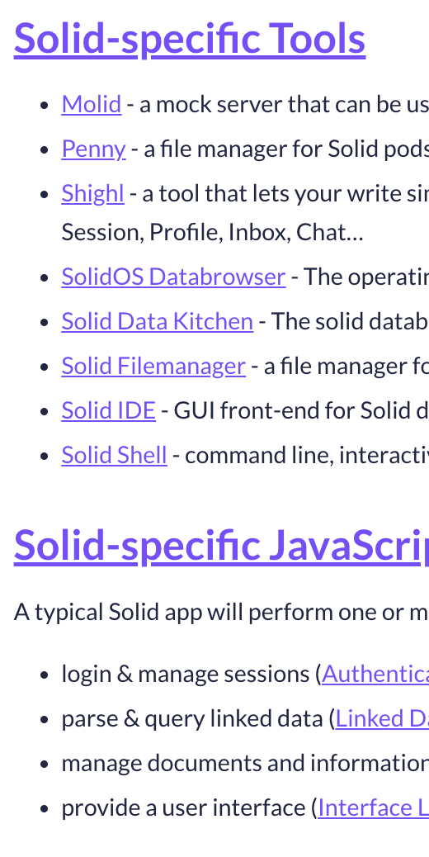
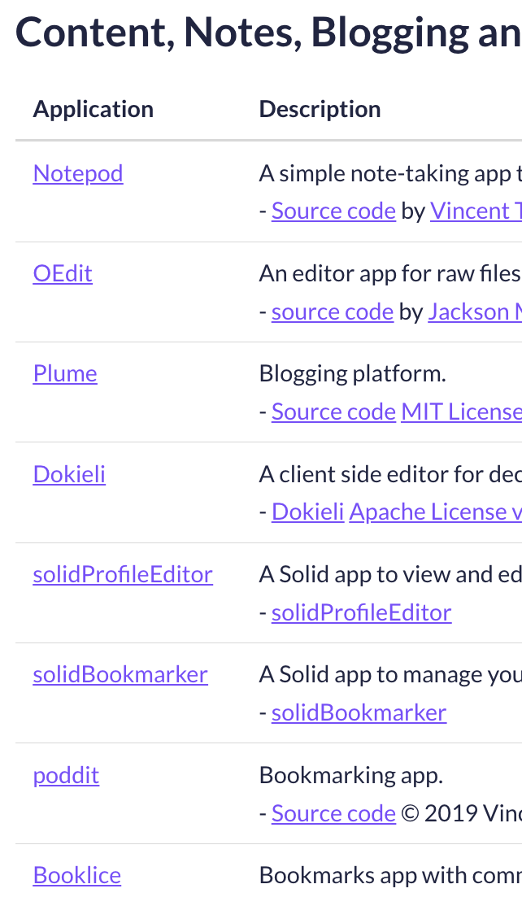
Example Solid Open-Source Tools and Applications
https://solidproject.org/apps
https://solidproject.org/developers/tools/

Slide 16
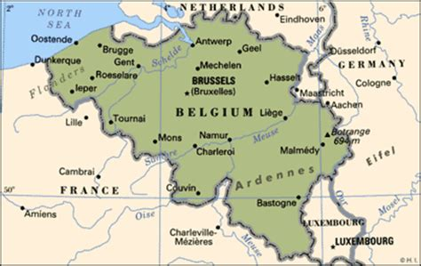
Early Adopter: Flemish Data Utility Company
A neutral entity created to stimulate citizens’ trust in sharing data, by focusing on responsible and secure data sharing. All while boosting the digital economy by making data more findable and exchangeable, between citizens, companies and associations for better cooperation.
Source: https://www.vlaanderen.be/digitaal-vlaanderen/het-vlaams-datanutsbedrijf/the-flemish-data-utility-company

Slide 17
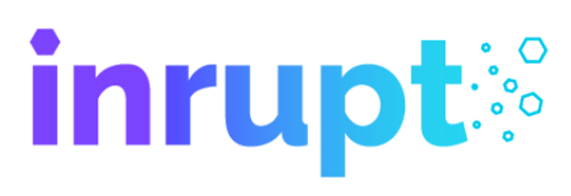
Transitioning from research to ecosystem backed by inrupt
MIT has been its home, in initial development of server and apps
Inrupt is accelerating development
Open the ecosystem for all
Create tools for developers
Offer services and apps
Maintain common building blocks as open source
Founded by Tim Berners-Lee with others at MIT in 2018
Goal re-decentralize the Web

Slide 18
Call to Action
Provider: Host a pod today!
Developer: Start hacking with Solid!
Spread the Word!
For more info:
https://solid.mit.edu
https://solidproject.org/
https://solid.inrupt.com/
https://solidcommunity.net/
https://www.w3.org/community/solid/
This presentation is a derivative of “Solid: taking back the Web through decentralization” by Ruben Verborgh used and relicensed under Creative Commons Attribution 4.0.

