Slide 1
Is It Just Me?
Talking About ADHD and Other Neurodiversity
Rob Lister | RIPE88
rob@lonap.net

Slide 2
whois robl
Various jobs in Support, IT, Networks for the past 30 (!!) years
Based in London
Currently Senior Network Engineer* at LONAP since 2012
(…This is my first presentation at a RIPE meeting)
rob@lonap.net
* Generic job title which means basically everything….

Slide 3
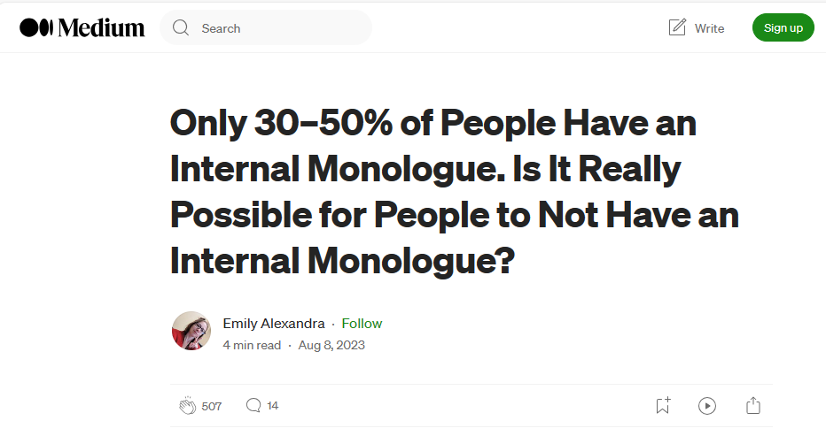
Inner Voices…
https://irisreading.com/is-it-normal-to-not-have-an-internal-monologue/
https://eccentricemmie.medium.com/only-30-50-of-people-have-an-internal-monologue-b75125ca5694
Notes:
Apparently, only 30-50% of People have an internal monologue in their head.
I don’t know if this is true or not, but let’s do a show of hands…
Who has an internal monologue?
Who doesn’t?
Who does not know what I’m talking about?

Slide 4
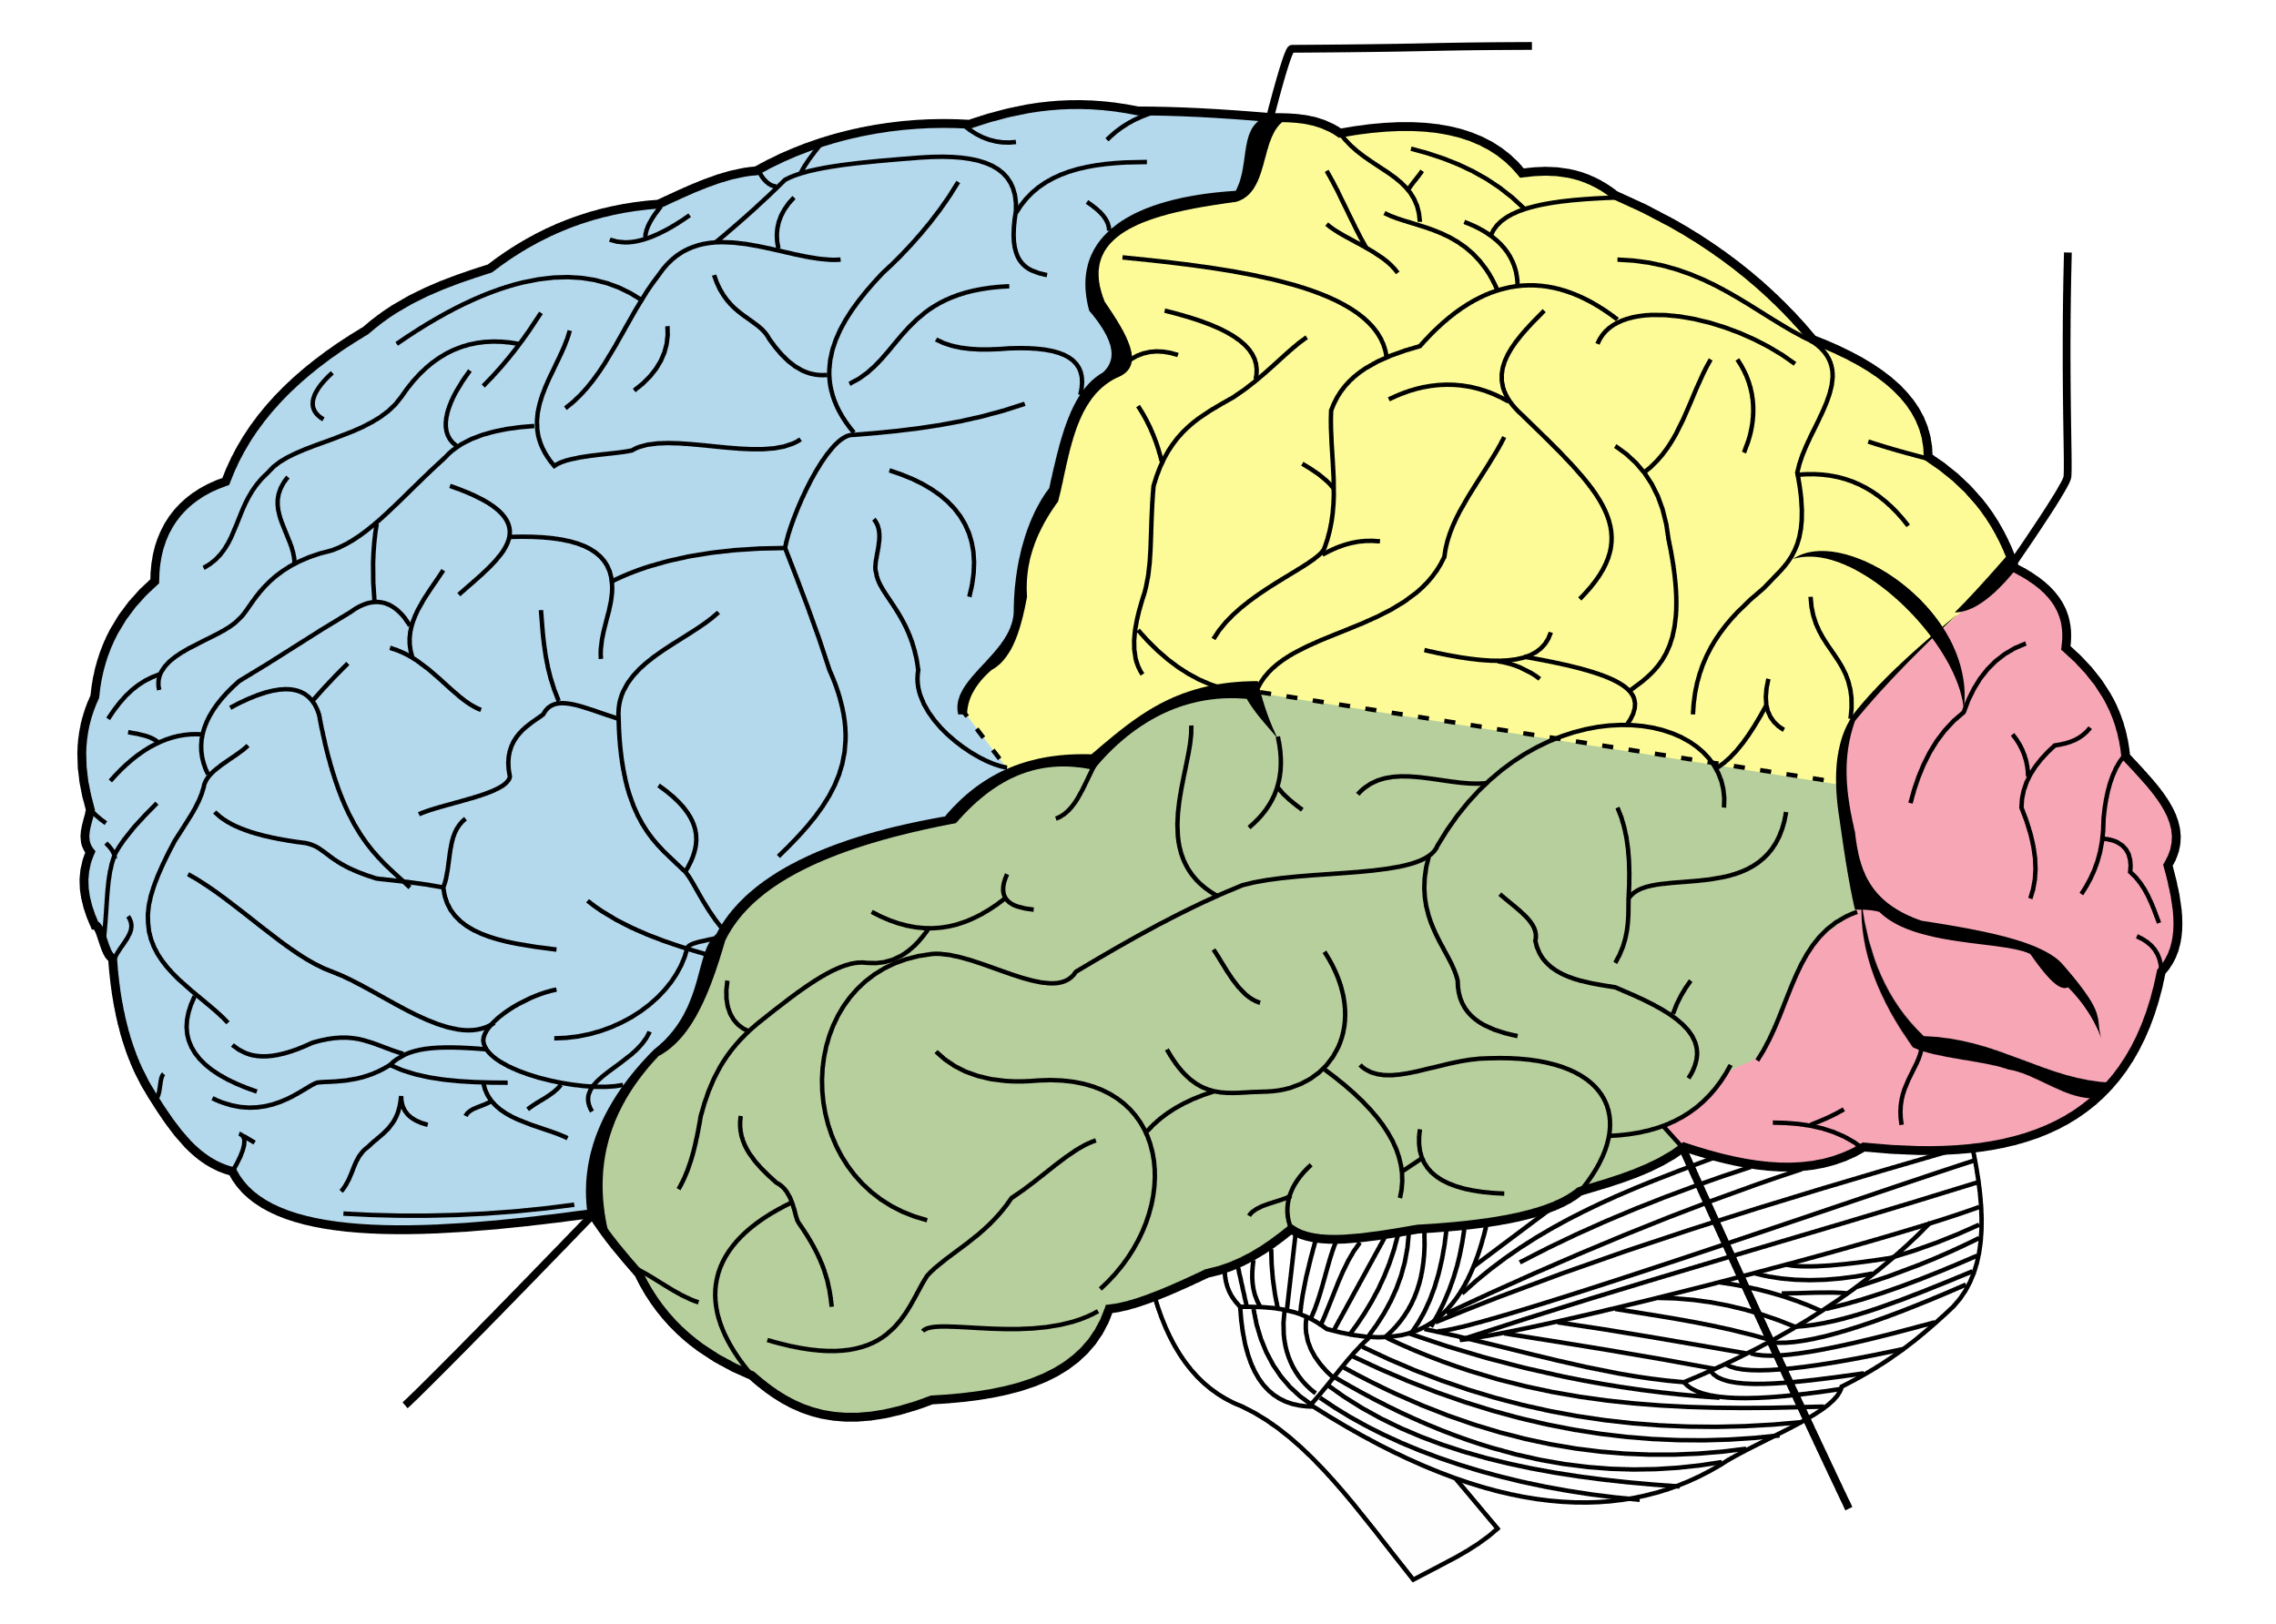

Coming out…
Brain: Model “B”
Notes:
Coming out…
“Are you like me?”
Model A… Model B… Or even Model C?
Why the shame? A fear of “coming out”… maybe we get branded as weird, difficult to work with… awkward…?

Slide 5
ADHD…
Attention Deficit Hyperactivity Disorder
:(
Notes:
Negative words… it doesn’t feel great!
Getting diagnosed at the age of 46, in 2021… was an experience!

Slide 6
ADHD Traits…
Short attention span and being easily distracted
  Hard to settle on one task
  “Butterfly mind” full of random/unconnected thoughts…
Hyperfocus
  Focus can be excellent… (but often not on the right task. ☹)
Disorganisation
  Time blindness – we are not great at deadlines!
  Often leave things until the last minute
Forgetful - Terrible working memory!

Slide 7
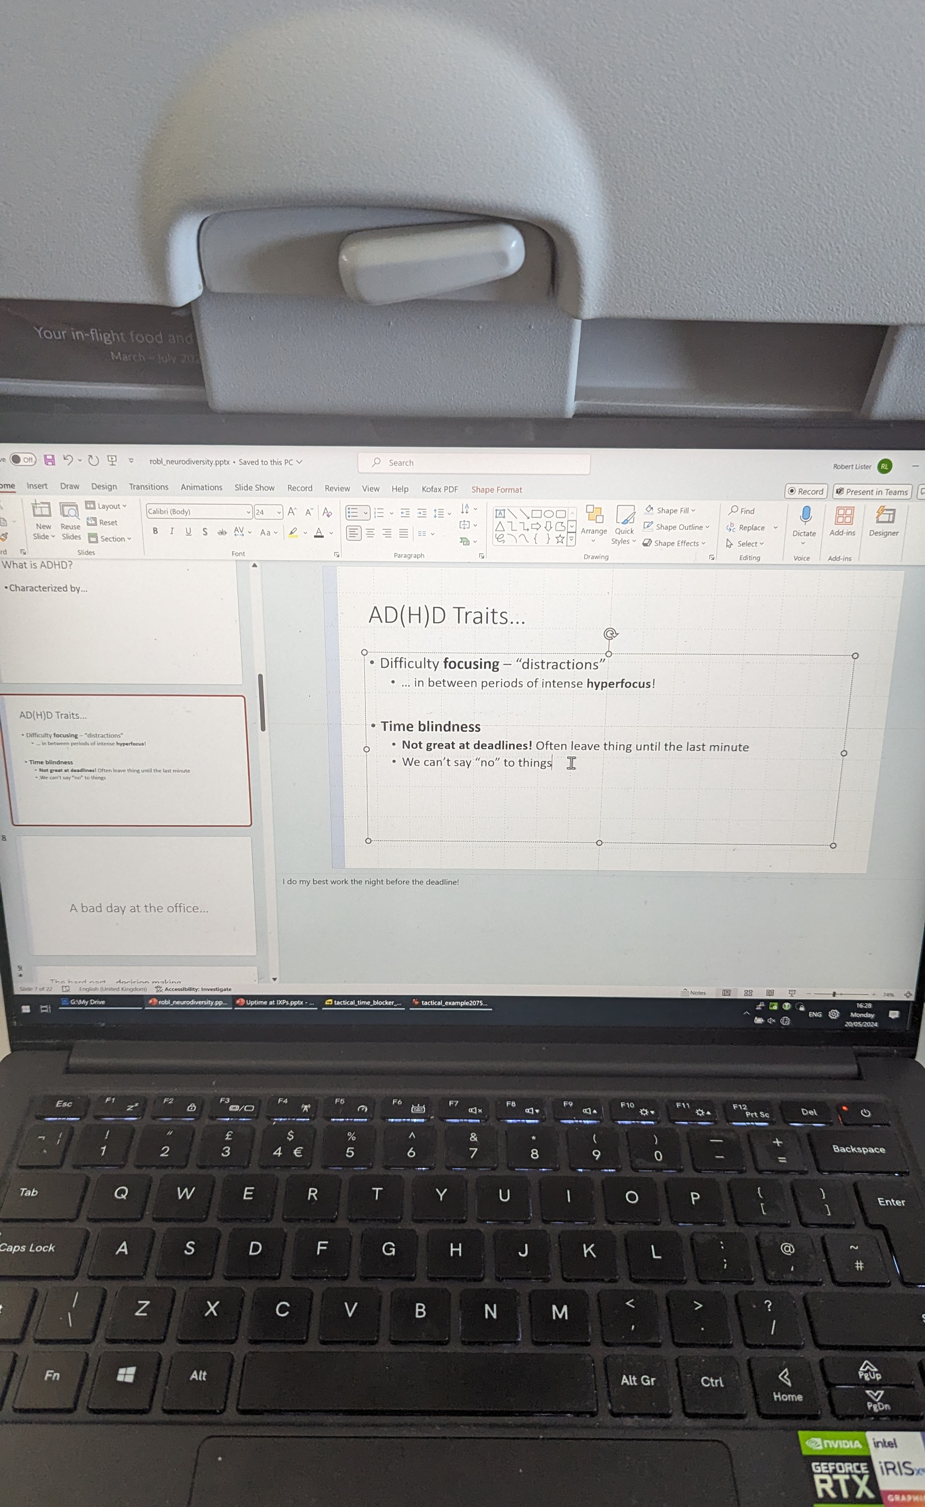
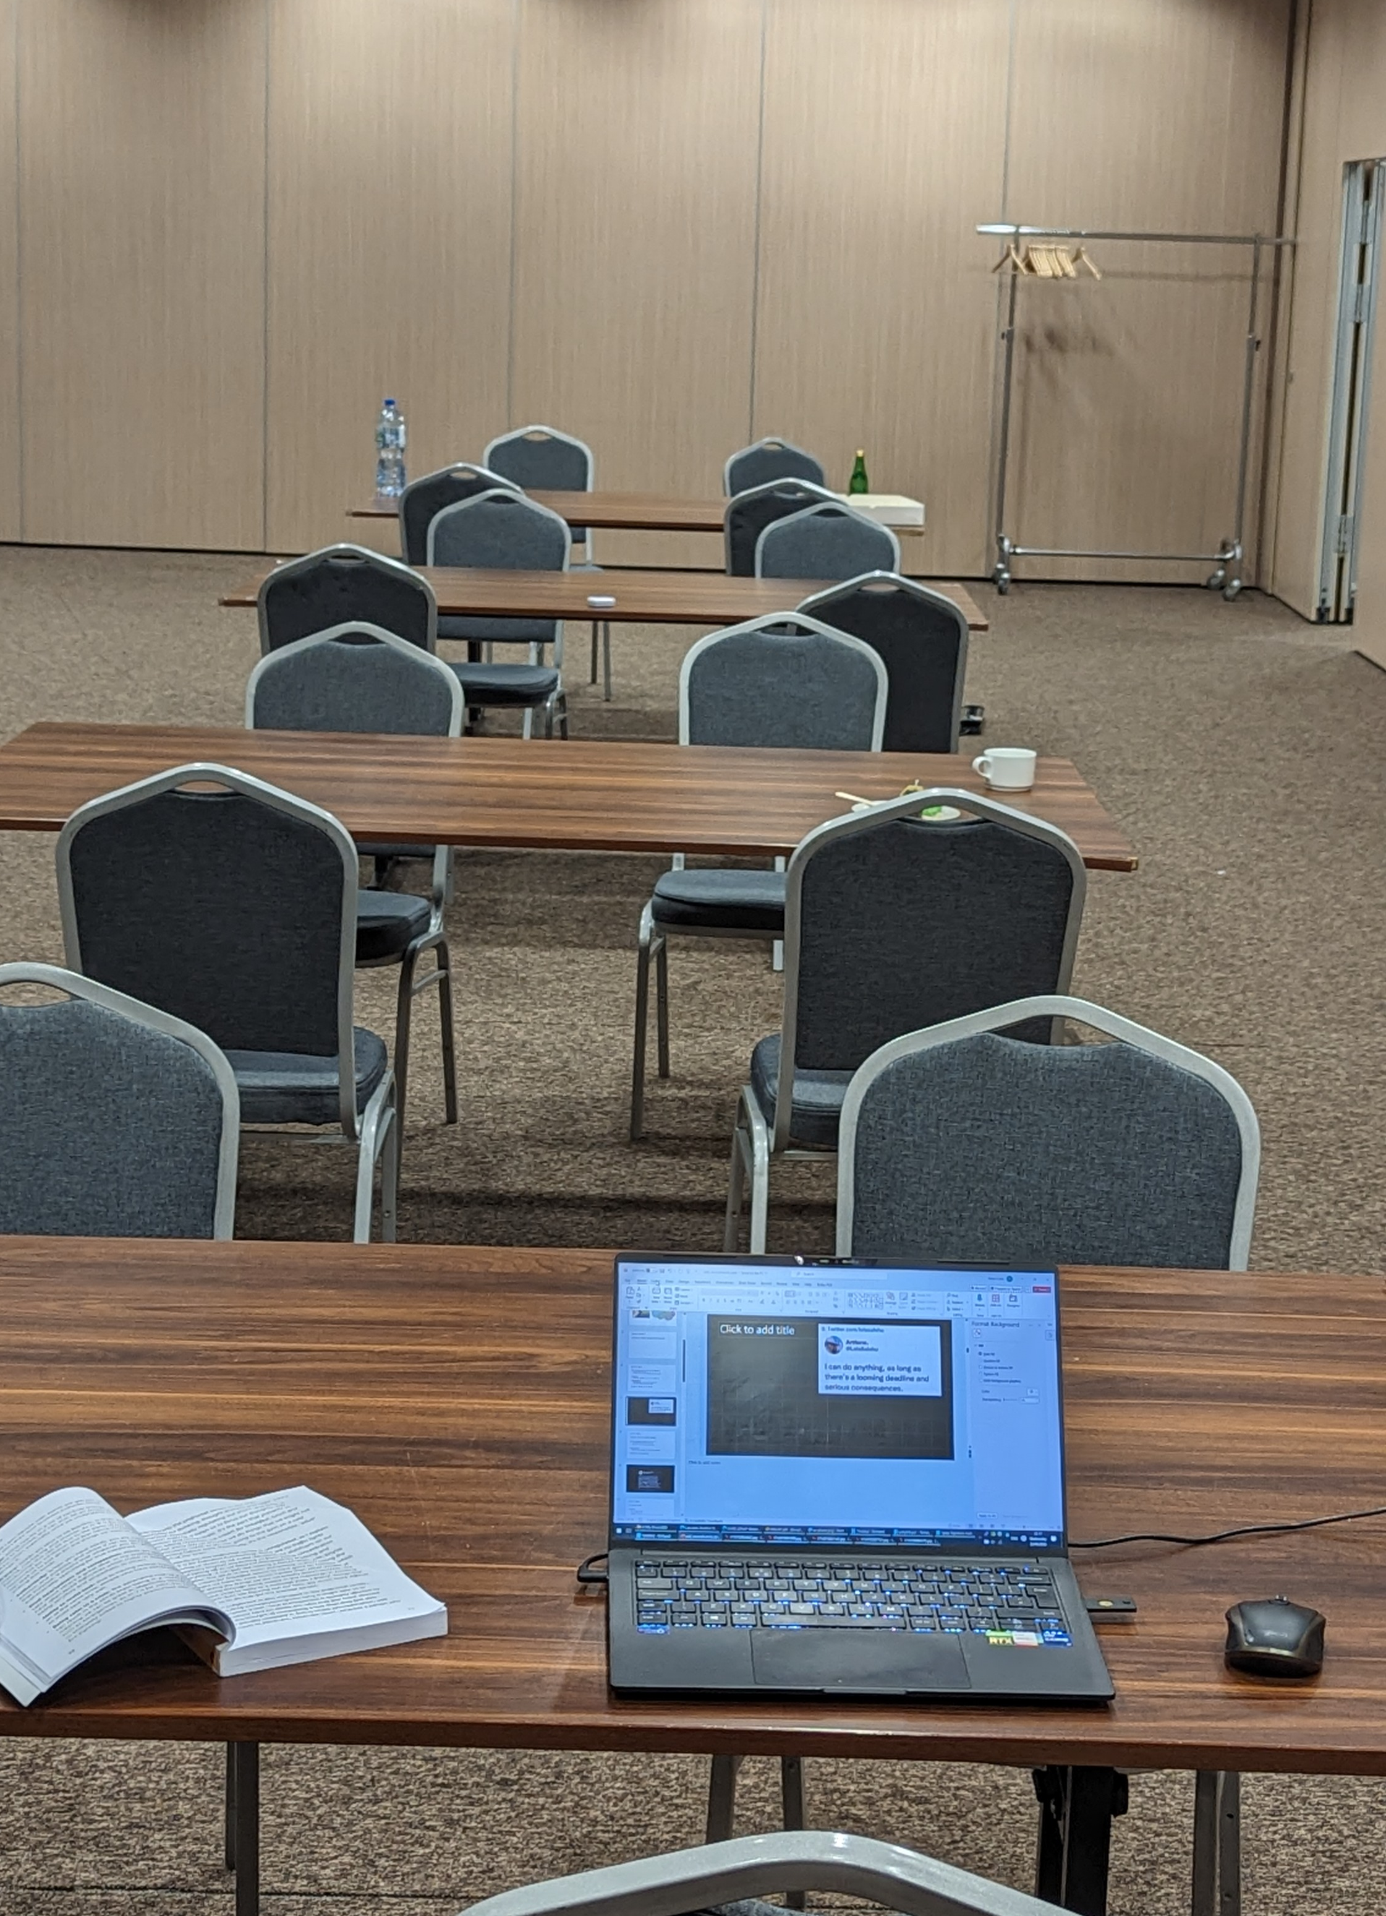

Slide 8
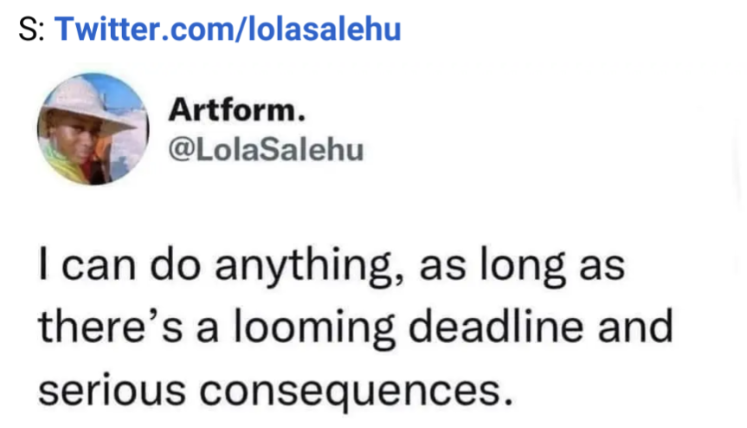

Slide 9
ADHD Traits…
Fidgeting, restlessness, problems sleeping…
Can have difficulty reading long-form text
  A “5 minute read” might take half an hour.
  (Even then I’ll have to read it several times.)
People pleasers
  We can’t say no to things and tend to take on too much…
‘Rejection Sensitive Dysphoria’

Slide 10
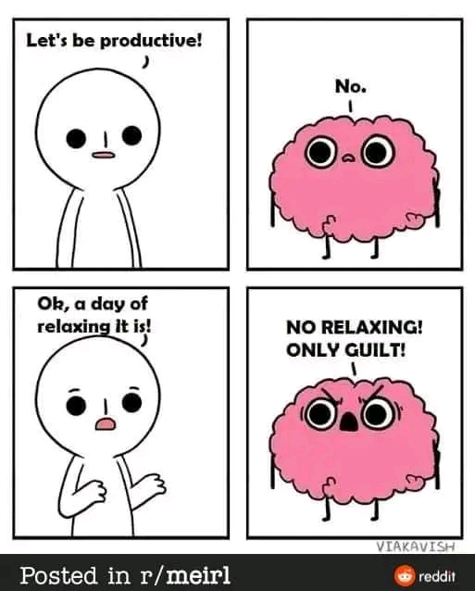

Slide 11
ADHD Traits – the good…
Being calm in a crisis
Creativity
  Natural problem-solvers
  ‘Think outside the box’
  Insightful connections between previously unconnected things
Energy
  Capable of delivering work to a very high standard

Slide 12
ADHD Traits – the good…
Authenticity
  Motivated by passion and purpose
  Great ‘social justice warriors’
Kind-heartedness and compassion
  We generally care about others a great deal
  Sensitive and empathetic to others
Bravery
  Fearless, in decision making, risk-taking and choices

Slide 13
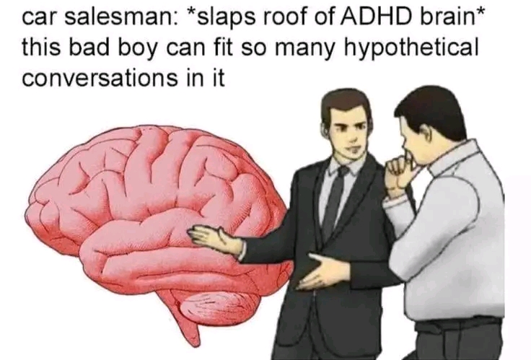

Slide 14
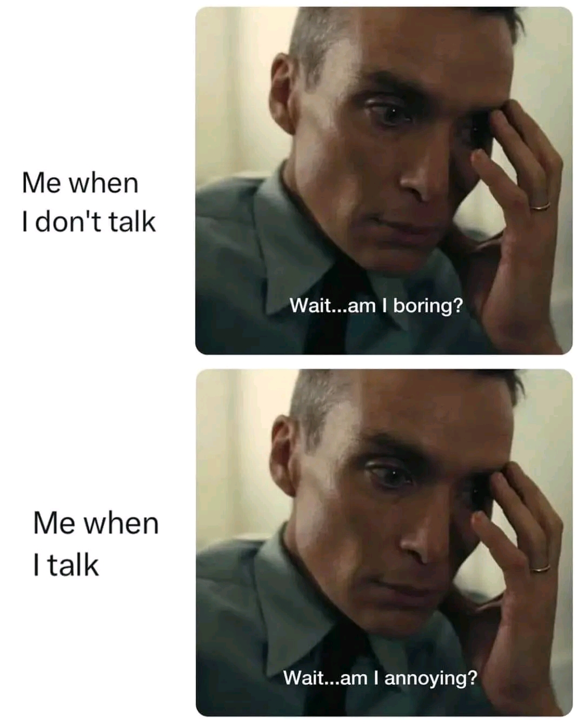
Communication – a mixed bag!
You’ll probably hear all about my current hyperfixation/project/random thoughts…
Plus all the back-story…
…and three tangents
Oh, here’s another thing I thought was important for you to know.
(Some other bonus content in brackets)
…Wait. What was your name, again?
Notes:
Most of the difficulties can be in our communication…
It can be intensely annoying for people!

Slide 15
Experiences
Unhelpful “advice”
  “Have you tried making a TODO list?”
  “Just do the thing…”
  ADHD isn’t a real thing - It’s just an excuse…
Slow to think in conversations - often left behind in the conversation
Concise thinking and getting to the point isn't a strong point!
We like to tell a story and give lots of context...
People find this incredibly annoying! "Just get to the point”
People talking over me
Notes:
I don't have the same level of social difficulty as with Autism, but ADHD causes some problems with communication.
The jury is still out on whether I have autism or not…

Slide 16
So what?
Notes:
So what can we do about it? How to make life easier?
Do we need to do anything at all?

Slide 17
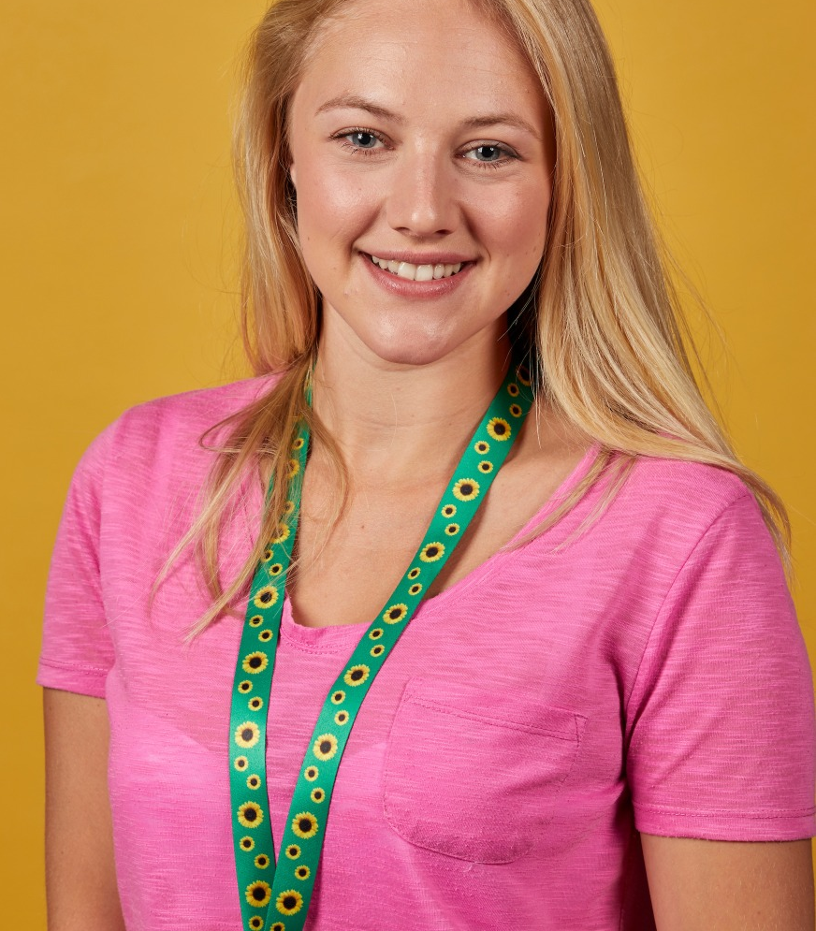
Notes:
Who has heard of the sunflower lanyard?
Hidden disabilities

Slide 18
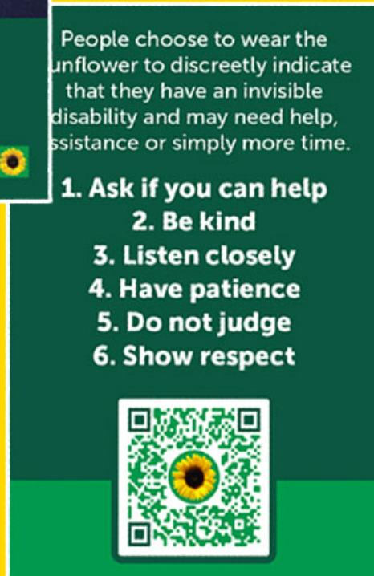
https://hdsunflower.com

Slide 19
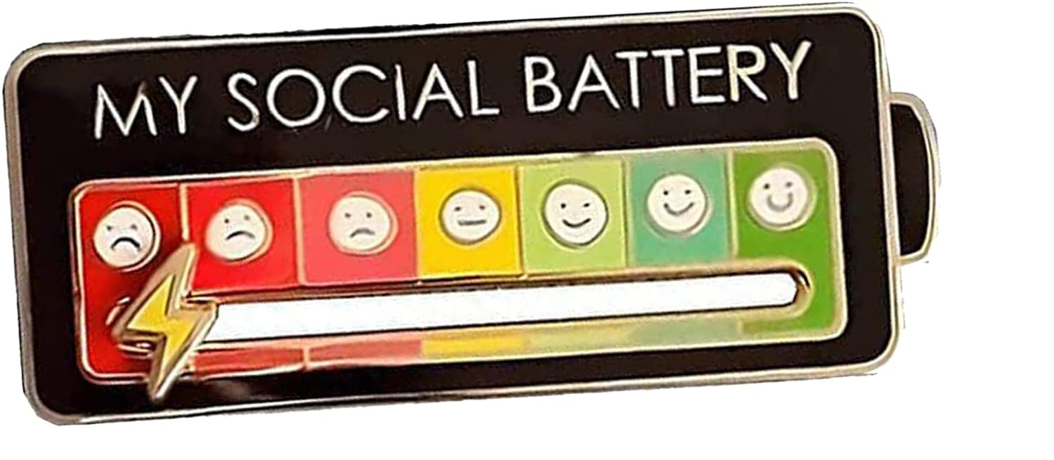

Slide 20
Accommodations….
Quiet spaces?
Flexibility with deadlines
Set clear expectations
Patience
Easier to read fonts and line spacing
Keep talking about it...
Raising awareness… Removing the stigma

Slide 21
Hidden brains… brilliant minds
Would the Internet ever have happened without amazing diverse minds?
Celebrate neurodiversity
Keep being awesome

Slide 22
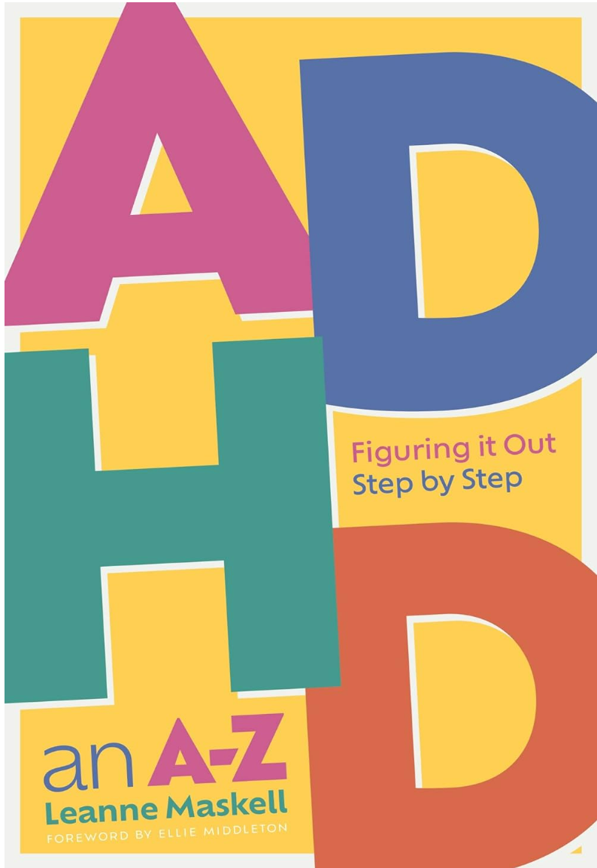
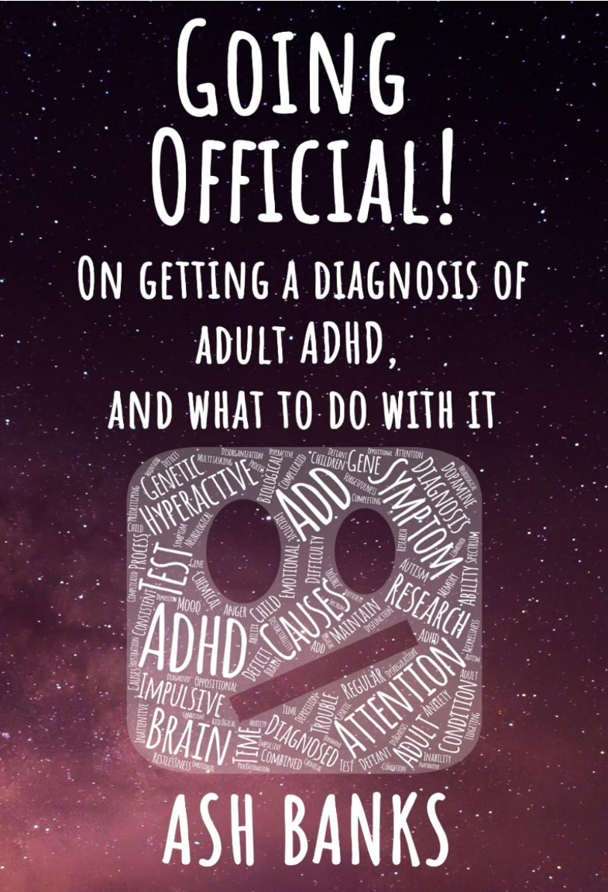
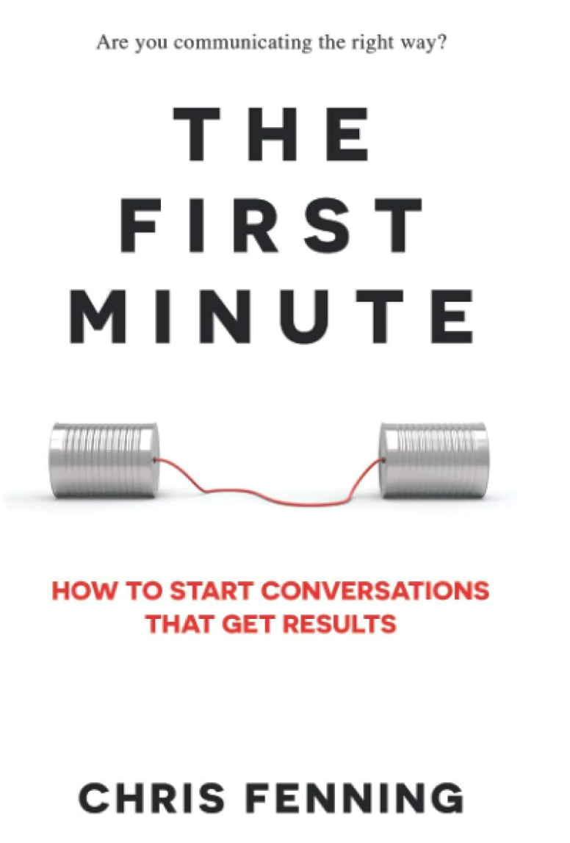
Your brain: Owner’s manuals…
ADHD an A-Z: Figuring it Out Step by Step. Leanne Maskell (2022) (ISBN: 978-1839973857)
Going Official! On getting a diagnosis of adult ADHD, and what to do with it. Ash Banks (2021) (ISBN: 979-8592736797)
The First Minute: How to Start Conversations That Get Results. Chris Fenning (2020) (ISBN: 978-1838244002)

Slide 23
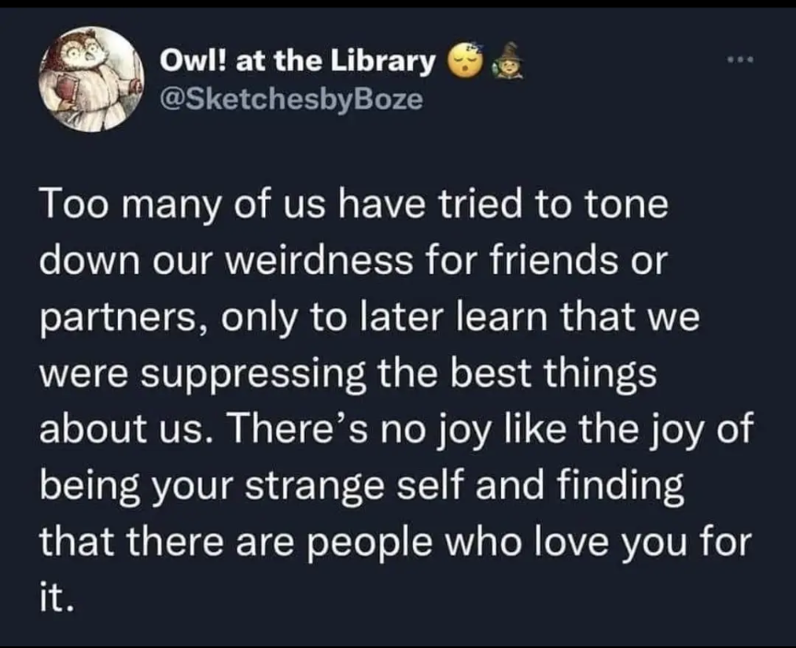

Slide 24
Questions? Discussion…

