Slide 1
Removing IPv4 infrastructure addressing from Meta’s edge network
RIPE 88
Kraków
Matt Kirkland
Network Engineer
Notes:
First time talking externally

Slide 2
Agenda
Introduction and Motivation
Approach
Lessons Learned
What next?
Q&A

Slide 3
Introduction and Motivation

Slide 4
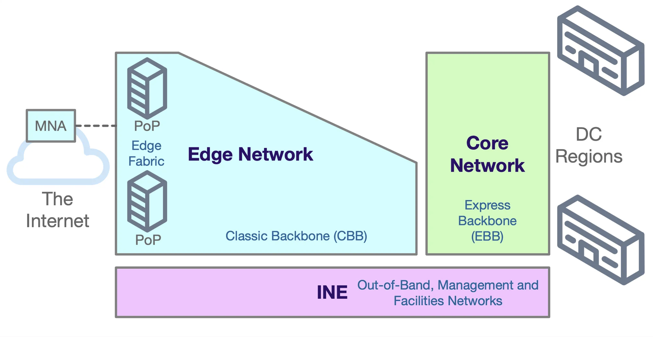
Meta Networks
Notes:
4 main network areas
DC networks
Ebb, express bb,
Edge network - pops with peering and cdn and CBB
Oob network

Slide 5
37%
>99%
Traffic between users and Meta is over IPv6. Edge network dual-stacked.
Internal traffic is over IPv6
Source: facebook.com/ipv6
Source: Internal report
Notes:
Meta to users - https://www.facebook.com/ipv6/?tab=ipv6_total_adoption
Now: 39%

Slide 6
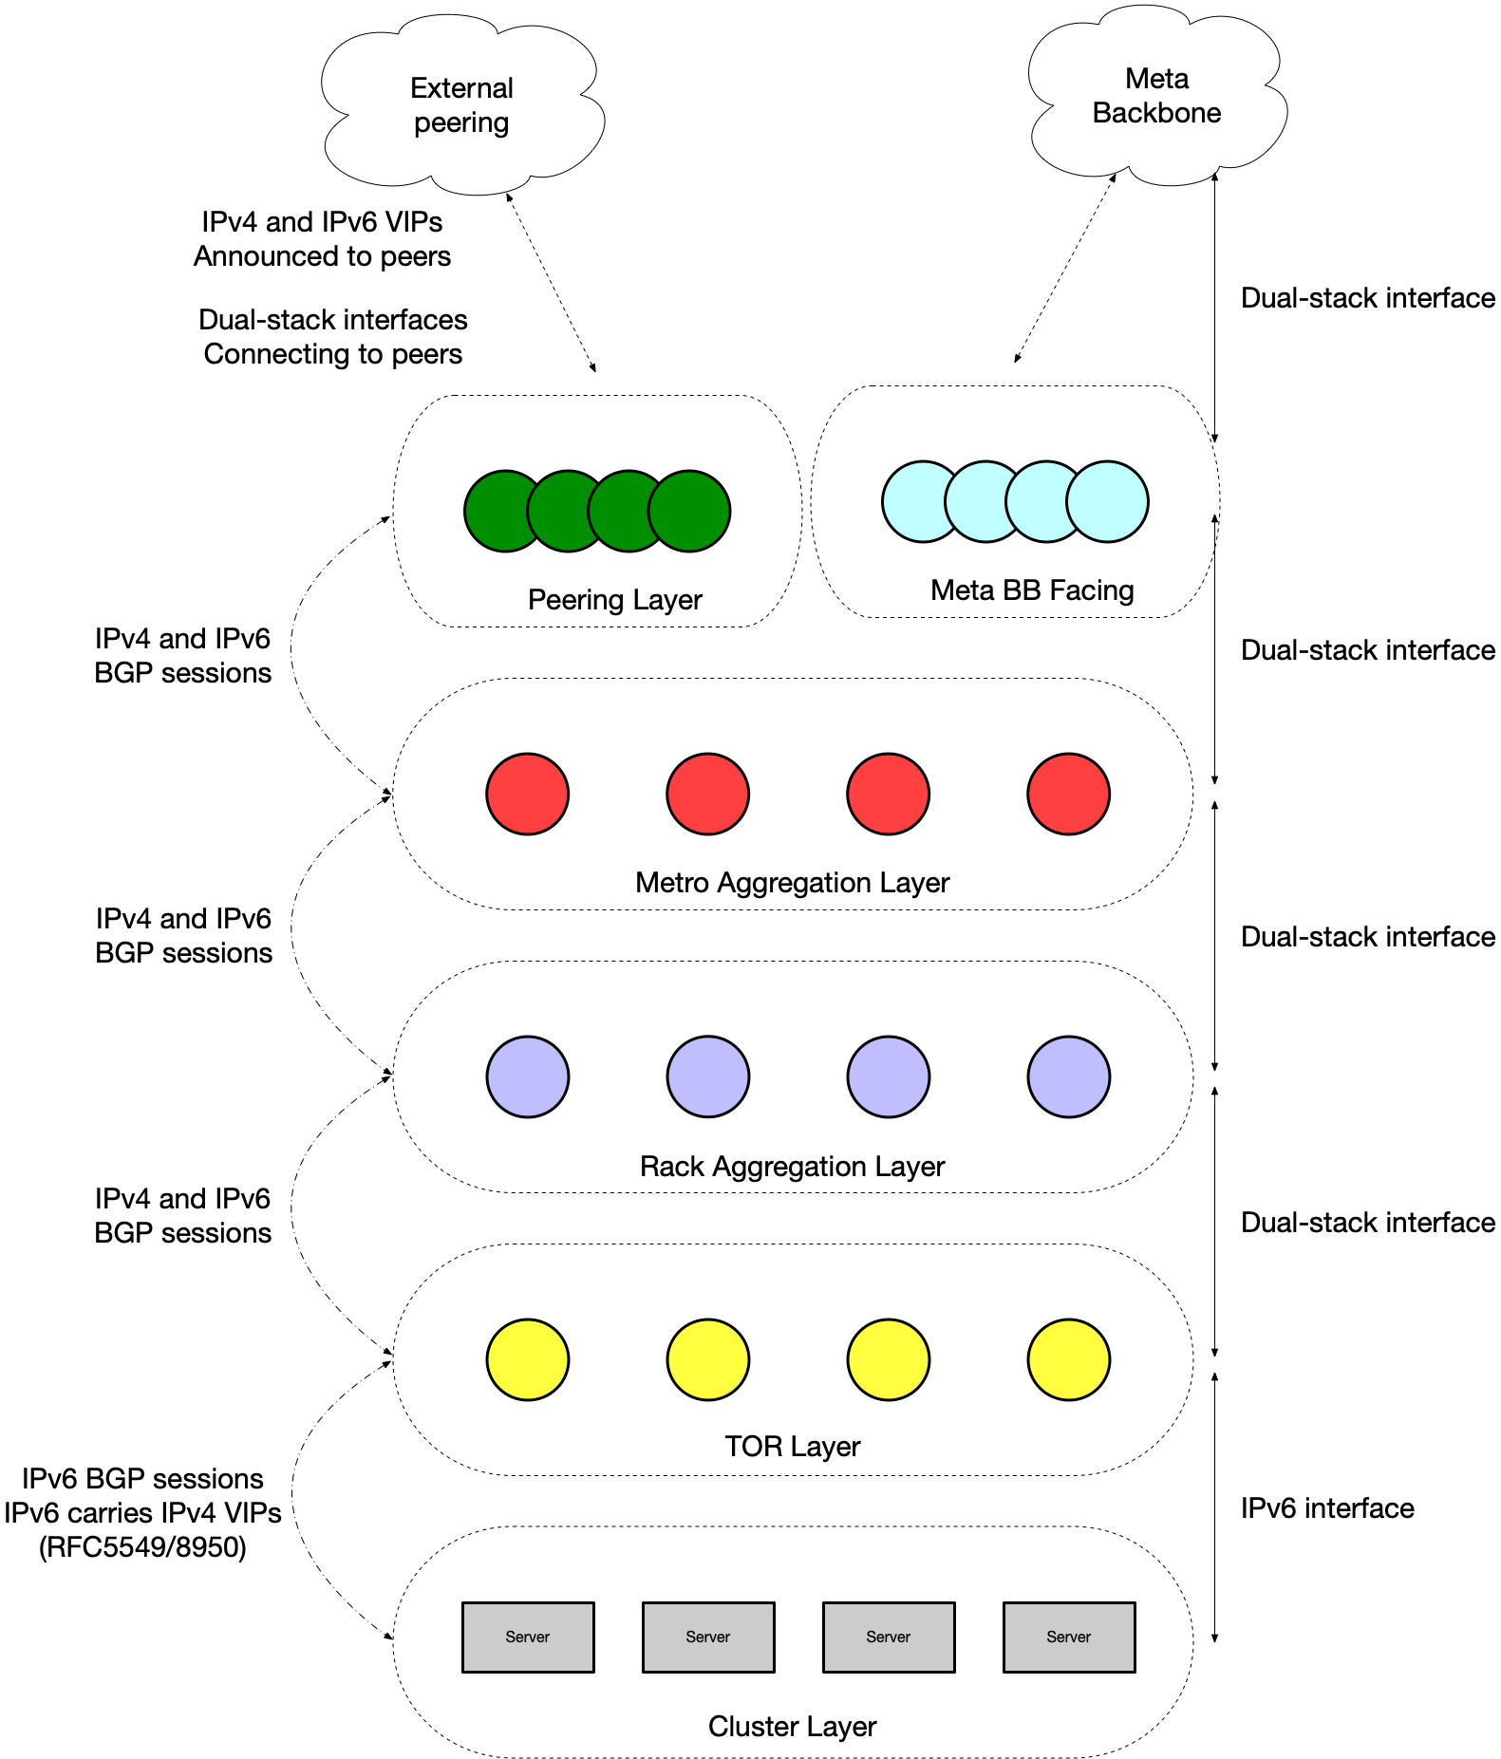
Edge Network - Dual Stack
Traffic is a mix of v6 and v4.
Server to ToR addressing is v6 only, v4 VIPs announced via v6 BGP sessions with v6 next-hop (RFC5549/8950)
Other infrastructure links are dual-stacked, dedicated v4 and v6 addresses and BGP sessions.
Links to peers are dual-stacked if peer supports it.
Notes:
Bottom to top
Servers already v6 only
Rack aggregation, aggregate tor
Metro aggregation, split peering and compute
Peering layer
All dual stack

Slide 7
Why do anything more?
Notes:
Keep operating at dual stack?

Slide 8
Motivation
Simplification
Scale
Planning Overhead
Maintaining two sets of address families increases engineering and operational overhead.
Our edge network infrastructure is sufficiently large that we have run into scaling problems with IPv4 addressing.
IPv4 is a valuable and finite resource, wherever used it needs to be carefully planned. Avoiding using it removes this need entirely.
Notes:
One address family is simpler
Previous diagram, all layers fully mesh
Large pops many layers
Many pops
As we grow our pop network, IPv4 space is limited and planning becomes more headache

Slide 9
Approach

Slide 10
Timeline
Q1-23
Q2-23
Q3-23
Q4-23
Q1-24
Q2-24
Lab testing completed Rack and metro aggregation layers
Single metro canary Rack and metro aggregation layers
Rollout to production metros Rack and metro aggregation layers
v4 addressing removed
Rack and metro aggregation layers
Lab testing
Peering and
LER layer
v4 address reclaim
Lab testing complete
TOR and rack aggregation layers
Rollout to production metros TOR and rack aggregation layers
Notes:
Timeline affected by vendor os release, then test deployments
Start with rack and metro aggregation, there was a project to expand this
Reclaim addressing last in case something went wrong and we needed to roll back :)

Slide 11
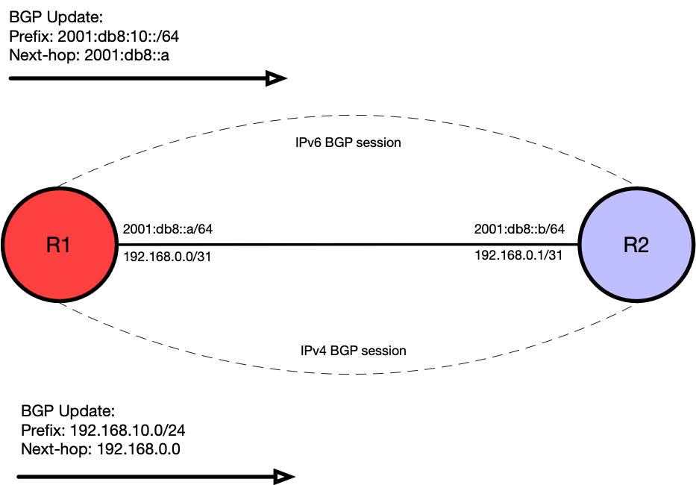
Dual Stack
Notes:
Ships in the night

Slide 12
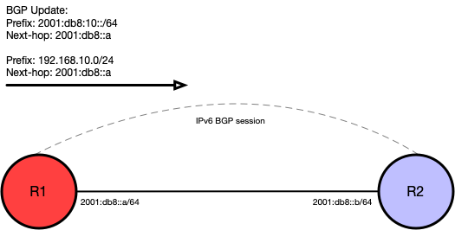
RFC 5549/8950
Notes:
RFC5549/8950

Slide 13
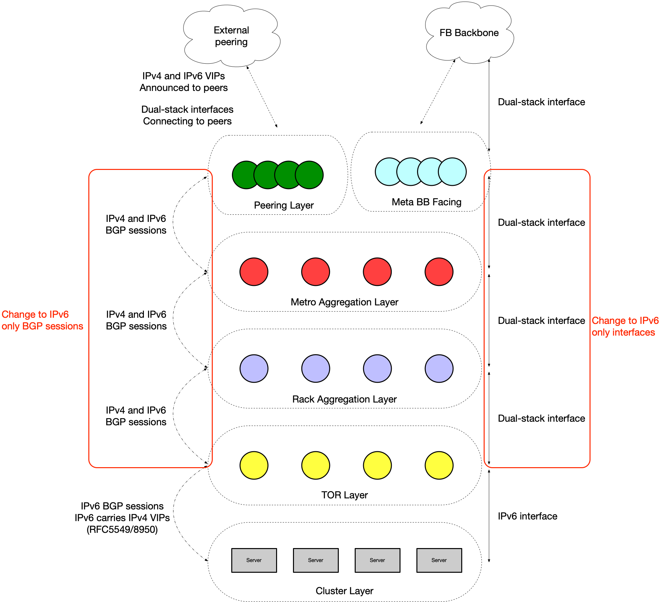
Edge Network - v6 only linknets
Server to ToR addressing is v6 only already, nothing further needed.
Enable v4 address family over existing v6 sessions.
Remove IPv4 BGP sessions and IPv4 addressing from all affected links.
Notes:
Not hard, change bgp to 5549
Remove ipv4 interface ip
That was easy!

Slide 14
Challenges
Notes:
Many platform and vendor dependant

Slide 15
What about traceroute?
v4 client
Typically routers will send TTL expired message sourced from the IP address associated with the outbound interface towards the sender.
If the interface no longer has an IPv4 address, what happens?
The router will reply using the loopback address.
RFC8335 and RFC5837 improving ping/traceroute.
v6 linknets
v4 dst
Notes:
Network users like traceroute
With no v4 link address how do we respond
Loopback
Not a lot of Support RFC 8335 and 5837
Working with vendors for implementation
RFC 8335 PROBE: A Utility for Probing Interfaces
Enhances ping to give more information about the state of interfaces on the node.
5837 Extending ICMP for Interface and Next-Hop Identification
Extends TTL expired message to include:
Interface the probe message was received
Interface the probe message would have been sent out if it had not expired.

Slide 16
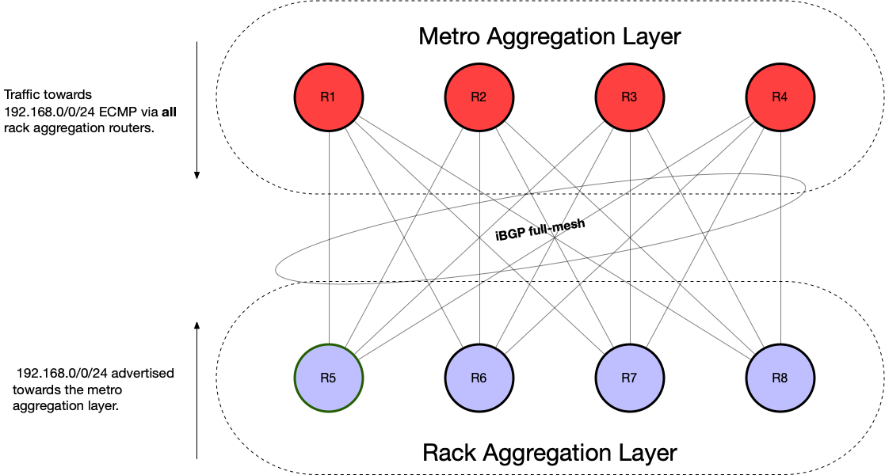
ECMP not that equal
Inter-layer connectivity is fully-meshed, many ECMP paths.
Some routers would not do ECMP between paths learnt with v4 and v6 next-hop, even if all other BGP attributes matched. Vendor specific behaviour.
Needed to increase the weight of the routes with v4 next-hop, until all v4 NLRI had been learnt via v6 sessions.
Three vendors, three different approaches.
Notes:
One vendor : v4 nh and v6 nh cannot be in the same ecmp group
Do bgp traffic engineering to balance load
One vendor: ipv6 nh routes get installed and no v4 nh routes do
Another vendor: does consider both nh in same group
Last vendor prefer v4 not v6

Slide 17
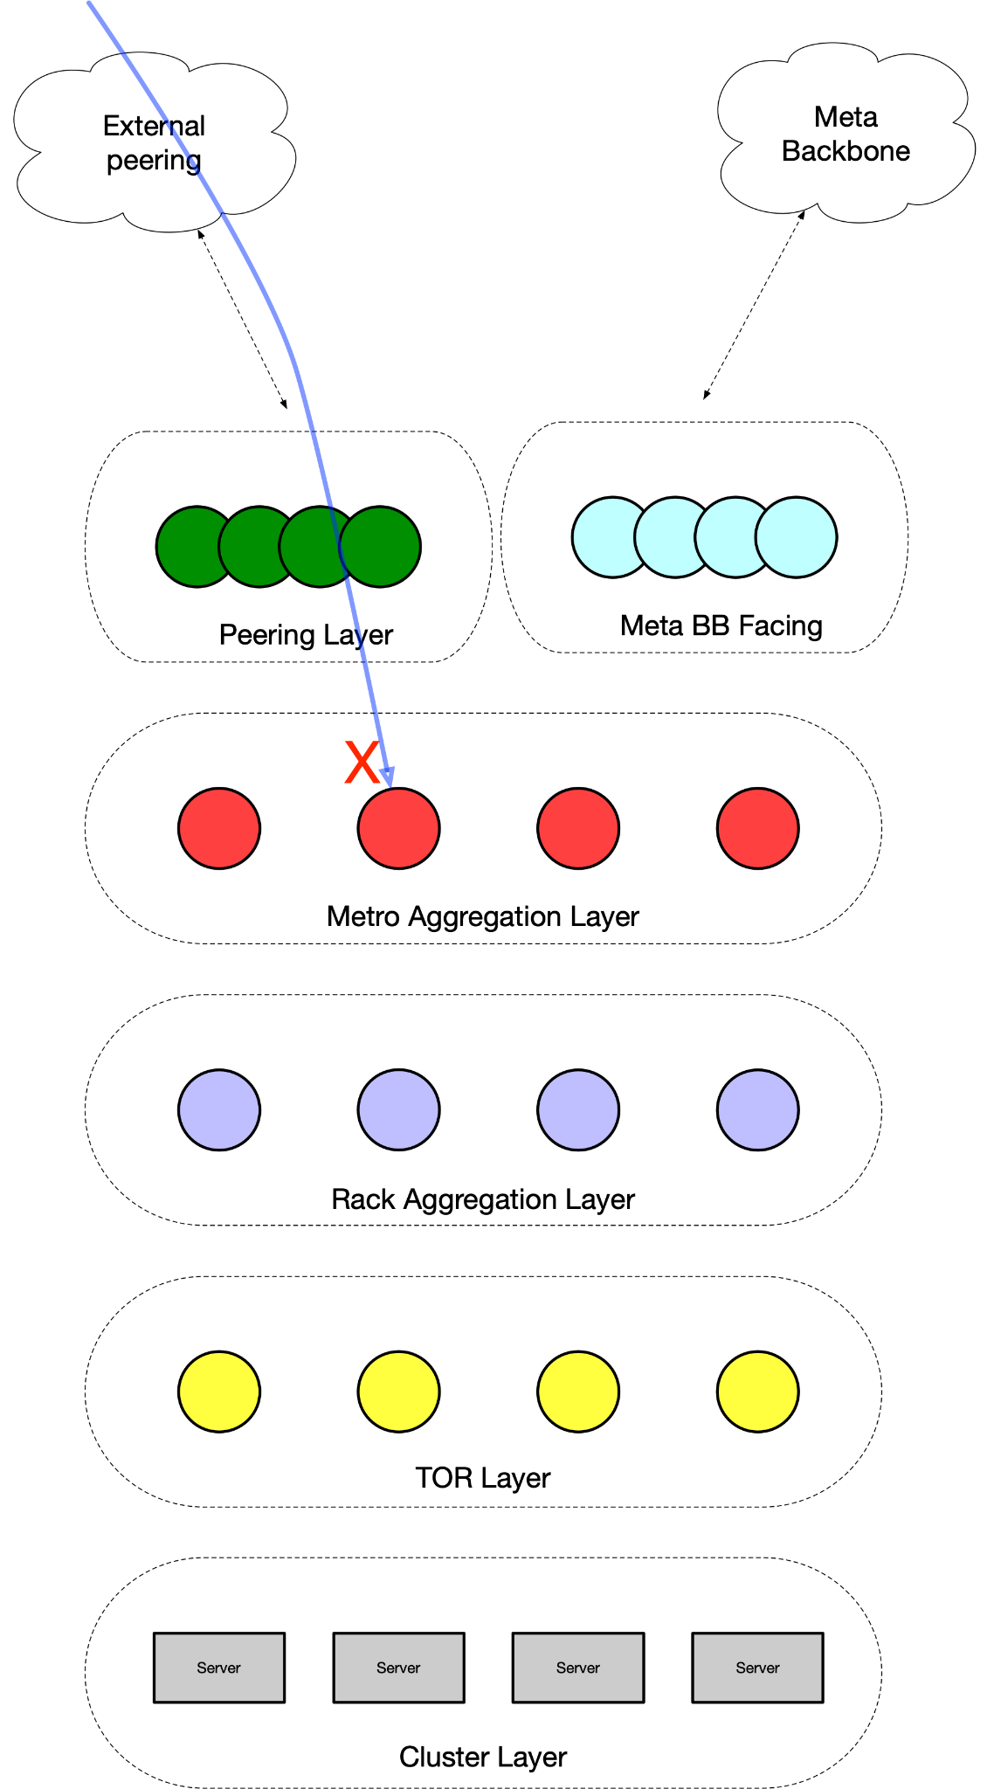
Some v4 just dropped
Some router platforms would drop v4 packets if they didn’t have a v4 address configured.
Needed additional command to forward v4 traffic without a v4 address.
This was not consistent across platforms, even from the same vendor.
Notes:
Require configuration to forward v4 packets on ipv6 only intf
Some need global commands
Some need interface level commands
Even within same vendor, requirement to configure command not consistent across platforms.

Slide 18
Interface counters not consistent
Platforms reported counters in different ways.
Some platforms would report v6/v4 counters in a single direction only.
Some would report total and v6 so we needed to subtract the v6 number from total to derive v4.
Important to test this!
Notes:
We want v4/v6 distinct counters so we can visualise util and for safety checks for v4, internal infra is v6 only
Not consistently implemented
Vendor A some platforms have egress / ingress, others just have egress
Vendor B, only get ipv6 counters, the rest you need to work out

Slide 19
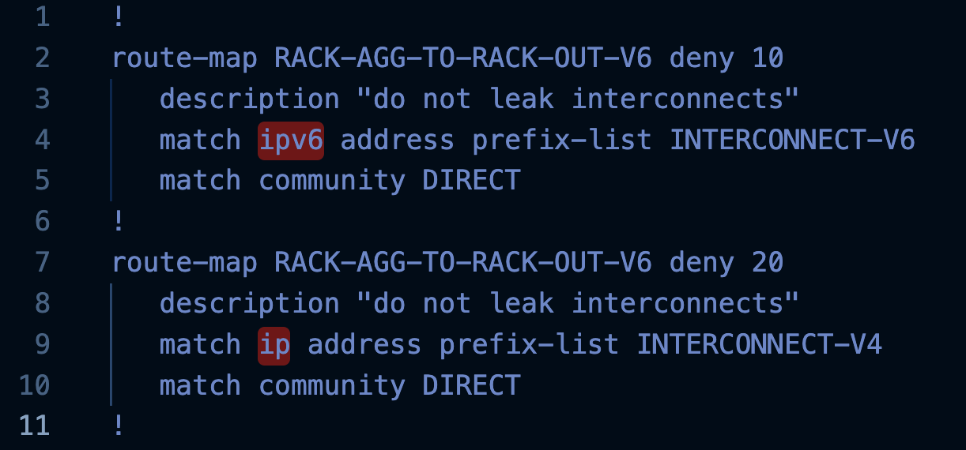
Mixed v6/v4 bgp policy
Different vendors handle mixed address family policy differently
Some vendors allow distinct policies per address family
Other vendors just have policy per peer and the policy must include all rules for all address families
Notes:
Some vendors you have to have mixed v4 and v6 in one policy
Distinct policy per afi
Max prefix lists need to account for both address families

Slide 20
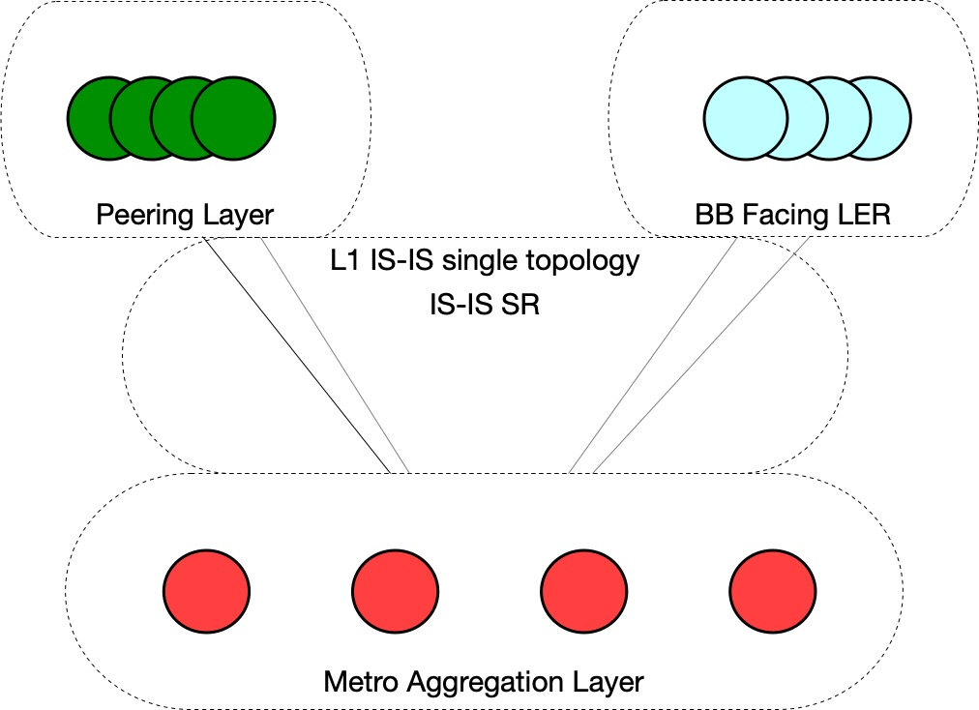
Peering layer migration
Peering, BB and aggregation layer are part of IS-IS L1 domain.
IS-IS Segment routing is enabled.
Removing v4 link addresses, some vendors require we move to MT IS-IS, while others do not.
This makes migration operations very disruptive.
Notes:
Previous layers had plain IP forwarding
Between metro, peering and bb there is is-is l1 and SR
Single topo isis not consistently supported for v6 only
Migration will be painful

Slide 21
Labelled forwarding
Using IS-IS segment routing on IPv6 only links
V4 packet is encapsulated
imp-null(3) is used to forward packet at the penultimate hop
Not universally supported, some vendors perform a check on the penultimate hop and drop the v4 packet because the link is v6 only
Notes:
Describe as I would in person
Takes place as you would expect
Labelled packet, implicit null and the penultimate hop forwards shoves the v4 packet out the last interface
We were lucky
LSR is different vendor
Same vendor as LER would drop packet

Slide 22
What next?
Notes:
Where do we go from here?

Slide 23
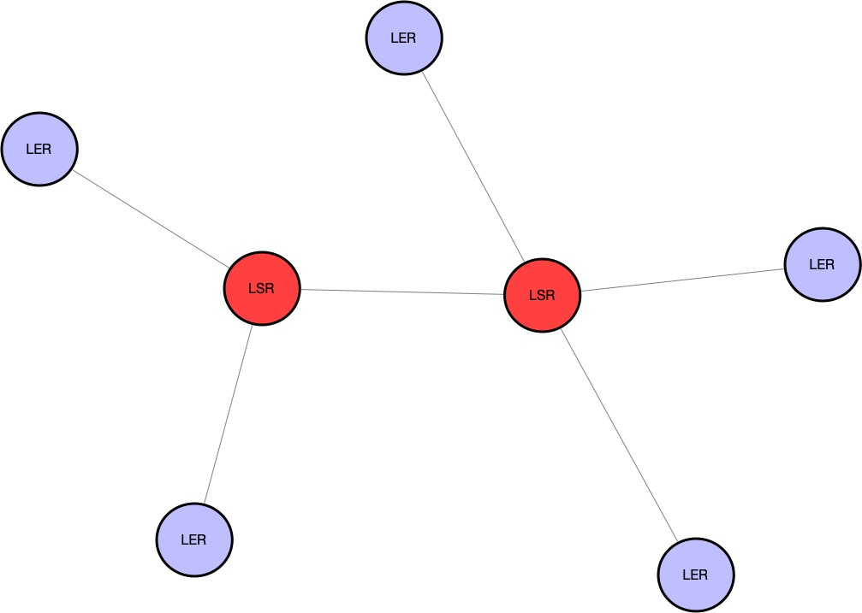
V6 only across the core
All links are addressed in v4 and v6
RSVP-TE core network
Vendor implementations of RSVP are IPv4 only, despite RFC3209 supporting IPv6
RFC5549 BGP prefix exchange works.
Not a lot of excitement to re-engineer the backbone.
Notes:
Core uses RSVPTE
No vendor has implemented RSVP signaling on v6
We went to 4 vendors, more than one told us “no one has ever asked for IPv6 RSVP”
Positive side, can still simplify BGP signalling with RFC5549
RFC3209 published in 2001
V6 support is needed for CSPF, ERO and RRO

Slide 24
Summary

Slide 25
01
02
03
Need to test
It’s worth it
RFC5549/8950 works
There were some hurdles along the way, no show stoppers but important to understand platform and vendor behaviour
Simplified configurations, provisioning workflows and planning
v4 NLRI with v6 next-hop works, we’re running it in production
Notes:
5549 BGP v4 with v6 nh works
Lot of testing is needed with your vendors / HW
It is worth it. Simplifying our topologies and getting rid of v4 overhead has been very helpful.

Slide 26
Thank You!

Slide 27
Questions?

