Slide 1
Exploring The Benefits of Carbon-Aware Routing
Sawsan El Zahr, Paul Gunning and Noa Zilberman

Slide 2
Toward Net Zero Internet
Net zero by 2050!
A large hyperscaler consumes 10-20 TWh/year
A large ISP consumes 3-6TWh/year
But there are a lot more ISPs…
The carbon emissions of the network are not negligible!
This work’s scope: routing, scope 2 emissions of routers
Notes:
To achieve net zero carbon by 2050, we have many initiatives. It’s true that computing mainly done in datacenters is one main driver of carbon in ICT with datacenters reporting in the order of 10 to 20 Twh per year. On the other hand, networks report less than 10 TWh per year which may seem not very significant. However, with the huge number of ISPs, these small contributions will sum up and then carbon related to networks cannot be neglected.
This work is in the context of routing so at the network layer and it specifically addresses scope 2 emissions associated with routers.

Slide 3
Motivation
Previous work focused on power efficiency
Carbon efficiency is a new optimization problem
C
D
E
A
B
Notes:
So, if we look at this small network, if we want to send a packet from router A to router E, there will be multiple paths. Previous works focused on increasing the power efficiency of these networks by for example choosing shorter paths, but

Slide 4
Motivation
Previous work focuses on power efficiency
Carbon efficiency is a new optimization problem
Adds the geographical dimension to the routing
C
C
D
D
E
A
B
B
Notes:
Routers placed at different locations will be fed from different energy sources and will have different carbon intensity. The carbon intensity is a weighted measure of the amount of CO2 released to produce 1kWh of energy. So, for example, here it would be better to route through the upper path instead of the lower one although the lower one is a shorter path. So, this adds the geographical dimension to the routing problem.

Slide 5
Motivation
Previous work focuses on power efficiency
Carbon efficiency is a new optimization problem
Adds the geographical dimension to the routing
Opportunity: carbon intensity is predictable per region
Goal: quantify the potential benefits of carbon-aware routing
Notes:
Now, with the ability to predict this carbon intensity per region from the power grid ahead of time, we can take benefit of this information, integrate it into the routing process and explore how much carbon emissions can be reduced based on carbon-aware routing.

Slide 6
Carbon Footprint
“You can’t improve what you don’t measure.”
Carbon emissions relate to:
Amount of energy consumed
Source of energy
Weighted carbon emissions associated with the source
Notes:
The first step is to clarify the building components of the carbon footprint for networks. It depends first on the amount of energy consumed, and then on the source of this energy (coal, gas, renewable energy) and finally, on the weighted carbon emissions associated with this source. The last two terms can be covered by the term carbon intensity.

Slide 7
Carbon Footprint
“You can’t improve what you don’t measure.”
Carbon emissions relate to:
Amount of energy consumed
Carbon Intensity
Notes:
We’ll go over both components and then move on to define the metrics that relate to these.

Slide 8
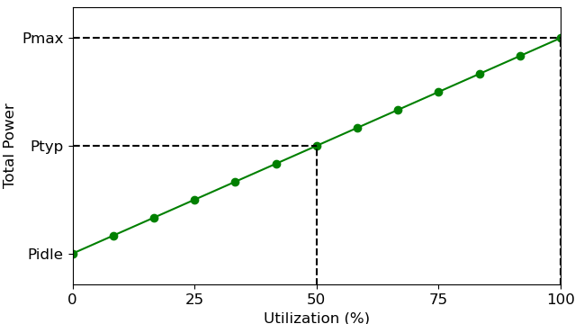
Power Consumption
Dynamic Power: proportional to the utilization
Idle Power is composed of:
Static Power
Power of Ports
Notes:
The energy consumption of a router has a dynamic part proportional to the utilization and an idle part, that is built from the static power or zero-port power in addition to the power of enabling every port.

Slide 9
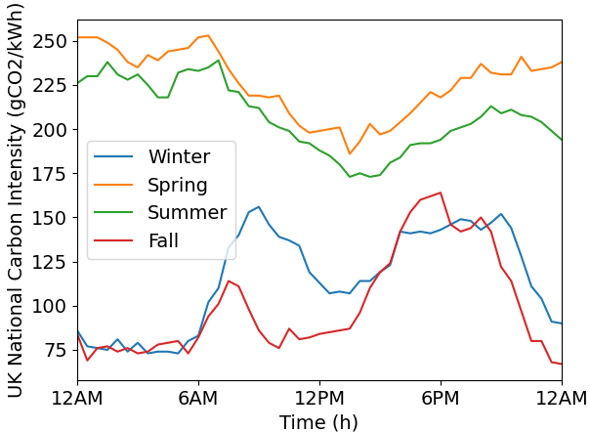
Carbon Intensity
Unit: gCO₂/kWh
Carbon intensity varies:
per day
per season
per region
Can noticeably change within a few hours
Can be forecasted up to 24-48 hrs beforehand
Carbon Intensity API
Notes:
The carbon intensity on the other hand, is the measure of gCO2 emissions per energy consumed so per kWh.
So, a higher carbon intensity means that the source of energy is emitting more carbon so is less green. Renewable energy sources will have an associated low carbon intensity.
In the figure, we can see the variation of the carbon intensity per day in the UK, during different seasons. So, this metric varies a lot per day, per season and per region and we can see a noticeable change within few hours.
Now, recent ML algorithms allow it to be forecasted up to 24-48 hours ahead of time and this is actually the motivation of this work to plan ahead to adapt the routing of traffic to greener paths.

Slide 10
Potential Metrics
Energy-related Metrics
Carbon-related Metrics
Notes:
So now, knowing that the carbon footprint relates to energy and carbon, we define a set of metrics to be considered by the routing problem and in subsequent sections, we evaluate the impact of these metrics on reducing the overall carbon emissions. Starting with the energy-related metrics,

Slide 11
Potential Metrics
Energy-related Metrics
Carbon-related Metrics
Typical Power
Power at 50% utilization
Extracted from datasheet
Notes:
The typical power is the first metric and is defined by the power consumption at 50% load and can be mostly extracted from datasheets.

Slide 12
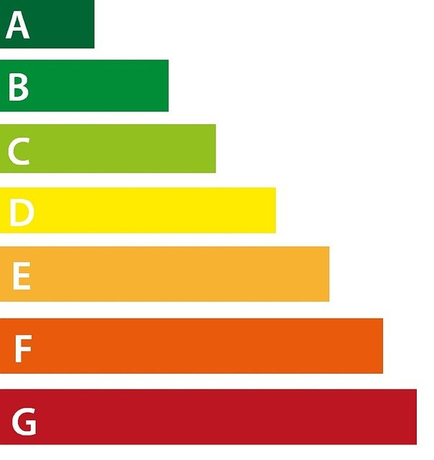
Potential Metrics
Energy-related Metrics
Carbon-related Metrics
Typical Power
Energy Rating
Not standardized yet
Ratio of typical power and maximum packet rate
Divided into a 7-star scale
Notes:
The second metric is the energy rating or labelling. This metric indicates the energy efficiency of a router. It is still not standardized but we define it as the ratio of the typical power and the maximum packet rate. It can be defined differently but we start with this definition, and after examining a range of routers available in the market, we derive a closed range and divide it into a 7-star scale from A to G.

Slide 13
Potential Metrics
Energy-related Metrics
Carbon-related Metrics
Typical Power
Energy Rating
Incremental Dynamic Power per Unit of Traffic
Ratio of dynamic power and maximum capacity (W/Mbps)
Notes:
Next, we look only at the dynamic power and divide it by the maximum capacity. So the unit is in W/Mbps. For the energy rating we considered the typical power but here we look at the effect of the dynamic power only per unit of traffic.

Slide 14
Potential Metrics
Energy-related Metrics
Carbon-related Metrics
Typical Power
Energy Rating
Incremental Dynamic Power per Unit of Traffic
Carbon Intensity
Notes:
Now we move to carbon-related metrics. The carbon intensity is an obvious metric and we talked about it before.

Slide 15
Potential Metrics
Energy-related Metrics
Carbon-related Metrics
Typical Power
Energy Rating
Incremental Dynamic Power per Unit of Traffic
Carbon Intensity
Carbon Emissions
Product of energy consumption and carbon intensity
Energy consumption weighted over the previous interval of time (30 min or 1 hour)
Notes:
Finally, the carbon emissions metric is different from the carbon intensity because it considers the actual energy consumption per router over a previous interval of time. So it’s the product of the energy consumption and the carbon intensity.

Slide 16
Potential Metrics
Energy-related Metrics
Carbon-related Metrics
Typical Power
Energy Rating
Incremental Dynamic Power per Unit of Traffic
Carbon Intensity
Carbon Emissions
→ Combinations of different metrics are also possible
Notes:
So, these are our metrics, and we can have in addition some combinations of these metrics such as the carbon intensity + energy rating and so on.

Slide 17
Approach
Change link costs based on the previous metrics
B
C
D
50
50
50
100
300
100
A
50
F
E
100
100
G
H
Notes:
To evaluate these metrics, we have two approaches: the first approach is to change the link costs based on the aforementioned metrics and then apply the Dijkstra algorithm.
Example of a network with the metric chosen as the carbon intensity. Mention ECMP… Change in metrics lead to different routing tables…

Slide 18
Approach: CATE
2. CATE: Carbon-Aware Traffic Engineering
Shut down links with least utilization and highest carbon emissions
Check if graph is still connected (+redundancy)
Check the improvement introduced
1
2
Notes:
The first approach will actually improve on the dynamic part only because all equipment are still on. The second approach aims at further reducing the idle part too by shutting down unnecessary ports. So, the second approach is a carbon-aware Traffic Engineering based heuristic that we denote by CATE, and what it does is, after changing the link costs, it will pick the links with the least utilization and highest carbon emissions and shut them down for the specified interval of time. It then checks if the graph is still connected and check if the carbon savings are still positive. It repeats this process until no further links can be disabled.

Slide 19
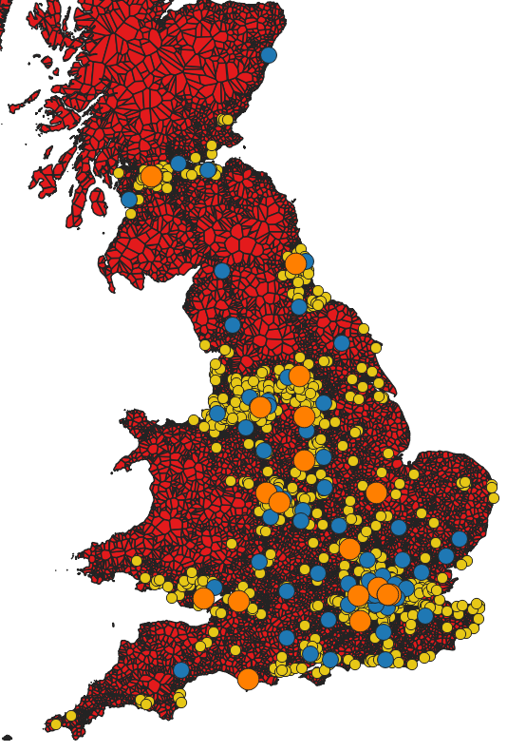
Approach
Simulation-based study using ns-3 simulator
Network topologies:
British Telecom (BT) in the UK
GEANT in Europe
BT Network
Notes:
This is a simulation-based study using the NS3 simulator and it is applied on real network topologies like BT in the UK which is a main ISP with more than 1000 nodes and we also look at GEANT topology that is an educational network based in Europe.
Core network of BT (not openreach)… for evening traffic we are not looking at the last mile network.

Slide 20
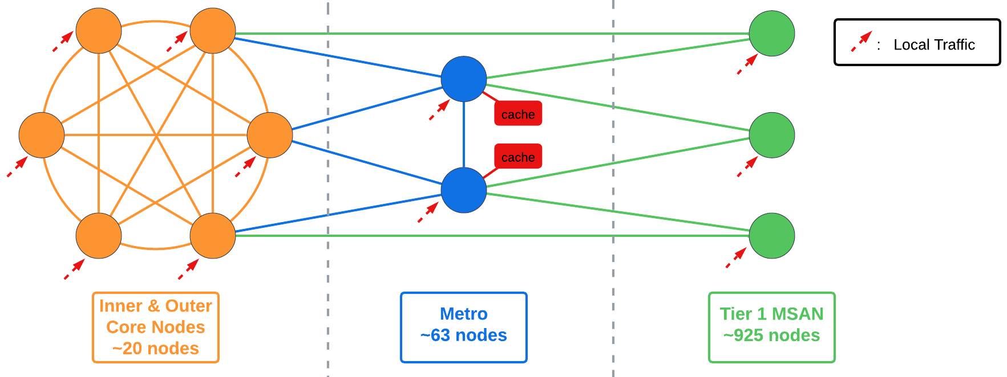
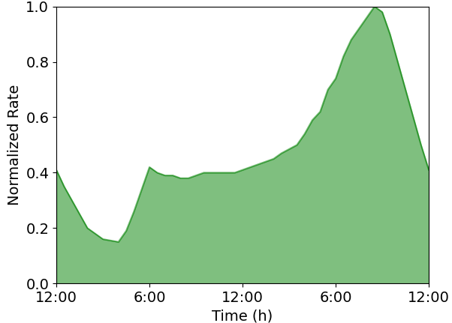
Traffic Patterns
Day Traffic:
Business customers during working hours [9AM - 5PM]
Mostly symmetric (any-to-any)
Overall throughput is almost constant
BT Network Topology
Normalized Network Traffic
Broadband ISP BT Sees UK Network Traffic Peak at 28Tbps - ISPreview UK
Notes:
Before proceeding to the results, , it is worth highlighting on the traffic patterns considered that turned out to be a game changer. We consider two traffic patterns: the daytime traffic is dominated by business customers and is mostly symmetric.

Slide 21
Traffic Patterns
Evening Traffic:
Residential customer traffic dominates
Predominantly downstream of content (90%) from content caches co-located within metro-nodes (for BT)
Peak between 7PM and 8PM
BT Network Topology
Normalized Network Traffic
Broadband ISP BT Sees UK Network Traffic Peak at 28Tbps - ISPreview UK
Notes:
On the other hand, evening traffic is dominated by residential customer traffic that is mostly downstreaming of content from caches co-located at metro-nodes. So here, you see core, metro and tier 1 nodes of BT, and caches are located at metro nodes. This downstreaming traffic peaks at around 8 PM.

Slide 22
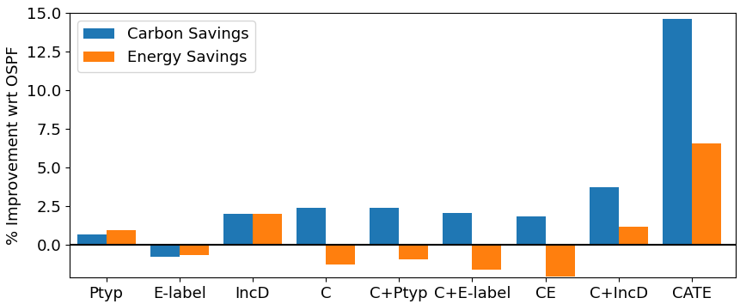
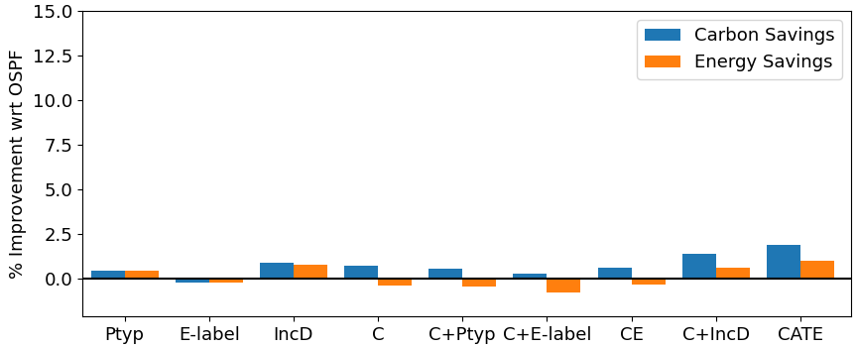
Results: Carbon & Energy (BT)
Carbon intensity + Incremental dynamic power are the best combination
CATE has the highest savings (shutting down unnecessary ports)
Carbon intensity-based metrics save carbon at the expense of 5% path stretching
Savings are negligible for evening-traffic (very short paths)
Legend:
Ptyp: Typical Power
E-label: Energy Label
IncD: Incremental Dynamic Power
C: Carbon Intensity
CATE: Carbon-Aware Traffic Engineering
Carbon & Energy Savings for Day-Traffic
Carbon & Energy Savings for Evening-Traffic
Notes:
So now we present some results. We see the carbon and energy percentage improvement with respect to OSPF for day traffic on the left and evening traffic on the right. We have different combinations of the metrics introduced and then we have CATE that is based on disabling ports. The first three metrics are energy metrics and we see that the incremental dynamic power per unit traffic leads to higher improvement in terms of energy and carbon. This is in the context of power efficiency because carbon is not considered. Then, combinations that include the carbon intensity save more on carbon at the expense of path stretching of about 5%. Path stretching is the increase in the average number of hops travelled by a packet. We can see that the combination of carbon intensity and incremental dynamic power per unit traffic is the best combination of metrics. CATE introduces additional carbon savings by disabling unnecessary ports. And all of these improvements vanish for evening traffic because the flows for downstreaming are all short and there is no room for changing paths. Even disabling ports is minimal and can be impossible at peak times.
More on evening traffic… caching might be a possible direction…

Slide 23
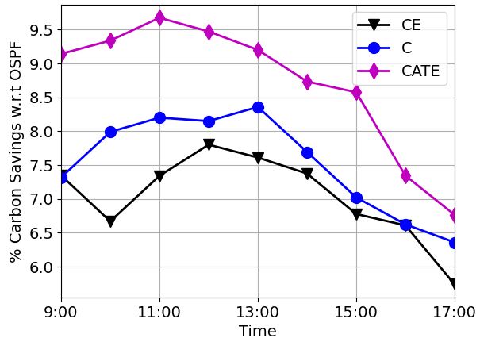
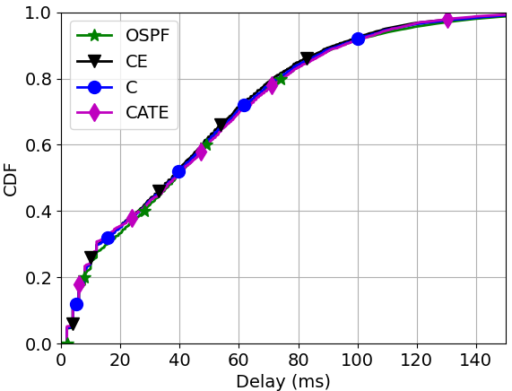
Results: Carbon & Energy (GEANT)
All nodes have the same energy parameters
CATE: highest savings, with around 8% links disabled
Delay is similar for all 4 scenarios
Carbon Savings Relative to OSPF
End-to-End Path Delay

Slide 24
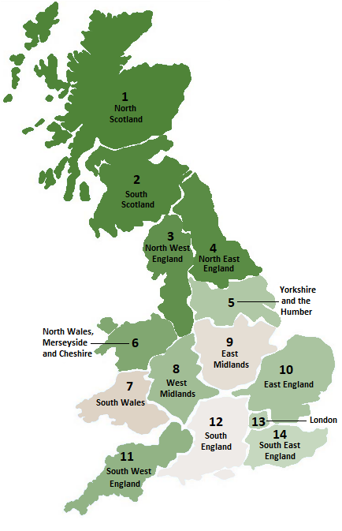
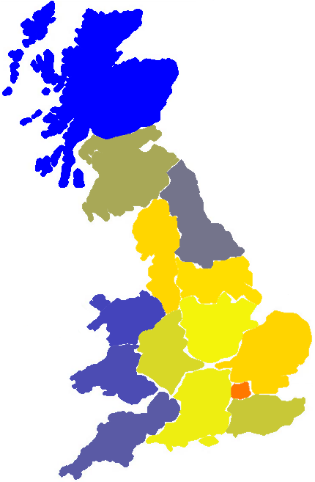
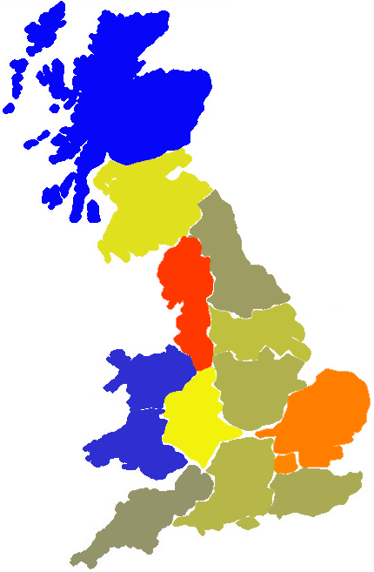
Results: Flow Intensity (BT)
Carbon Intensity in gCO2/kWh
400
350
300
250
200
150
100
50
0
Flow Intensity in Gbps
600
500
400
300
200
100
Carbon Intensity API
OSPF
Carbon-Aware Routing
Notes:
Back to BT, if we want to see the variation of flow paths, on the left we have the carbon intensity heat map, and on the right we have the flow intensity in Gbps per region in the UK. According to the carbon intensity API where we extracted the carbon intensity information from, the UK is divided into 14 regions and they did an analysis for the energy flow between regions to derive the carbon intensity for the energy consumed per region.
So, we see that in OSPF, London has the highest cross-section throughput. Then, with carbon aware routing, flows are higher for north-west England and east England that have a lower carbon intensity. On the other hand, we can see that East Midlands and South England have less flows in carbon aware routing because of their relatively higher carbon intensity. London on the other hand did not change, and this is because of the high density of nodes in London and this leads to have a bottleneck in the topology.

Slide 25
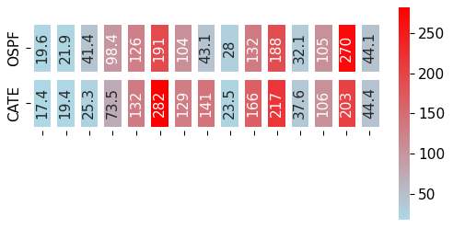
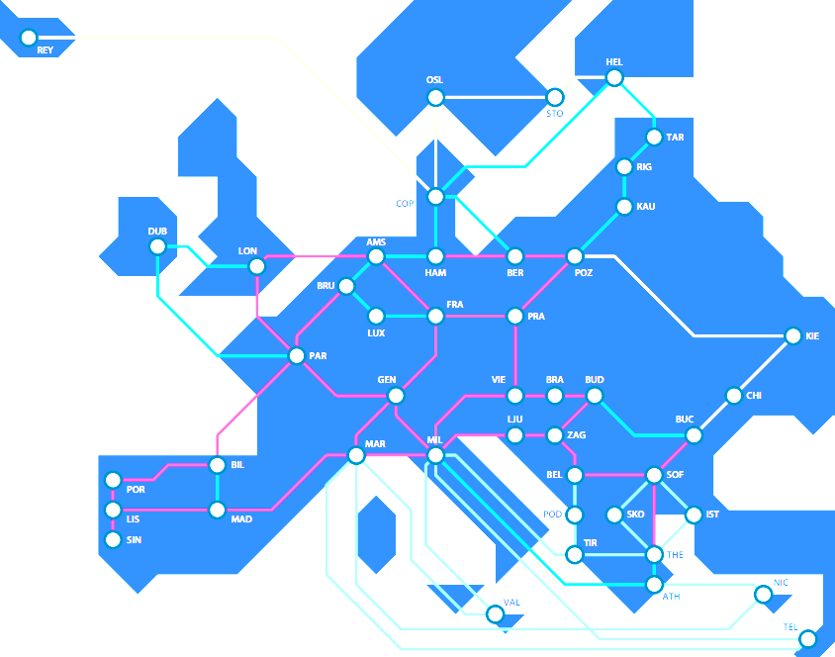
Results: Flow Intensity (GEANT)
Iceland
Ireland
UK
Portugal
Spain
France
Netherlands
Belgium
Luxembourg
Switzerland
Italy
Norway
Denmark
Germany
Finland
GEANT Network Map
source: geant.org
Notes:
Looking at the flow intensity for GEANT topology. We have similar patterns but it’s worth highlighting on the change in few regions. In carbon-aware routing, we see that France, Italy and Germany have the highest intensity of flows. But when, compared to the values in OSPF, we see that Flows increased in France, increased in Italy and decreased in Germany but yet Germany is still with the regions of highest flow intensity. And this highlights again on the issue of having bottlenecks in the topology where some high carbon intensity regions cannot be avoided.

Slide 26
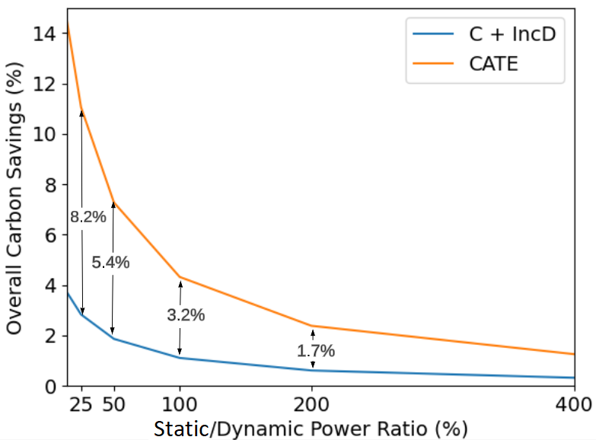
Results: Static/Dynamic Ratio
Different routers have different ratios of static/dynamic power
Architecture and design dependent
Example: chassis-based routers have a high static power for chassis elements
Improvement of carbon-aware routing diminishes as the static/dynamic ratio increases
→ Invest in replacing equipment with lower static power routers
Notes:
Another aspect of the simulation was to see the effect of changing the static/dynamic power ratio because different routers will have different values of this ratio. For example, chassis-based routers have a very high static power for the chassis. So, we vary this ratio, and we see that carbon savings diminish as this ratio increases. So, it’s always better to invest in equipment with lower static power.

Slide 27
Summary
Carbon intensity + Incremental dynamic power are the best combination of metrics
Notes:
In summary, some takeaways of this work, are first, in terms of metrics, carbon intensity combined with incremental dynamic power per unit traffic are the best combination of metrics.

Slide 28
Summary
Carbon intensity + Incremental dynamic power are the best combination of metrics
Energy labels: good for purchasing, limited routing benefits
Notes:
Energy labels are a good metric for purchasing but in its current form has limited routing benefits. It can be better to divide it into two separate metrics, one for static and one for dynamic power, respectively.

Slide 29
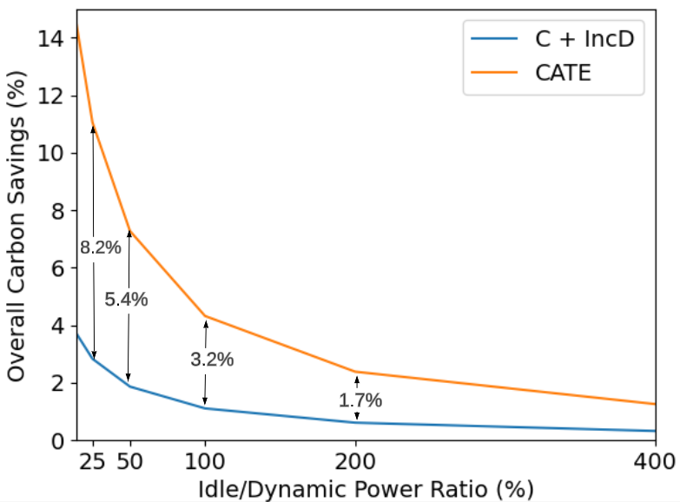
Summary
Carbon intensity + Incremental dynamic power are the best combination of metrics
Energy labels: good for purchasing, limited routing benefits
High idle power limits carbon savings
Notes:
Limitations include the high idle power that limits carbon savings.

Slide 30
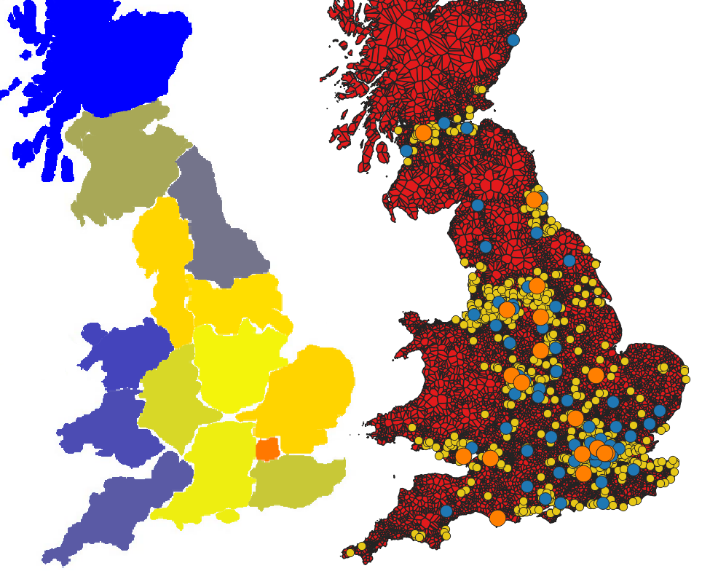
Summary
Carbon intensity + Incremental dynamic power are the best combination of metrics
Energy labels: good for purchasing,
3. High idle power limits carbon savings
4. Routing bottlenecks limit carbon savings
Notes:
Routing bottlenecks also limit carbon savings and it’s better to place additional renewable energy sources at these bottlenecks.

Slide 31
Summary
Carbon intensity + Incremental dynamic power are the best combination of metrics
Energy labels: good for purchasing, limited routing benefits
High idle power limits carbon savings
Routing bottlenecks limit carbon savings
Carbon optimization is application-specific
Notes:
carbon optimization is application-specific. Downstreaming traffic is hard to be rerouted and one possible future direction is to look at time-shifting flows instead of space-shifting.

Slide 32
Next Steps
Identify and agree on a set of metrics
Establish veracity of reported metrics
Define standard reporting format
Tying electricity consumption and carbon intensity to applications (carbon tracing)

Slide 33
Questions?
Code is available! https://github.com/ox-computing/CATE
Iceland
Ireland
UK
Portugal
Spain
France
Netherlands
Belgium
Luxembourg
Switzerland
Italy
Norway
Denmark
Germany
Finland
Carbon & Energy Savings for Day-Traffic

