Slide 1
Adding Contact Methods in Whois & RDAP
Cynthia Revström, Dmitry Kohmanyuk, Leo Vegoda

Slide 2
Agenda
What we have now
Whois versus RDAP
First step
What we could have
Make it a NWI?
Discussion & questions

Slide 3
What we have now
Useful
  Phone
  E-mail
Less useful
  Postal address (since 1635)
  Fax (since 1843)
It would be nice to have a contact method developed in the last 50 years (the first ARPANET network mail was sent in 1971)

Slide 4
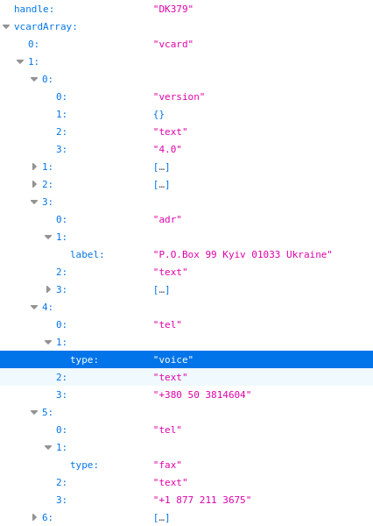
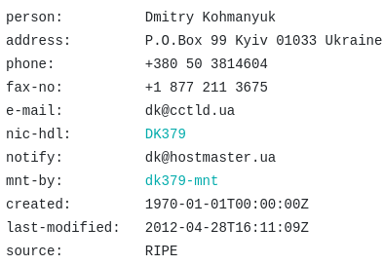
What we have now

Slide 5
Whois versus RDAP
We can easily add whatever we want to whois
But RDAP does not automatically give the same view

Slide 6
First step?
RFC 8605 (ICANN Extensions for the Registration Data Access Protocol) already exists and introduced a CONTACT-URI that can include an HTTPS value
OTT messaging apps like Signal and WhatsApp have private URIs and offer an HTTPS intermediary, e.g. https://signal.me/#p/+15555555555
Is this good enough as a first step towards modernising the contact methods supported in the RIPE Database?

Slide 7
What we could have
https://signal.me/#p/+380503814604

Slide 8
Make it a NWI?
If this is good enough to deliver an improvement, should it become an NWI?
If so, should support for private URIs be included or just the HTTPS redirection service?

Slide 9

Discussion & Questions
question mark made of question marks by Khaydock CC BY-SA 3.0 DEED

