Slide 1




A BCP for the use of IRR DBs by IXP Route Servers
S. KONSTANTARAS – AMS-IX
M. D’ITRI - MINAP
W. van GULIK – ROMANDIX
A. DINU – INTERLAN IX
K. BLUMBERG – TORIX
RIPE 88 2024
Krakow – PL

Slide 2
BCP proposal
IXP operator must trust and use only the following IRR databases for building and maintaining Route Server filters:
  AFRINIC
  ARIN
  RIPENCC
  LACNIC
    NIC.MX
    NIC.BR
  APNIC
    APJJ
    CNNIC
    JPNIC
    KRNIC
    TWNIC
    VNNIC
    IRINN

Slide 3
Grace Period 1/2
The authors understand that the adoption of this policy will probably result in a massive transfer of RPSL objects from non-supported databases to the supported ones.
Therefore, the policy introduces a grace period of 12 months in which the list of allowed databases is supplemented by these:
  RADB
  RIPE-NONAUTH
  NTT
  LEVEL3

Slide 4
Grace Period 2/2
At the end of the grace period, IXP operators must stop supporting these additional IRRs and operate filter generation tools that will only query the 5 RIR databases.
During the grade period, IXPs will make multiple best effort attempts to warn their members relying on these IRRs about the need to replicate their policies in the appropriate RIR IRR.

Slide 5
What’s the impact if we apply this BCP now?
We know the theoretical impact
  Valid aut-num/route/route6 objects need to move back to their official DBs
  However, Global-Ops might get affected with ARIN legacy space
Can we measure the impact on ARIN Legacy space?
  How many prefixes are affected?
  What type of prefixes might get lost?

Slide 6
Practical Analysis
Marco wrote a script
  You feed the script with your master table (or multiple BIRD tables)
  You feed the script with ARIN’s legacy space from ARIN’s FTP server
  Execute the script & get the results in a txt file

Slide 7
Analysis – Prefix amounts
Discovered around 5880 prefixes
  Represents around 1.9% of AMS-IX full table
InterLAN 4.3K prefixes (around 3.5% of their full table)
MINAP 3.9K prefixes
DE-CIX after a miss-calculation decided to do a deeper analysis and contribute results

Slide 8
Analysis - Source
Amount of Prefixes | Next Hop | Customer | Type
3331 | 80.249.209.150 | - | Local
188 | 80.249.211.6 | - | Remote
170 | 80.249.208.124 | - | Remote
103 | 80.249.212.8 | - | Remote
97 | 80.249.213.7 | - | Remote
85 | 80.249.211.191 | - | Local
83 | 80.249.214.93 | - | Remote

Slide 9
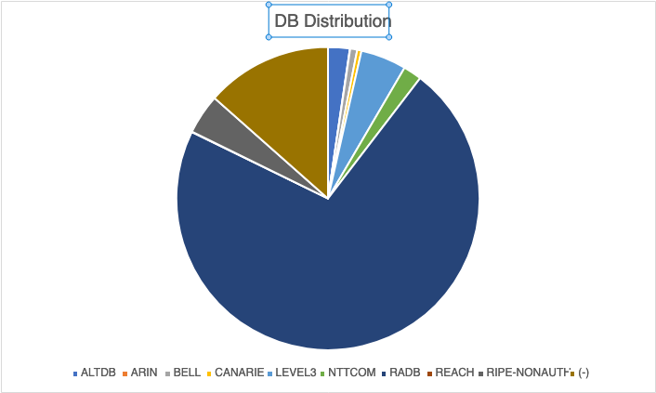
Analysis – DB Distribution
DB | Number
ALTDB | 136
ARIN | 2
BELL | 44
CANARIE | 27
LEVEL3 | 287
NTTCOM | 115
RADB | 4223
REACH | 3
RIPE-NONAUTH | 250
(-) | 792

Slide 10
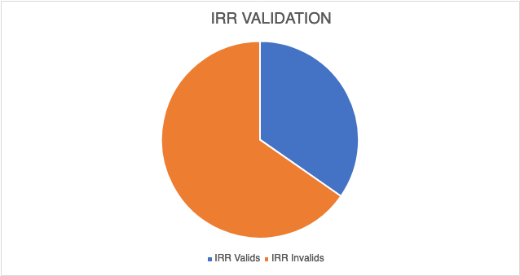
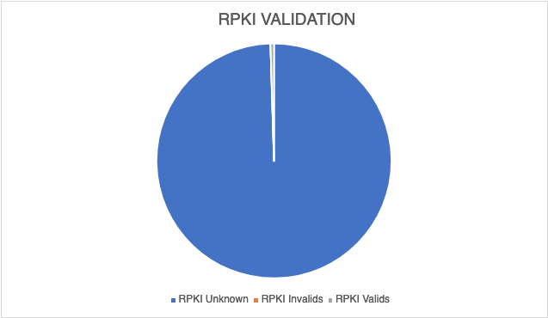
Analysis - Validity
Number of Prefixes | IRR Valids | IRR Invalids | RPKI Unknown | RPKI Invalids | RPKI Valids
2090 | 725 | 1365 | 2080 | 0 | 10

Slide 11
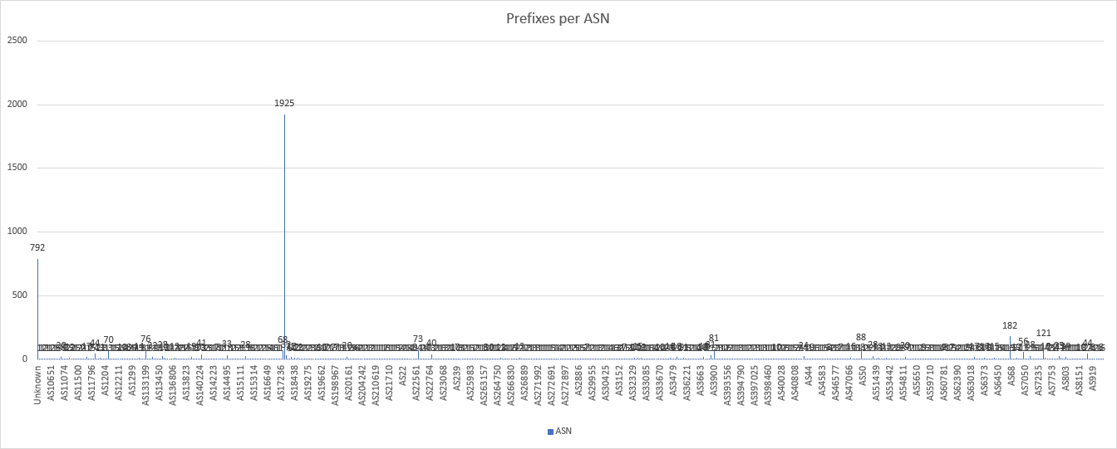
Analysis – Origin
Origin | Occurence
Unknown | 792
AS174 | 1925
AS668 | 182
AS7377 | 121

Slide 12
The problem with ARIN
Legacy resources* are the networks allocated before ARIN was established in 1997.
Unlike the other RIRs, ARIN has decided to not provide IRR and RPKI services to legacy resources holders.
There is no authoritative IRR server for these IP networks and they cannot be validated using RPKI either.
*https://www.arin.net/resources/guide/legacy/

Slide 13
Legacy networks commonly seen in Europe
Access operators leasing networks from Cogent.
US universities (also: USG HEP labs).
US local and central government.
Enterprise networks of local branches of US companies.
Amateur packet radio.
USG-managed DNS root servers (C E G H).
But also:
DoS scrubbing centers (mostly Prolexic (Akamai)).
Companies actually based in the US and announced in Europe by global carriers.

Slide 14
A better classification of prefixes (IXPs)
IXP | Total amount | Cogent | US EDU | US MIL | US GOV | AMPR | DoS | Other
MIX | 44552 | 116 |  |  |  | 3 | 451 | 46
MINAP | 6537 | 19
NAMEX | 6467 | 30
AMS-IX | 214961 | 1432 | 93 |  | 1 | 61 |  | 456
LONAP | 32882 | 65 |  |  |  | 18 |  | 37
BCIX | 13275 | 3 |  |  |  | 3 |  | 10
BNIX | 2695 | 14 |  |  |  | 2

Slide 15
A better classification of prefixes (providers)
Carrier | Total amount | Cogent | US EDU | US MIL | US GOV | AMPR | DoS | Other
HE | 92963 | 1579 | 430 | 293 | 107 | 56 |  | 684
NetIX | 6259 | 40
PacketFabric | 2924 | 43 | 2
Zayo | 25497 | 171 | 5

Slide 16
Analysis – My RADB objects
Digging into AMS-IX automation
  Caching and resolving around 296 objects with “source: RADB”
    Based on our customers’ policy description.
Checking duplications:
  For all the RADB objects check if an equivalent object exists in an official DB
    stavros@experimentix:~$ whois -h whois.radb.net -s RADB,RIPE,ARIN,AFRINIC,APNIC,LACNIC AS-TWITTER | grep source
    > source: RIPE
    > source: RADB
  Discovered 76 objects that are double-registered (25%)
  Next question: the remaining 75% how easily can be moved to

Slide 17
Conclusions
  The BCP enhances routing security and helps towards this direction
  We have very strong signs that not supporting anymore filtering with RADB is feasible (but annoying).
  Losing the peering routes of US-based networks is usually (?) not a big deal. Anecdotal evidence suggests that most carry negligible traffic in Europe.
  Major casualties:
    Local networks leasing Cogent IP space.
    NASA’s E root server

Slide 18
Collaboration with DE-CIX
An impact analysis of the BCP at the DE-CIX platform
  Performed by Matthias Wichtlhuber and Daniel Wagner

Slide 19
Simulated Scenarios
current: default IRR db search order
  peers prioritize their preferred db to the front
radb-and-rirs: default IRR db search order without non-RIR dbs but with RADB
  peers prioritize their preferred db to the front
  if the preferred db is a non-RIR db, customer preference is ignored
rir-only: same as radb-and-rirs, but RIR dbs only

Slide 20
Simulation Method
current
current.conf
allowed prefixes
lost prefixes
estimated traffic loss
radb-and-rirs
radb-and-rirs.conf
allowed prefixes
DE-CIX BIRD toolchain
IRR filter parser
Traffic accounting
lost prefixes
estimated traffic loss
rir-only
rir-only.conf
allowed prefixes
one day of IPFIX flows

Slide 21
DE-CIX toolchain AS filter/prefix loss
Scenario | Resolved IRR prefix lists | Deaggregated unique /24s
current | 98’253 (100%) | 10’997’437 (100%)
radb-and-rirs | 96’424 (98.1%) | 10’847’256 (98.6%)
rir-only | 65’870 (67%) | 9’759’854 (88.7%)
Prefixes lost/gained:
150‘189/8
Prefixes lost/gained:
1’237’628/45

Slide 22
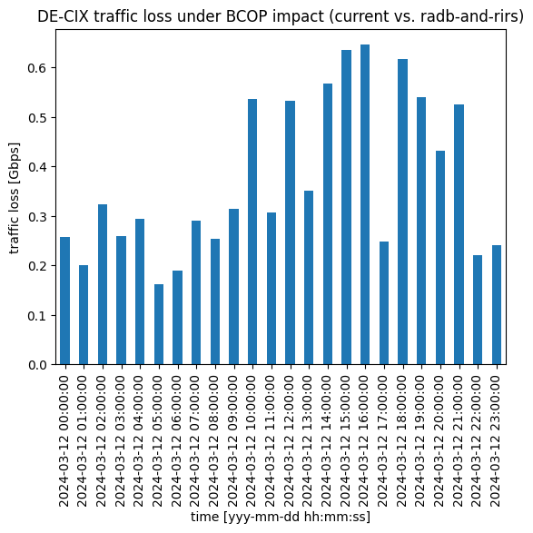
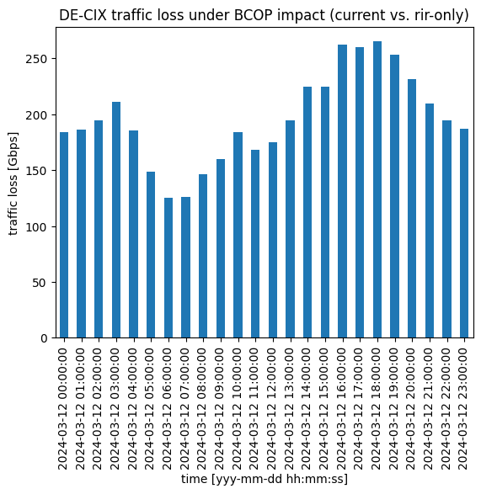
Estimated traffic loss current vs. radb-and-rirs/rirs-only
loss radb-and-rirs
vs rir-only
traffic loss [Gbps]
time [hh:mm:ss]
time [hh:mm:ss]

Slide 23
Key Takeaways
Phasing out all alternative IRR dbs except RADB is doable mid-term
RADB has substantial impact
  We loose one third of resolved filtering lists and 11% of /24s
  Traffic loss could be up to 250 Gbps during peak
Proposal
  Gather like-minded IXPs and find a date X (>6 months) for removing non-official IRR dbs except RADB
  Coordinate and prepare customer communications, monitor results
  Implement changes at date X
  Work jointly on a plan for RADB
Notes:
RIPE-NONAUTH
Adapt for public communication.

Slide 24
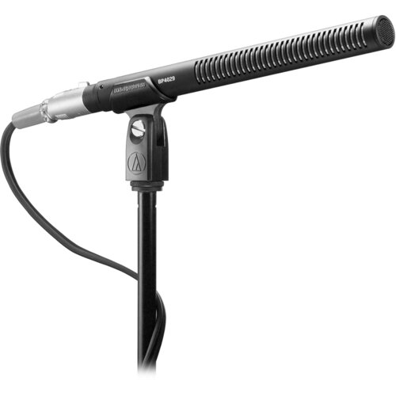
Thank you
Questions?
Let the discussion begin
URL for the Document:
https://amsix-my.sharepoint.com/:b:/g/personal/stavros_konstantaras_ams-ix_net/EWvrurCwi3VNnUc-ocF5ODwBd_OLGCbdhC9T8jNb1IQNZg?e=MregHo

