Slide 1
Update
Paul Hoogsteder
paulh@peeringdb.com
RIPE 88
Kraków, Poland
23 May 2024
Notes:
What is PeeringDB? Its a directory of information related to peering including sites, networks, internet exchanges and other useful information (unique voltage offerings, contact information and other data)

Slide 2
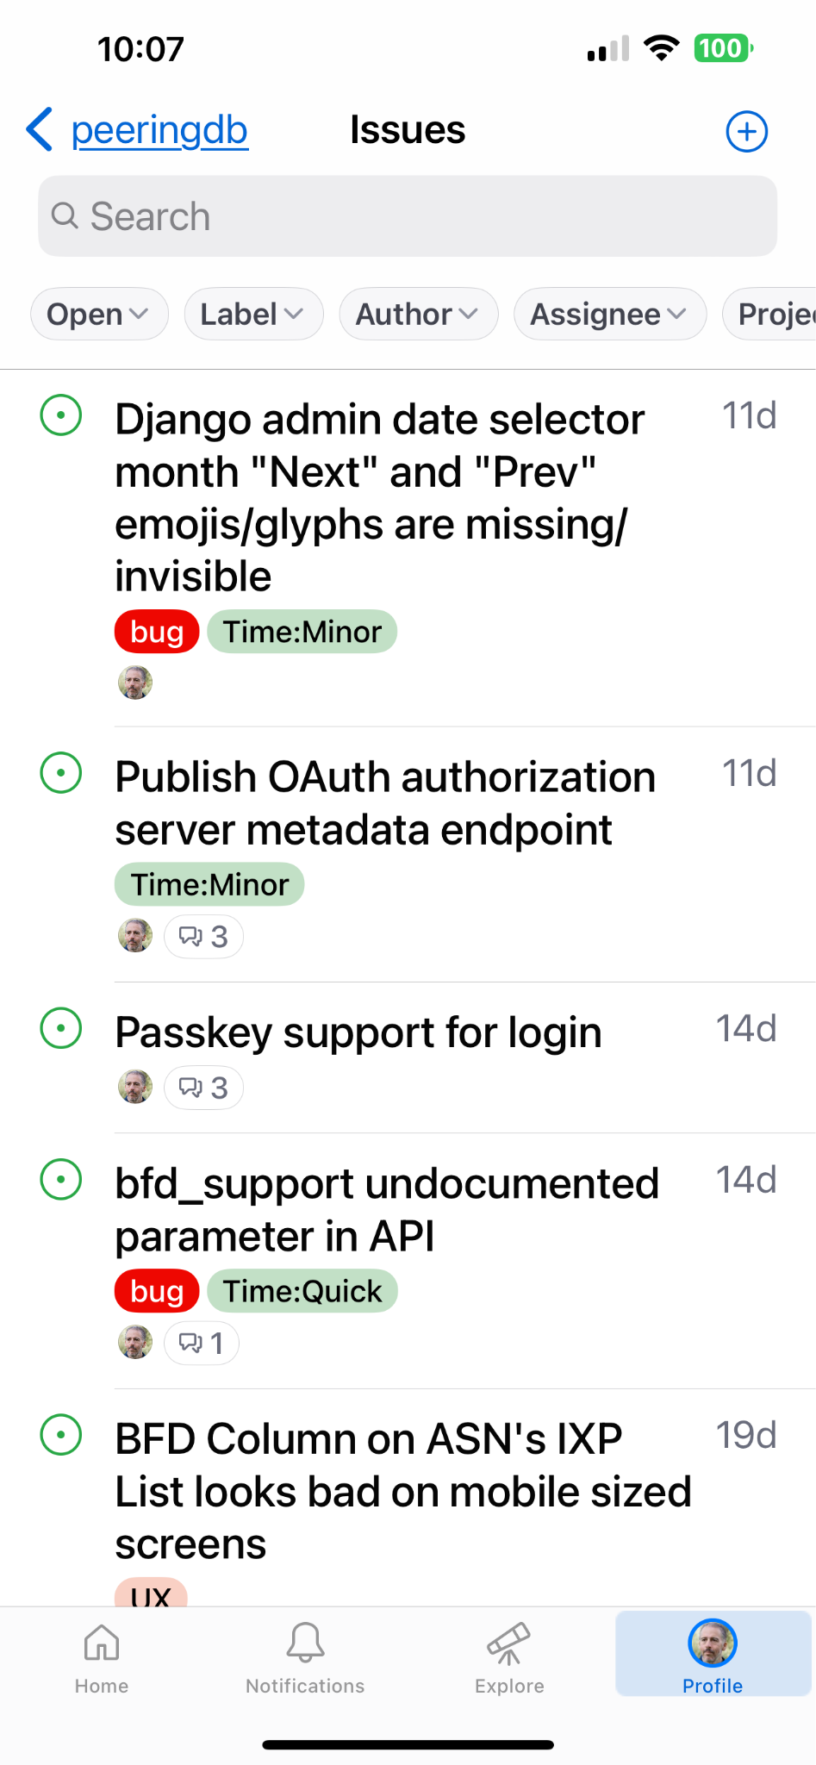
Updates
News from the Frontlines
People changes
v2 Search improvements
.KMZ dump and export
Beta is better!
Notes:
Web UI summary changes
Facility data to KMZ!
Search functionality - why that’s important
Beta testers
CFV

Slide 3
People Changes
Board Elections
Job Snijders and Aaron Hughes re-elected
Product Committee
Jack Carrozzo replaced Stephen McManus as Chair
Admin Committee
Looking for volunteers
Email us at admincom@lists.peeringdb.com for more info.
Notes:
PeeringDB runs on volunteers
- need AC volunteers
- good global exposure
-get to know people (ticket submitters! Hah!)
- great experience learning about PDB
-about a 1 HR commit per week

Slide 4
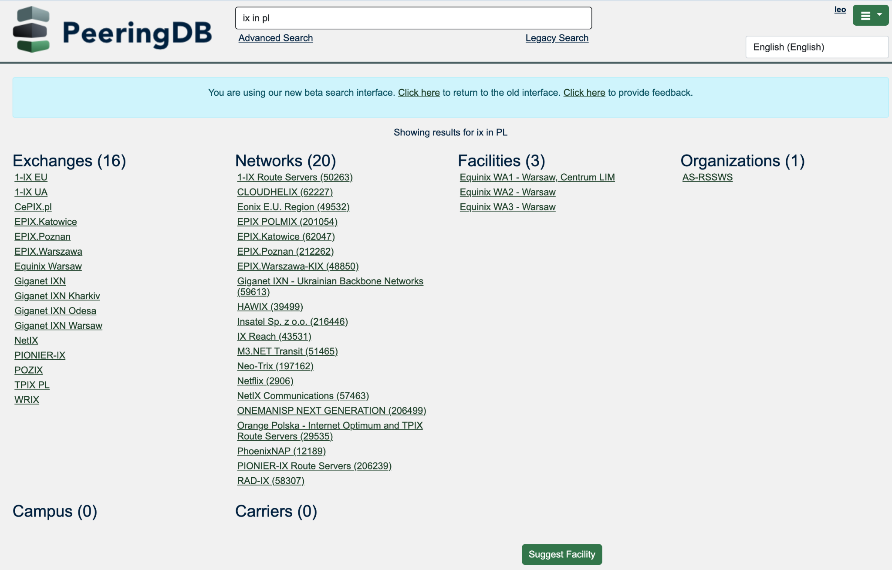
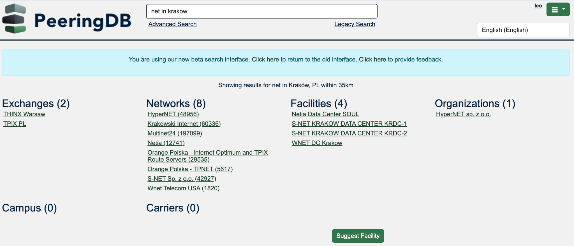
Search
Search is getting better
ISO 3166 support
ISO 3166-2 subdivision support coming
Notes:
Location support includes ….
Simple search knows about objects to move at user speed
We have more work to do, but we’ll be retiring legacy simple search in the near future

Slide 5
KMZ Improvements
Facility Data
Locations and metadata
Exported daily
Importable to Google Maps
Later this year
Export searches to KMZ
Improved visual attributes
Notes:
KMZ being auto generated once a day.
Contains useful record metadata (Thank you to our Sponsor Digital Realty)
Powerful uses, FEMA, quake, near facilities (Thanks Digital – and they’re safe)
Other very cool uses aligned with personal data

Slide 6
We Need Beta Testers
Consider using the Beta environment as default
Regular data refresh throughout the month
Beta separated from production
Early access to improvements
Easy feedback mechanism
Try it at https://beta.peeringdb.com
Contact us at pc@peeringdb.com with any questions
Notes:
Beta testers wanted
- beta environment moving closer to production except for writes
- We could use volunteers to let us know when they see issues
- Reporting is easy via interface

Slide 7
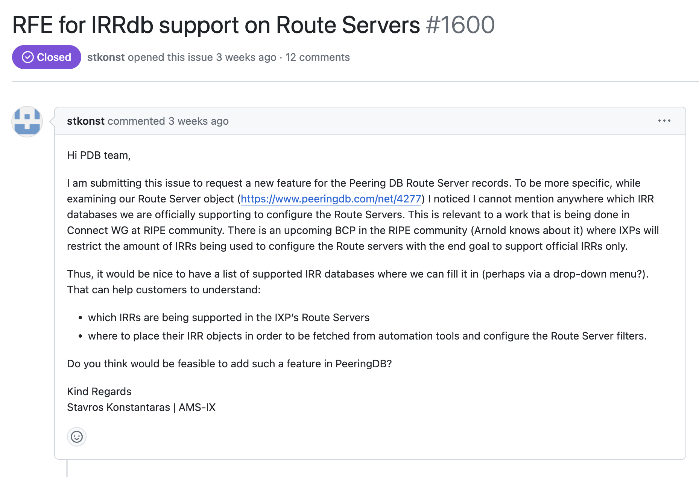
IRRdb support at IXPs
Our process
This issue was community proposed
To move forward with an issue like this we need to understand how users will benefit
Will they automate?
Will they choose IXPs based on this information?
Notes:
Location support includes ….
Simple search knows about objects to move at user speed
We have more work to do, but we’ll be retiring legacy simple search in the near future

Slide 8
Call for Volunteers
Admin Committee
Answer user support questions
Suggest improvements based on experience
Email us at admincom@lists.peeringdb.com for more info.
Notes:
PeeringDB runs on volunteers
- need AC volunteers
- good global exposure
-get to know people (ticket submitters! Hah!)
- great experience learning about PDB
-about a 1 HR commit per week

Slide 9
Thank you to our sponsors!
Diamond Sponsor
Platinum Sponsors
Gold Sponsors
Silver Sponsors
Notes:
Logo height proportions: 100%, 85%, 65%, 40%

