Slide 1
RIPE 88
Bijal Sanghani

Slide 2
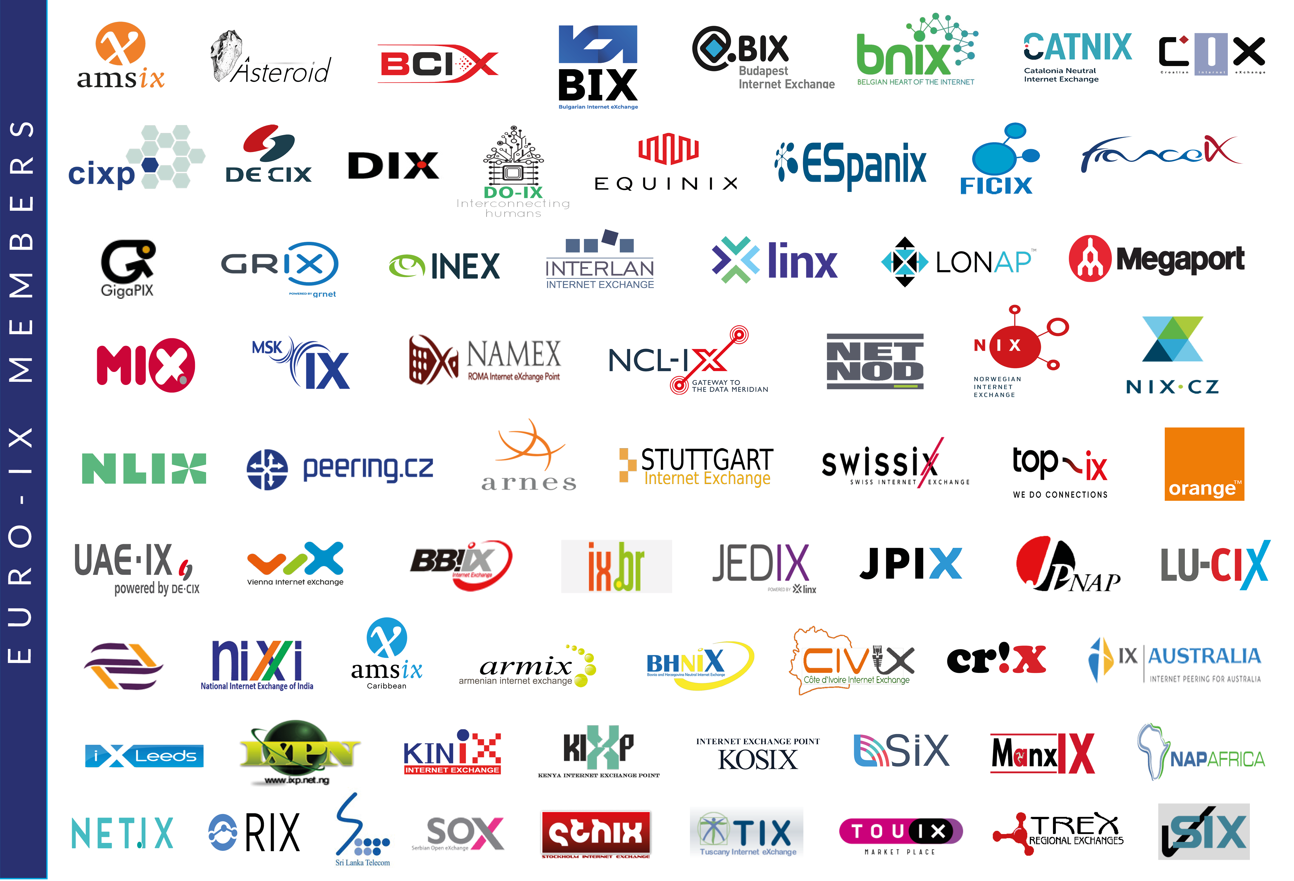

Slide 3
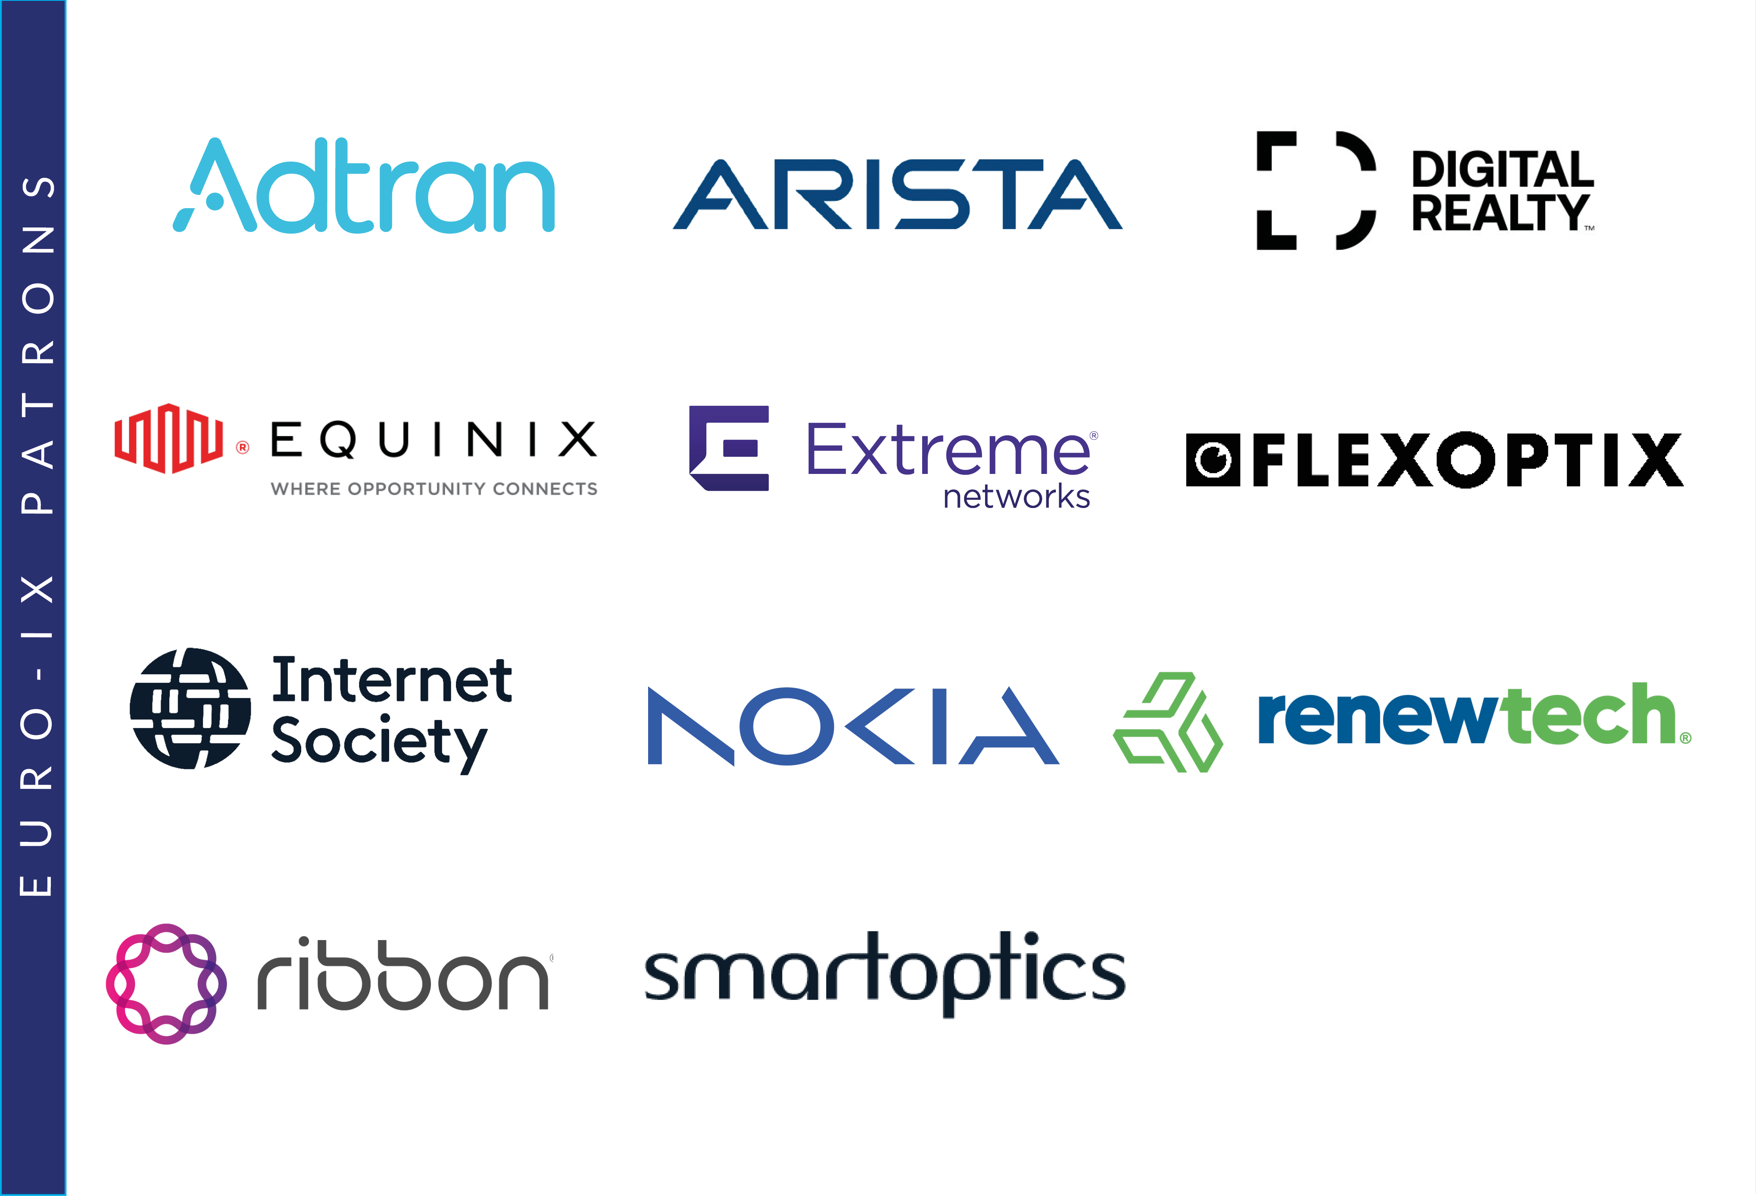

Slide 4
Membership Association of IXPs
Events
2 Forums a year
Workshops
Community & Tools
Internet eXchange Point Database – IXPDB
Peering Toolbox
Fellowship & Mentor-IX
A new IXP Film
Working groups

Slide 5
Peering Toolbox
Community Focused Learning Tool
5

Slide 6
Peering Toolbox
Website focused on learning:
Short sections with clear explanations of each topic
Easy for new entrants to discover what they need to make the best decisions for their network
Easy for organisations already peering to learn about current best practices, keep up to date with technology, and help with troubleshooting connectivity and reachability issues
Advice from experienced peers sharing tips and tricks
Use of the IXPDB and the PeeringDB

Slide 7
Route Server Working Group
Irene Lalioti (LU-CIX)
Stavros Konstantaras (AMS-IX)

Slide 8
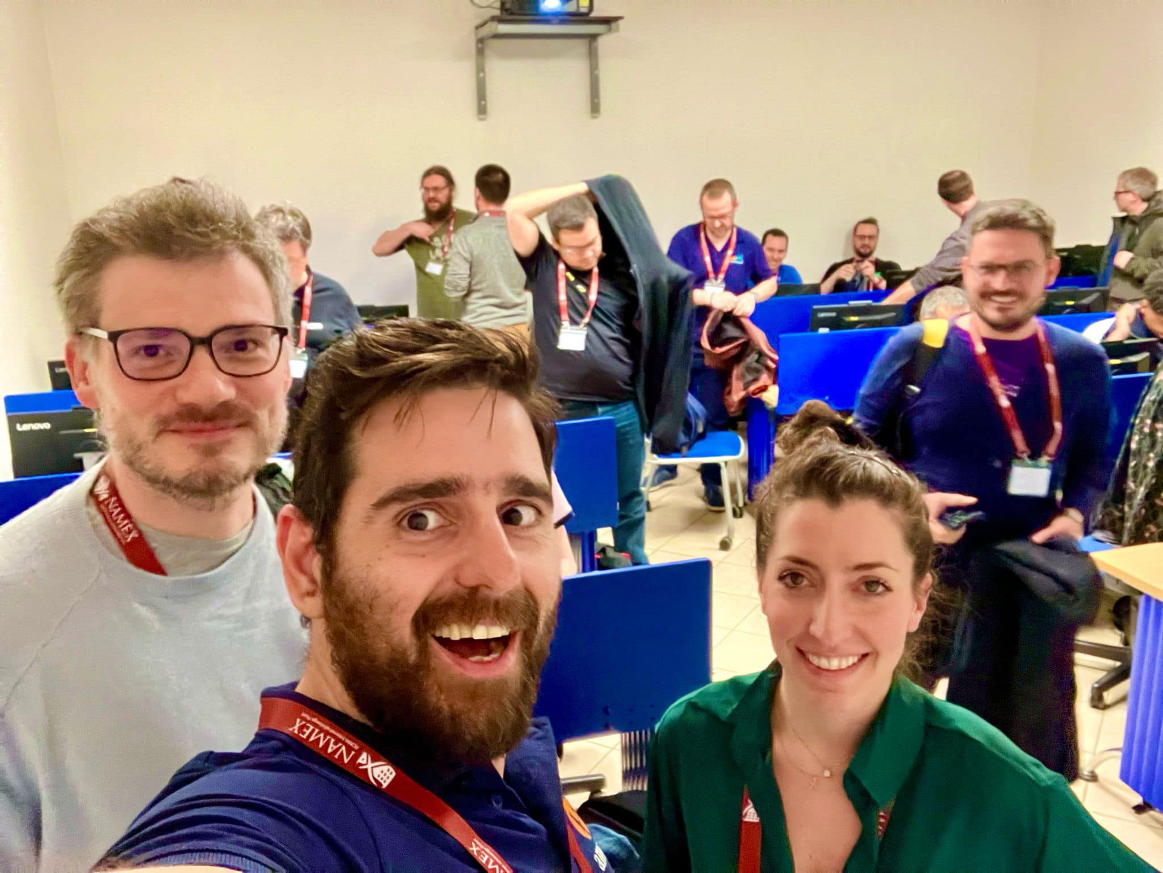
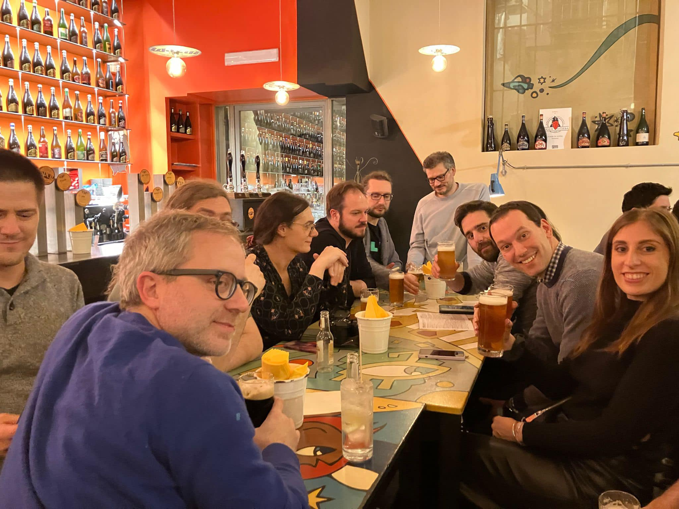
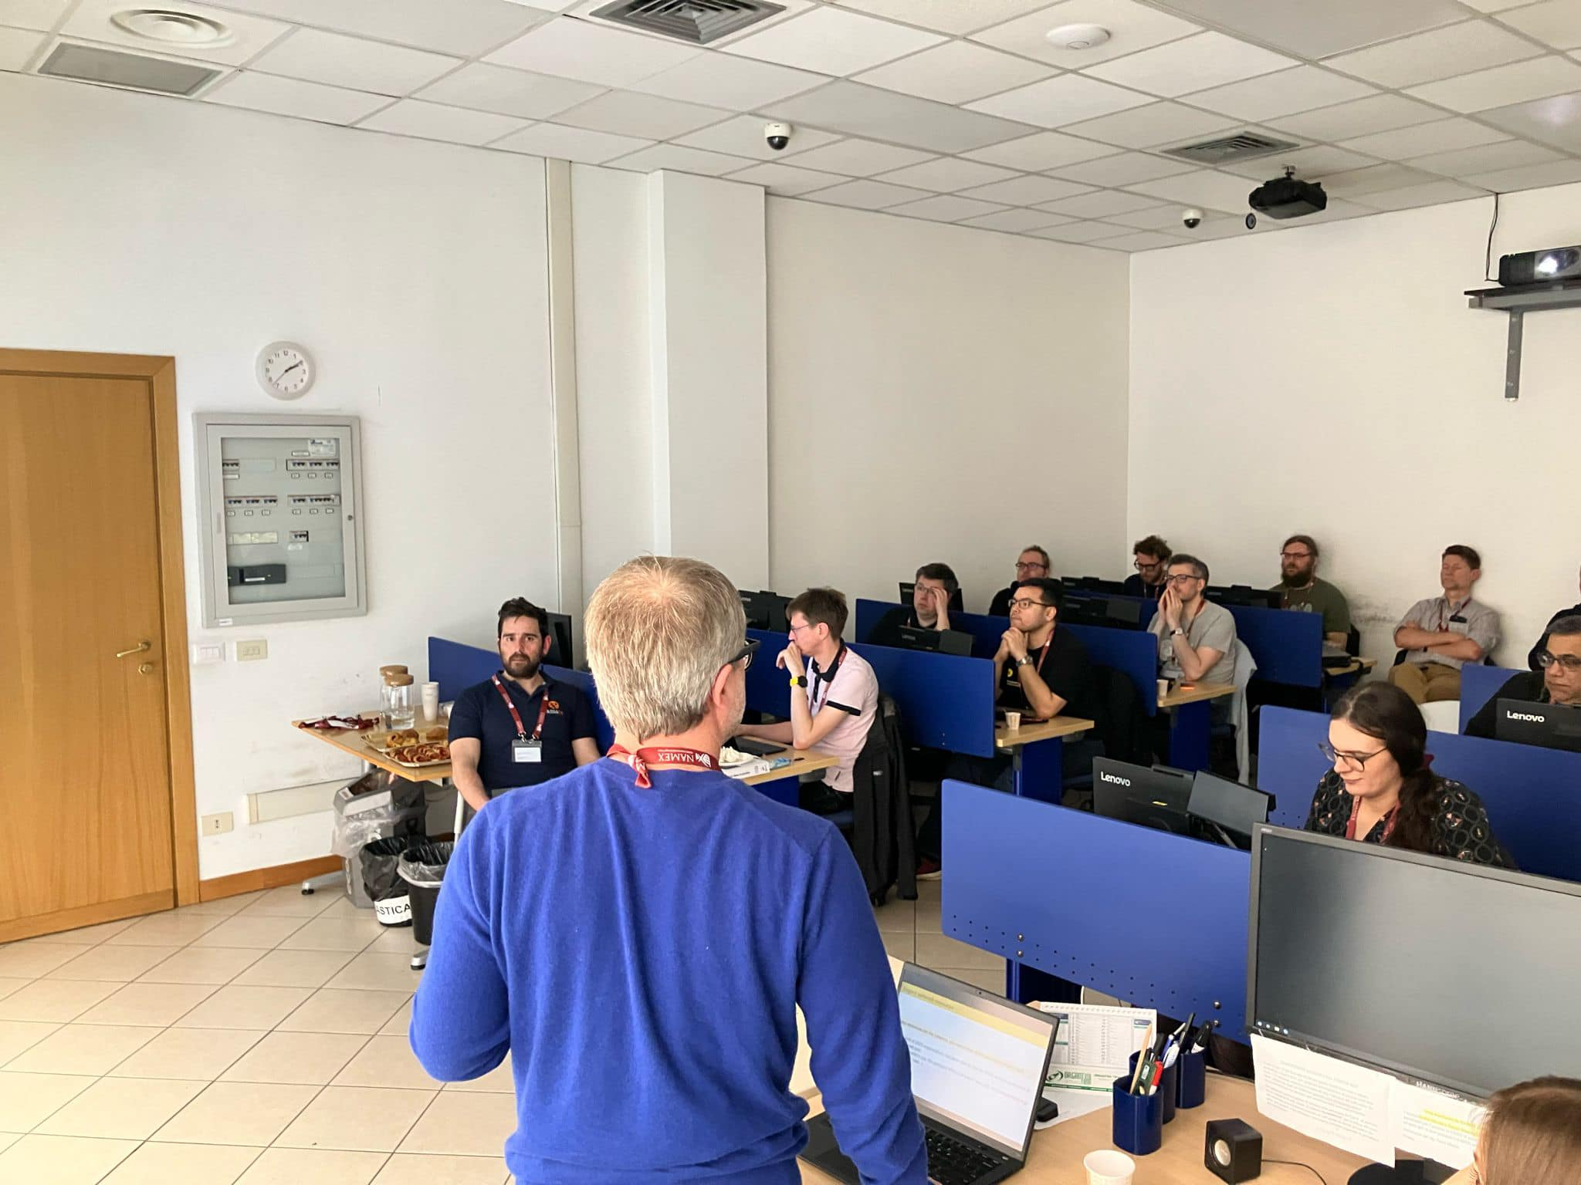
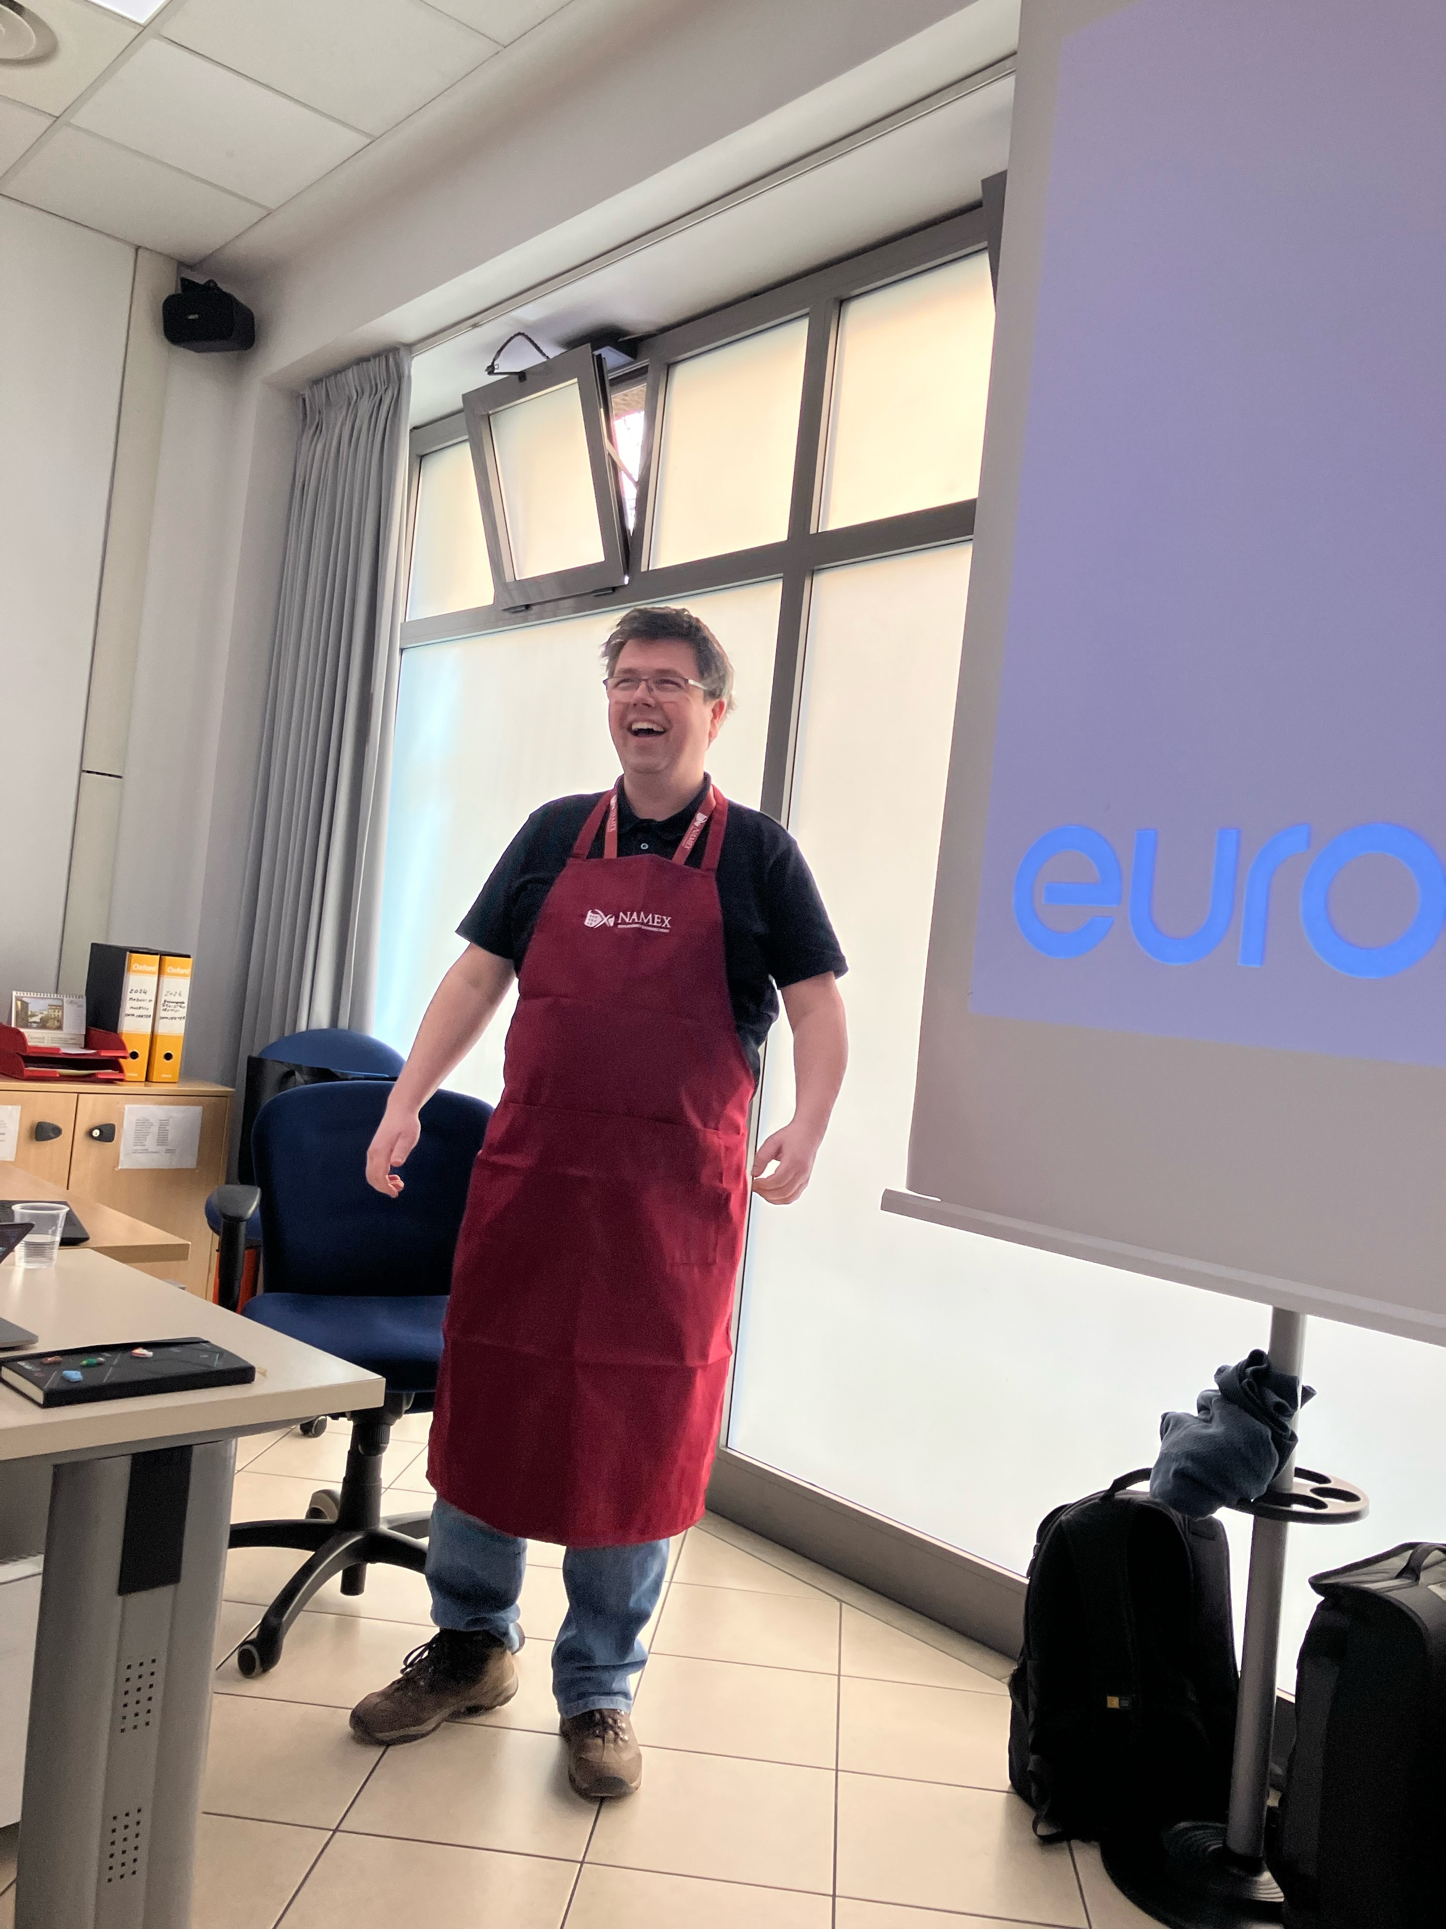
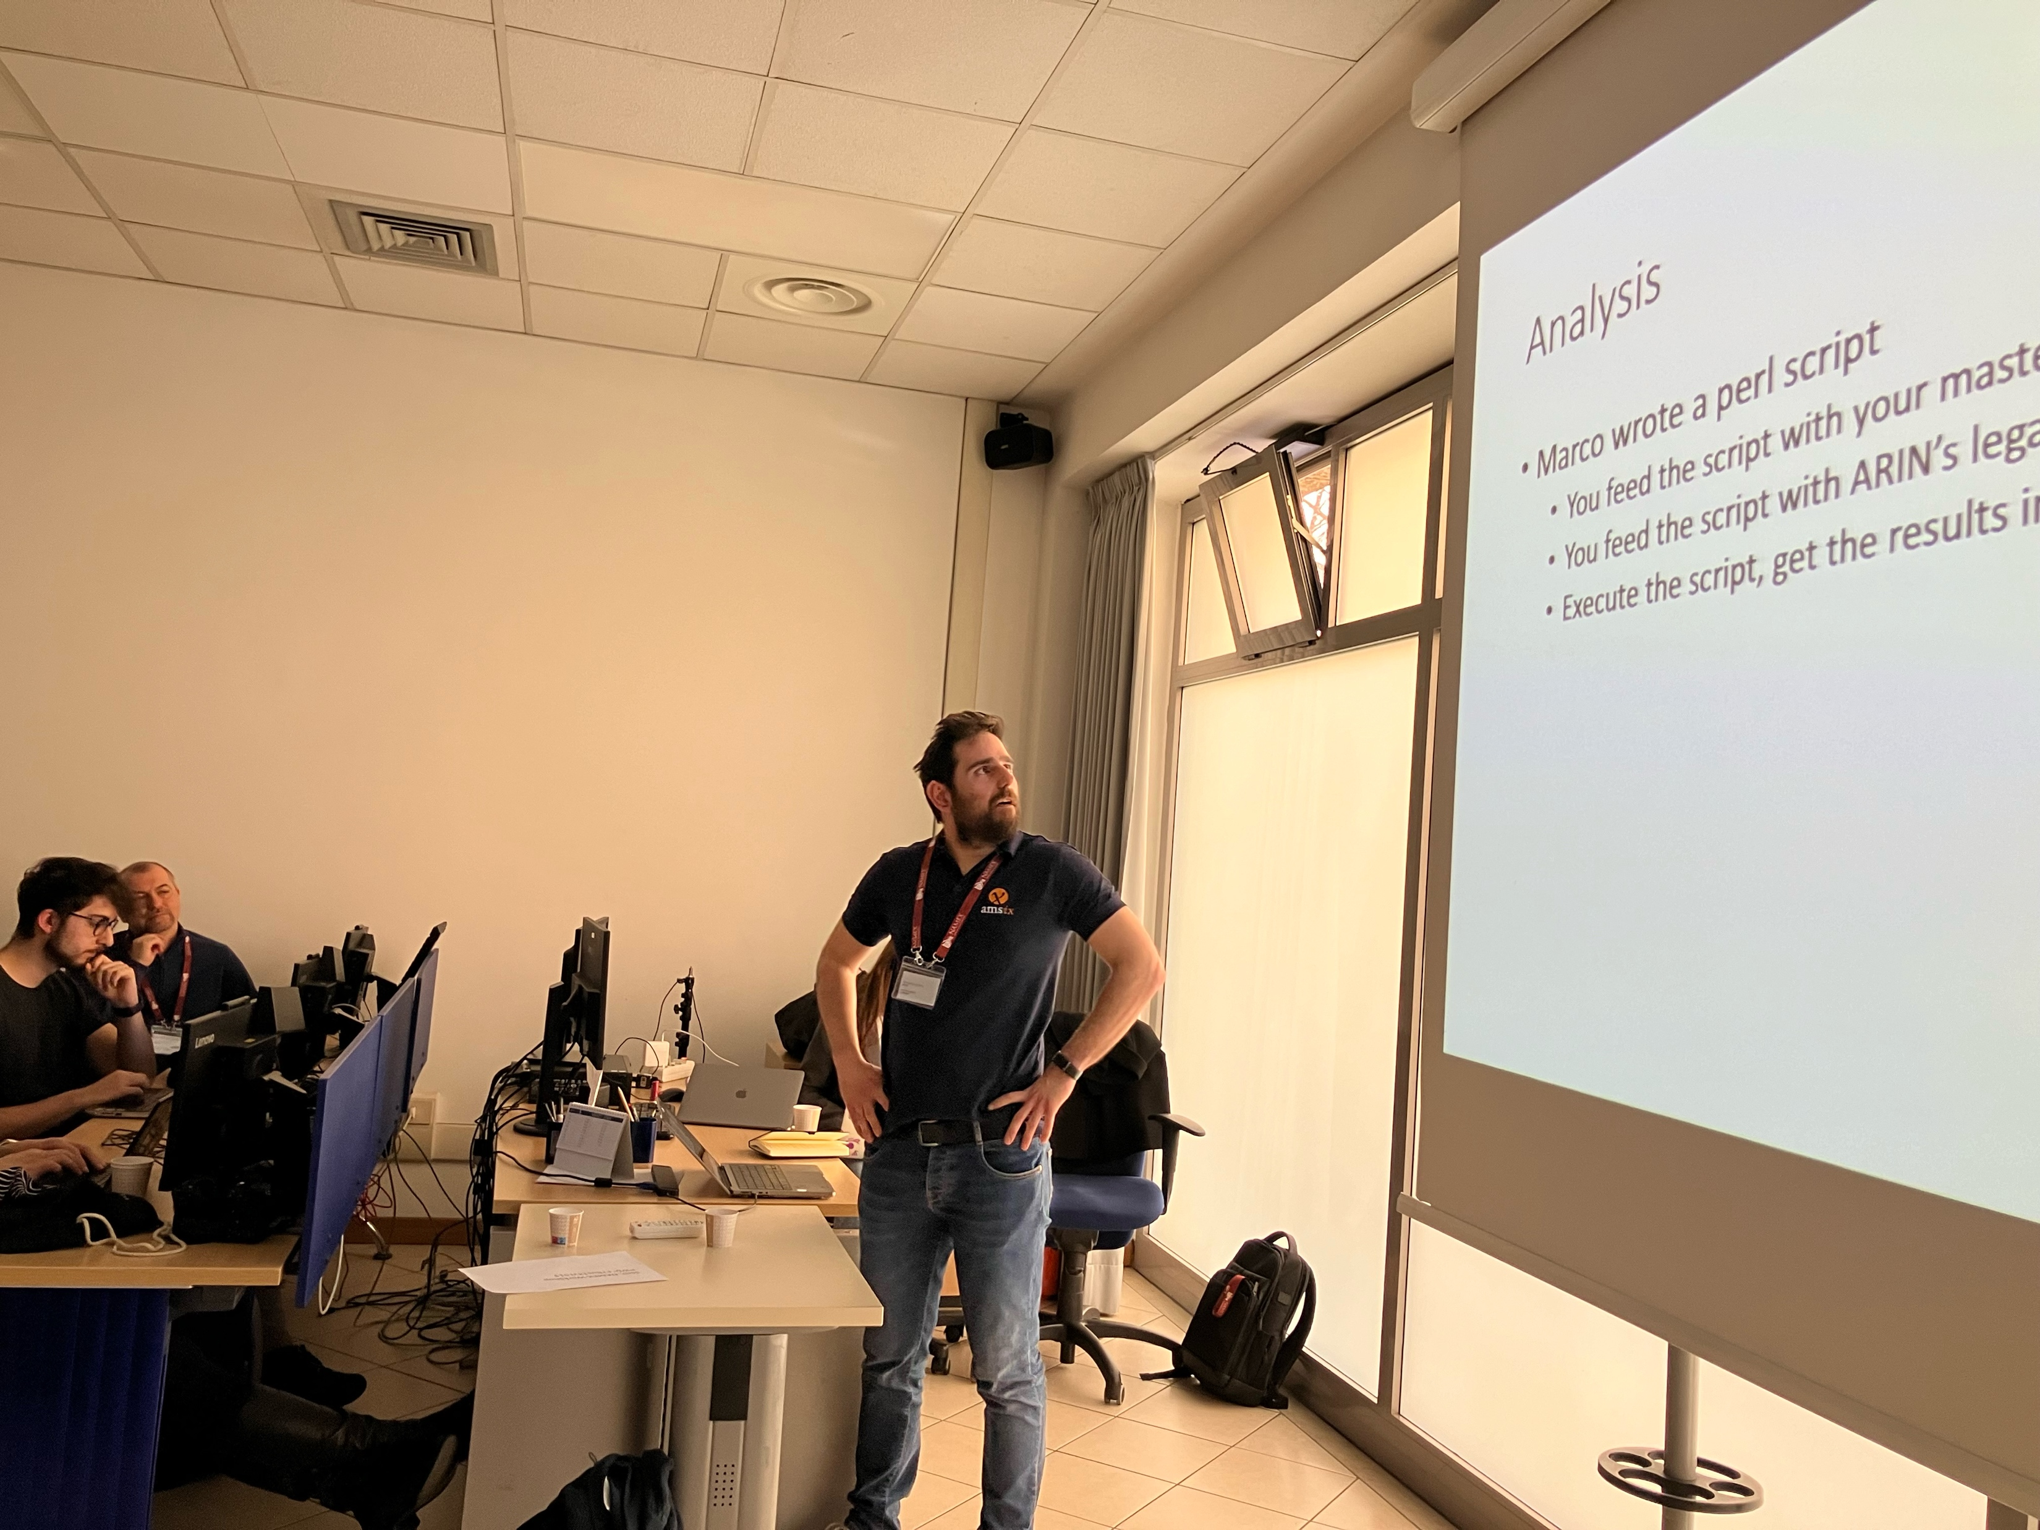
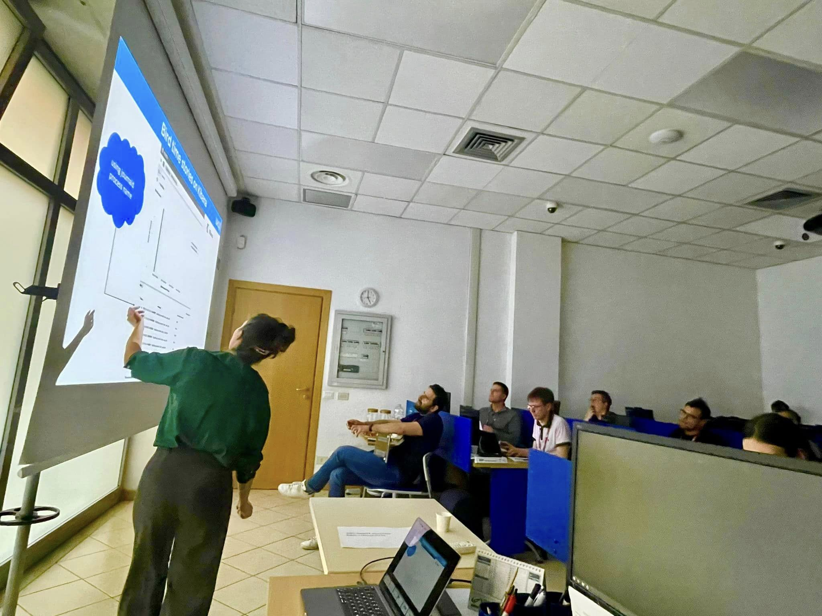
20 IXPs Presents
BCIX
Namex
MINAP
LONAP
BNIX
France-IX
NIX.CZ
RomandIX
NL-IX
MSK-IX
AMS-IX
LU-CIX
BIRD
OpenBGPd
Alice-LG
INEX
TOP-IX
VIX
LINX
DE-CIX

Slide 9
Route Server Working Group
We welcomed the RS developers Ondrej (BIRD), Claudio (OpenBGPd) and Annika (Alice-LG) where they gave us latest updates
Stavros presented the BCP for the usage of IRR DBs when generating Route Server configuration
Claudio had an insightful presentation for ASPA
Stavros talked about the RS Wishlist

Slide 10
RFC8950
Working Group
10

Slide 11
RFC8950
Progress:
More interop testing results published
Supported implementation of RFC8950 in ARouteServer
Developed long-term migration idea
PeeringDB feature request #1576
Working on:
Improving IXP Manager and Alice-LG
Promoting and liaising with promoters (Meta, ...)
Large scale test scenarios

Slide 12
Rules of Engagement:
Navigating the Evolving World of Interconnection

Slide 13
Rules of Engagement
Let’s discuss..
Remco van Mook
Paul Hoogsteder

Slide 14
Rules of Engagement
The idea of this panel discussion is to look at how interconnection has evolved over the last decade or two.
Are we collaborating in the same way we did 10+ years ago or are there too many barriers?

Slide 15
Rules of Engagement
Over the past decade, how have the dynamics of peering evolved, and what impact has this had on the industry?

Slide 16
Rules of Engagement
In an industry where sharing internal knowledge can be fraught with legal and competitive risks, how can we foster a culture of openness and collaboration without compromising corporate interests?

Slide 17
Rules of Engagement
How has the perceived increase in competition within the interconnection landscape affected relationships and other advancements, are we as innovative now as we were 10+ years ago?

Slide 18
Rules of Engagement
If you could implement any futuristic idea in interconnection without any limitations, what would it be and why?

Slide 19
Thank You!

