Slide 1


The Surprising Impact of 1% Packet Loss
Kemal Šanjta
Principal internet analyst
kemals@cisco.com

Slide 2
Researched but not quantified problem
Intricacies of TCP are well researched
Packet loss has negative effect on flows
Not something that we quantify often
Network engineers tend to look past “small” levels of packet loss (say 1 or 2%)

Slide 3
Various Methods TCP Uses To Handle Packet Loss
Duplicate ACKs
Timeouts
Explicit Congestion Notifications (ECN)
Selective Acknowledgements (SACK)
Congestion Avoidance Algorithms

Slide 4
CUBIC: The Default Congestion Avoidance Algorithm
Given increased popularity of the Internet and growth of networks, network engineers realized that earlier congestion avoidance algorithms such as Tahoe, utilized available bandwidth slower than they should, especially in higher-bandwidth networks
Default congestion avoidance algorithm on all major operating systems

Slide 5
CUBIC: HOW IT WORKS?
Congestion Window Adjustment
  CUBIC employs a cubic function to adjust the congestion window size
  The congestion window is increased aggressively during the slow start phase and cautiously during congestion avoidance. It reduces the congestion window sharply upon detecting packet loss, indicating network congestion
Window Scaling
  Adjusts the congestion window size based on the current network capacity and congestion level
TCP Timestamps
  CUBIC uses TCP timestamps for fine-grained measurement of round-trip time (RTT). Helps in estimating the available bandwidth and adjusting the congestion window accordingly
Congestion Avoidance
  Once the congestion window reaches a certain threshold, CUBIC switches to congestion avoidance mode. It increases the congestion window size gradually, probing for additional bandwidth without inducing congestion
Packet Loss Reaction
  CUBIC reacts to packet loss by reducing the congestion window size sharply
  Implements an additive increase, multiplicative decrease (AIMD) approach to adjust the congestion window dynamically

Slide 6
Test methodology
Five Linux (Ubuntu 22.04) hosts configured to forward packets
1Gbps connectivity between devices
Static routing
Sub interfaces configured on hosts, required VLAN configuration on switch
Measuring throughput using iperf3
Unlike bandwidth, which represents the maximum capacity of the channel, throughput reflects the real-world performance and efficiency of the data transmission process

Slide 7
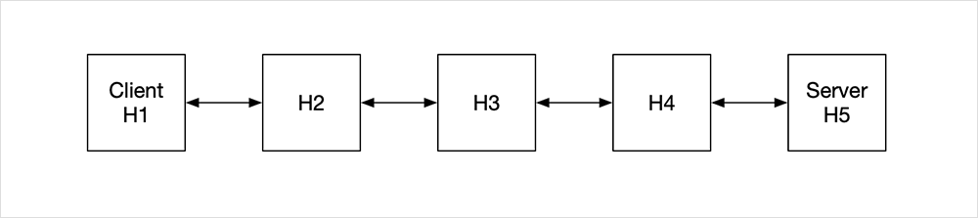
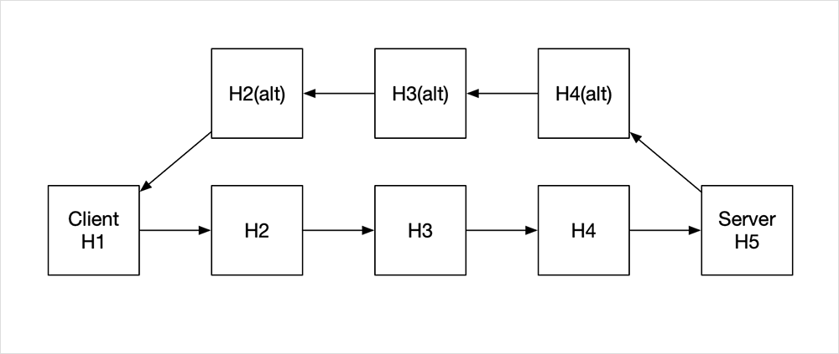
Symmetric and Asymmetric Network Paths
Symmetric network (forward and reverse traffic path is the same)
Asymmetric network (reverse traffic is taking a different path when compared to the forwarding path)

Slide 8
Establishing a Baseline (NO PACKET LOSS)
 | Baseline (symmetric)
Mean | 804.673506
STD | 13.0217464
Min. | 710
25% | 799.99
50% | 809.93
75% | 810.046
Max. | 830.419
 | Baseline (asymmetric)
Mean | 864.139471
STD | 14.647341
Min. | 720.067
25% | 859.973
50% | 869.965
75% | 870.3815
Max. | 900.002
804.6 Mbps and 865.13 Mbps of Throughput for symmetric and asymmetric network, respectfully
Asymmetric network traffic saw 7.3% increase in Throughput over symmetric network

Slide 9
introducing PACKET LOSS
tc ("traffic control") utility
tc has capabilities such as shaping, scheduling, policing, and dropping
Enhancement called netem ("network emulation") that allows adding delay, packet loss, duplication, and other characteristics to packets outgoing from a specific network interface

Slide 10
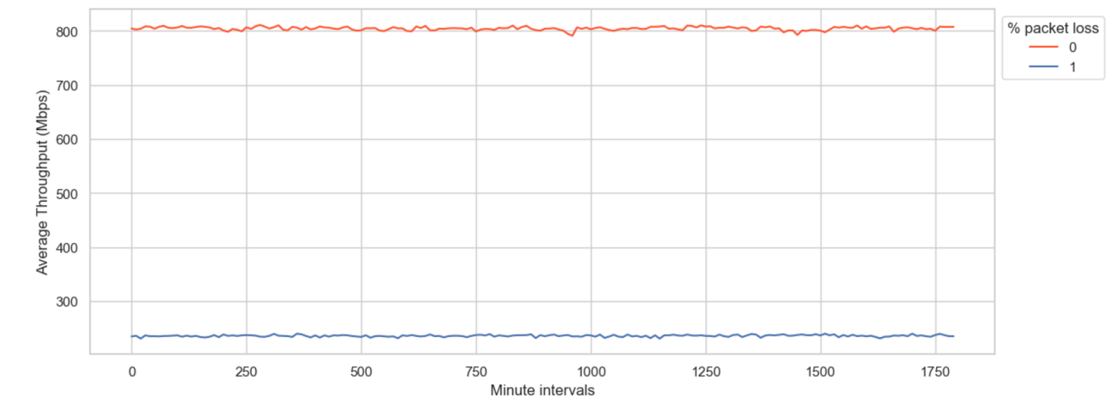
The Curious Case of 1% Packet Loss
On average, 1% of packet loss causes 70.0%+ decrease in throughput!
804.6 Mbps of Throughput at baseline, 235.5 Mbps of Throughput at 1% loss in symmetric topology
864.13 Mbps of Throughput at baseline, 222.4 Mbps of Throughput at 1% loss in asymmetric topology

Slide 11
The Curious Case of 1% Packet Loss
 | 1% (symmetric)
Mean | 235.513105
STD | 13.5692798
Min. | 93.967
25% | 229.667
50% | 236.635
75% | 243.596
Max. | 281.886
 | 1% (asymmetric)
Mean | 222.493196
STD | 13.7883065
Min. | 51.21
25% | 214.788
50% | 222.729
75% | 230.675
Max. | 280.877
1% of packet loss caused a 70.7% decrease in throughput in symmetric network topology, while in asymmetric topology it resulted in 74.2% decrease in throughput!

Slide 12
Overall RESULTS
Symmetric network
 | 1% | 2% | 3% | 4% | 5% | 6% | 7% | 8% | 9% | 10%
Mean | 235.51 | 175.19 | 109.76 | 65.68 | 41.37 | 23.95 | 16.75 | 11 | 7.52 | 5.29
STD | 13.57 | 37.48 | 46.68 | 36.09 | 25.48 | 17.31 | 12.16 | 8.4 | 5.97 | 4.33
Min. | 93.97 | 11.93 | 0 | 0 | 0 | 0 | 0 | 0 | 0 | 0
0.25 | 229.67 | 158.09 | 74.56 | 37.77 | 21.38 | 9.94 | 6.96 | 4.97 | 2.98 | 1.99
0.5 | 236.64 | 190.91 | 111.86 | 61.67 | 37.77 | 19.89 | 13.92 | 8.95 | 5.97 | 3.98
0.75 | 243.6 | 199.86 | 150.14 | 89.53 | 57.18 | 33.81 | 23.37 | 15.41 | 9.95 | 6.96
Max. | 281.89 | 223.72 | 201.33 | 175.49 | 149.62 | 119.3 | 87.5 | 68.59 | 46.76 | 37.78
Asymmetric network
 | 1% | 2% | 3% | 4% | 5% | 6% | 7% | 8% | 9% | 10%
Mean | 222.49 | 168.03 | 106.43 | 63.57 | 36.59 | 24.99 | 15.52 | 10.82 | 36.59 | 15.52
STD | 13.79 | 34.91 | 44.62 | 34.81 | 24.44 | 16.93 | 11.58 | 8.26 | 24.44 | 11.58
Min. | 51.21 | 5.97 | 0 | 0 | 0 | 0 | 0 | 0 | 0 | 0
25% | 214.79 | 151.14 | 72.57 | 35.8 | 16.9 | 11.93 | 5.97 | 4.97 | 16.9 | 5.97
50% | 222.73 | 182.45 | 108.35 | 59.66 | 31.84 | 21.87 | 11.94 | 8.95 | 31.84 | 11.94
75% | 230.68 | 191.89 | 144.67 | 87 | 51.7 | 34.79 | 21.87 | 14.92 | 51.7 | 21.87
Max. | 280.88 | 212.79 | 188.91 | 163.07 | 148.64 | 118.81 | 82.03 | 63.64 | 148.64 | 82.03

Slide 13
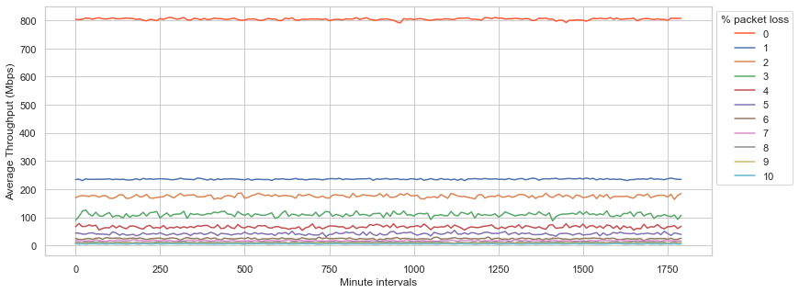
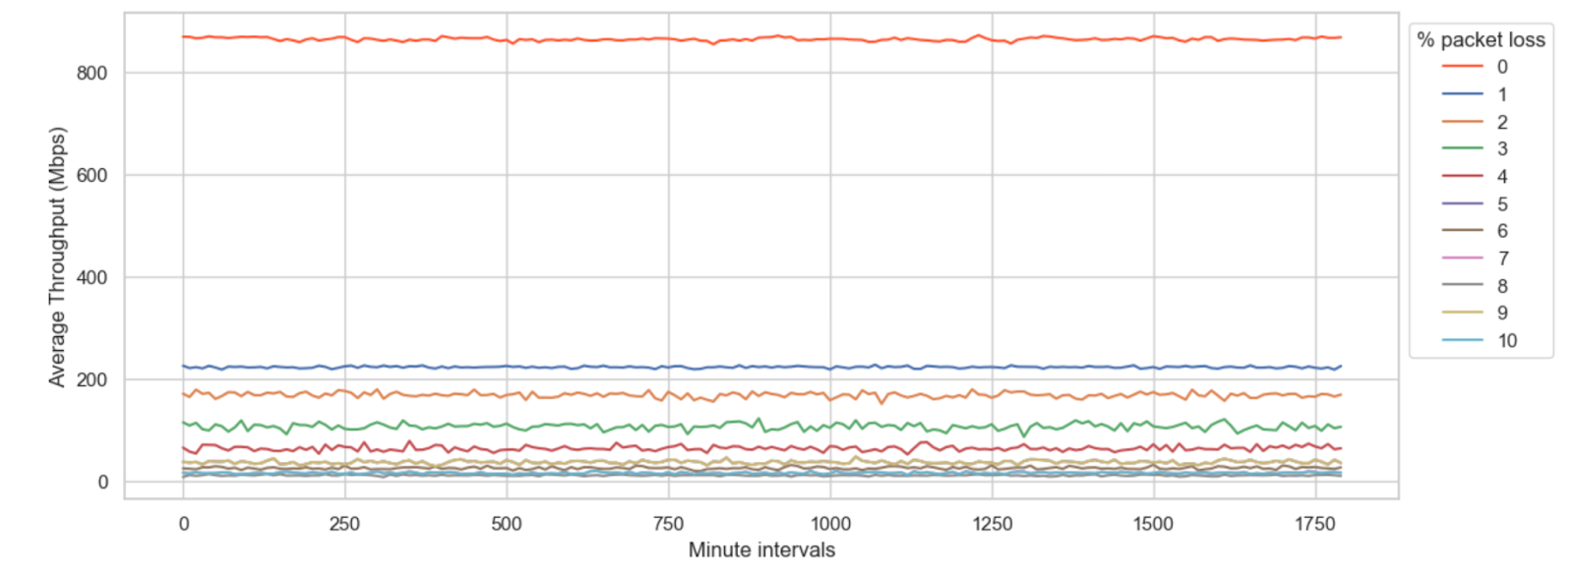
Overall RESULTS VISUALISED
Throughput achieved in symmetric network
Throughput achieved in asymmetric network

Slide 14
BBR: The future of congestion avoidance?
BBR stands for Bottleneck Bandwidth and Round-Trip Time
It is a congestion control algorithm developed by Google
Designed to optimize network utilization and throughput by continuously probing for the available bandwidth and adjusting sending rate accordingly

Slide 15
BBR: How it WORKS?
Bandwidth estimation
  BBR estimates the available bandwidth by measuring the delivery rate of packets
  Uses concept of pacing to ensure a steady flow of packets without causing undue congestion
Round-Trip Time (RTT) Estimation
  Maintains an estimate of the minimum RTT of the connection
  RTT variations are used to adjust the pacing rate, ensuring smooth transmission and reduced latency
Bottleneck Detection
  Identifies the bottleneck link in the network path through various techniques like probing for increased delivery rates and utilizing RTT feedback
Congestion Window Management
  Adjusts the sending rate by maintaining two parameters: pacing gain and probing gain
Low Latency Operation
  Aims to keep the queue size low, which helps in reducing latency

Slide 16
KEY DIFFERENCES BETWEEN CUBIC AND BBR
Congestion Window Adjustment
  CUBIC: Adjusts congestion window based on cubic function, reacting strongly to loss
  BBR: Dynamically adjusts sending rate based on bandwidth and RTT estimations, avoiding unnecessary loss
Bandwidth Estimation
  CUBIC: Relies on packet loss as an indicator of congestion
  BBR: Actively probes for available bandwidth and adjusts sending rate, minimizing latency
Latency Optimization
  CUBIC: Prioritizes throughput over latency, potentially leading to increased latency under heavy congestion
  BBR: Maintains low latency by continuously monitoring network conditions and adjusting congestion control parameters accordingly
Implementation
  CUBIC: Widely adopted in many operating systems and network devices
  BBR: Developed by Google for its data centers, gaining adoption in various platforms and protocols.

Slide 17
ENABLING BBR
cat /proc/sys/net/ipv4/tcp_congestion_control
cubic
Verify currently configured algorithm
echo "net.core.default_qdisc=fq" >> /etc/sysctl.conf
echo "net.ipv4.tcp_congestion_control=bbr" >> /etc/sysctl.conf
sysctl -p
Enable BBR
cat /proc/sys/net/ipv4/tcp_congestion_control
bbr
Verify that BBR is configured

Slide 18
Establishing a BASELINE WITH BBR (NO PACKET LOSS)
 | Baseline (symmetric)
Mean | 868.50
STD | 49.36
Min. | 679.99
25% | 860.15
50% | 889.99
75% | 890
Max. | 900.31
 | Baseline (asymmetric)
Mean | 827.20
STD | 46.06
Min. | 639.99
25% | 839.92
50% | 840
75% | 849.99
Max. | 860.26
868.5 Mbps and 827.20 Mbps of Throughput for symmetric and asymmetric network, respectfully
Asymmetric network traffic saw 4.7% decrease in Throughput over symmetric network

Slide 19
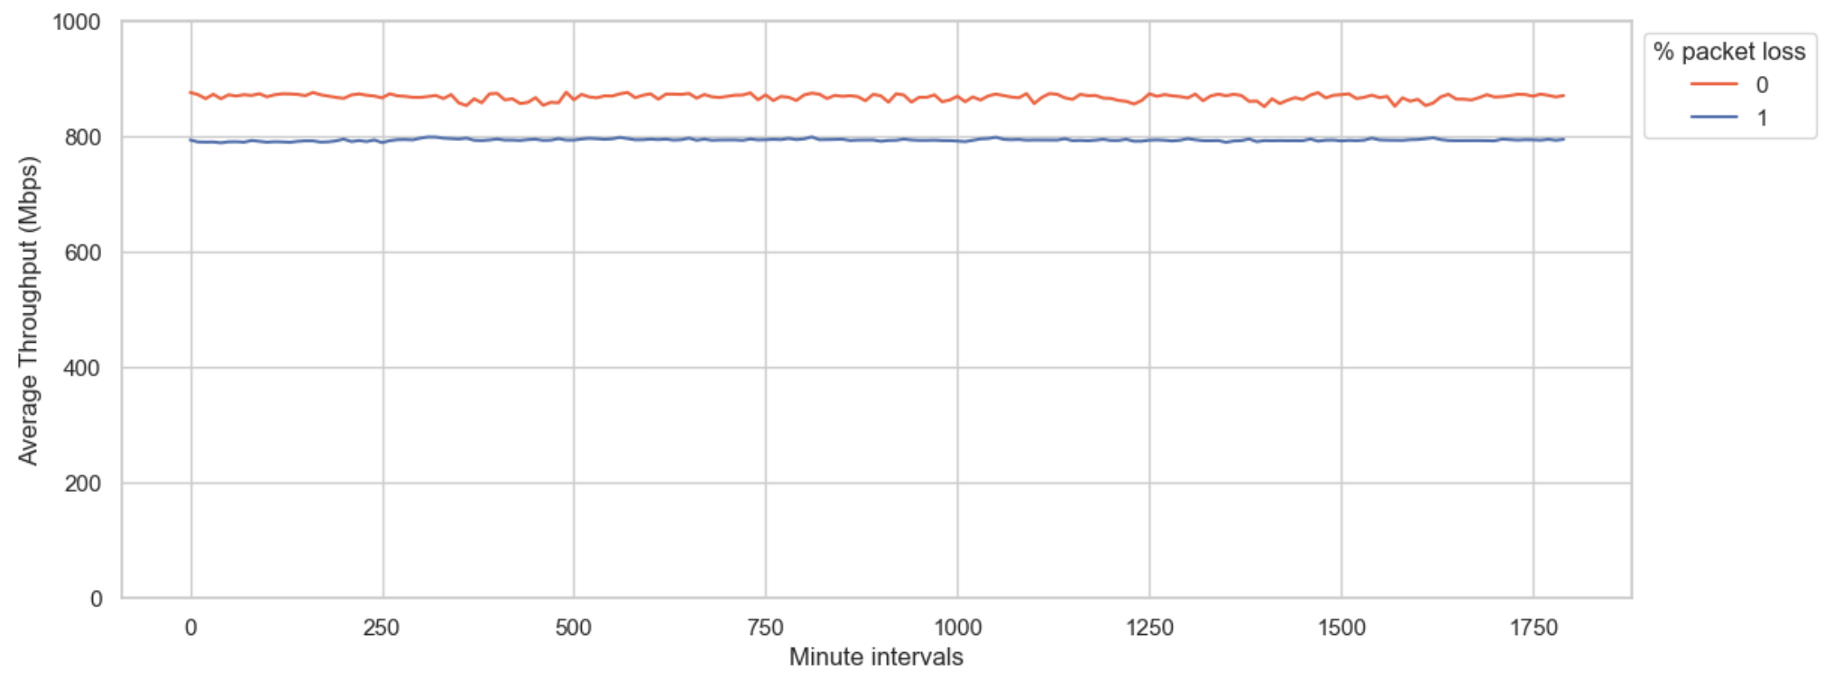
MEASURING IMPACT OF 1% packet loss while using BBR
On average, 1% of packet loss caused 8.5% decrease in throughput while using BBR, stark difference to 70.7% decrease using CUBIC!

Slide 20
MEASURING IMPACT OF 1% packet loss while using BBR
 | 1% (symmetric)
Mean | 794.06
STD | 44.08
Min. | 489.99
25% | 800.33
50% | 809.99
75% | 810.01
Max. | 830.08
 | 1% (asymmetric)
Mean | 763.42
STD | 44.28
Min. | 519.96
25% | 760
50% | 779.99
75% | 789.98
Max. | 810.41
1% packet loss, in symmetric network topology using BBR, caused 8.5% throughput decrease compared to 70.7% throughput decrease in the same topology while using CUBIC
In asymmetric network topology using BBR, we saw 7.7% throughput decrease compared to 74.2% decrease in throughput while using CUBIC

Slide 21
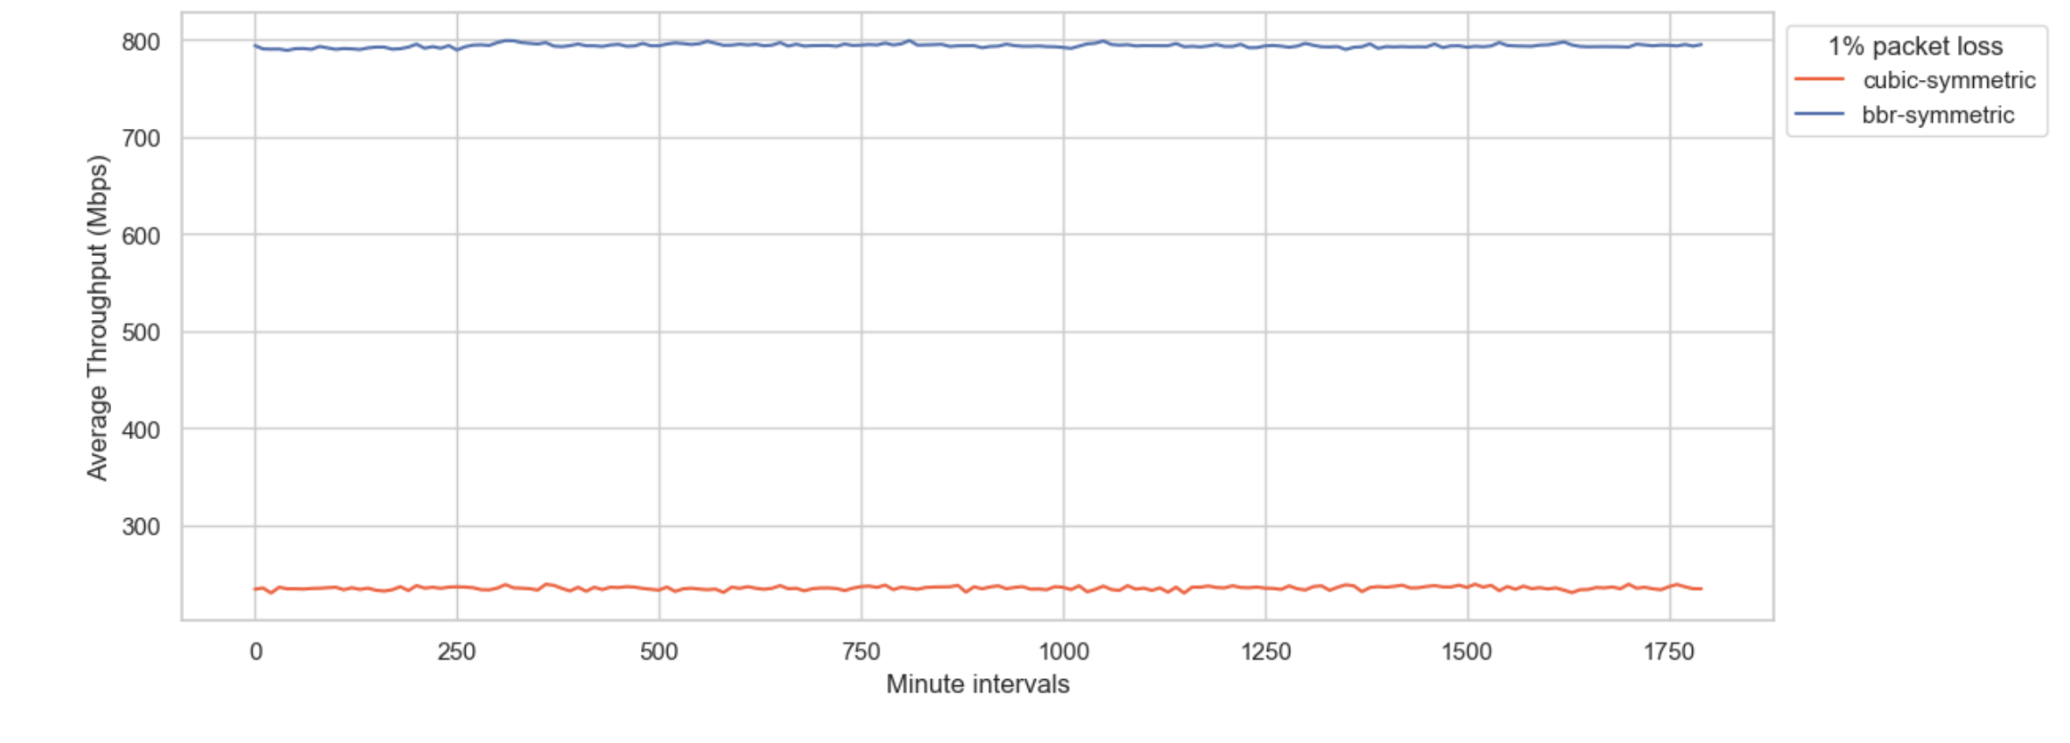
COMPARISON BETWEEN CUBIC and BBR AT 1% LOSS

Slide 22
OVERALL RESULTS WITH BBR
Symmetric network
 | 1% | 2% | 3% | 4% | 5% | 6% | 7% | 8% | 9% | 10%
Mean | 794.06 | 791.65 | 768.94 | 775.34 | 773.7 | 787.71 | 784.07 | 644.04 | 761.61 | 751.89
STD | 44.08 | 44.58 | 47.55 | 50.11 | 56.29 | 61.42 | 64.99 | 268.31 | 76.86 | 77.96
Min | 490 | 370 | 140 | 280.05 | 209.86 | 0 | 130 | 0 | 0 | 0
25% | 800.34 | 799.99 | 779.99 | 780.27 | 788.9 | 800 | 799.99 | 750.01 | 780 | 770
50% | 810 | 809.93 | 780.02 | 790 | 790 | 800.92 | 800 | 769.99 | 780.03 | 770.8
75% | 810.01 | 810 | 790 | 790.2 | 790.25 | 810 | 810 | 770.02 | 790 | 780
Max | 830.09 | 830.76 | 810.53 | 831.33 | 820.09 | 831.26 | 830.07 | 800.09 | 810.07 | 800.2
Asymmetric network
 | 1% | 2% | 3% | 4% | 5% | 6% | 7% | 8% | 9% | 10%
Mean | 763.42 | 822.11 | 795.6 | 812.53 | 792.47 | 793.79 | 750.63 | 749.33 | 760.8 | 751.64
STD | 44.28 | 46.83 | 48.91 | 53.64 | 57.29 | 62.64 | 63.99 | 68.44 | 73.83 | 81.68
Min | 519.96 | 500 | 270 | 249.83 | 160 | 39.98 | 0 | 0 | 0 | 0
25% | 760.01 | 830 | 800.02 | 820.01 | 800.33 | 809.6 | 760.01 | 760 | 779.98 | 770
50% | 780 | 839.99 | 810 | 830 | 810 | 810 | 770 | 770 | 780.01 | 779.77
75% | 789.99 | 840.01 | 819.98 | 830.07 | 811.09 | 819.98 | 770.05 | 770.03 | 790 | 780.01
Max | 810.42 | 860.04 | 840.08 | 850.17 | 840 | 840 | 820 | 810.09 | 810.14 | 800.07

Slide 23
BBR PRODUCTION TESTING
Single POP (Tokyo) testing at Dropbox
  Performance comparison between BBRv1 and BBRv2
  Performance comparison with CUBIC and Reno
  Results indicate production readiness
Subset of Spotify users
  Results indicate production readiness
Google
  They built it for their use case, kind of expected
Reports of Netflix working with BBR on FreeBSD
Cisco Catalyst SD-WAN enables it between SD-WAN endpoints when “tcp-optimization” feature is selected

Slide 24
CONCLUSION
Even the smallest amount of packet loss has extremely negative consequences on throughput
Outlines importance of monitoring and addressing even minor levels of packet loss
CUBIC is, still, default congestion avoidance algorithm
Packet loss outcomes significantly differ based on congestion avoidance algorithm used
BBR shows significantly better results at any packet loss %

