Slide 1
Simulating networks at scale with Clabernetes and OVHcloud
Carl Montanari <carl.r.montanari@gmail.com>
Simon Peccaud <simon.peccaud@ovhcloud.com>

Slide 2
Agenda
Clabernetes
Clabernetes at OVHcloud
Q&A

Slide 3
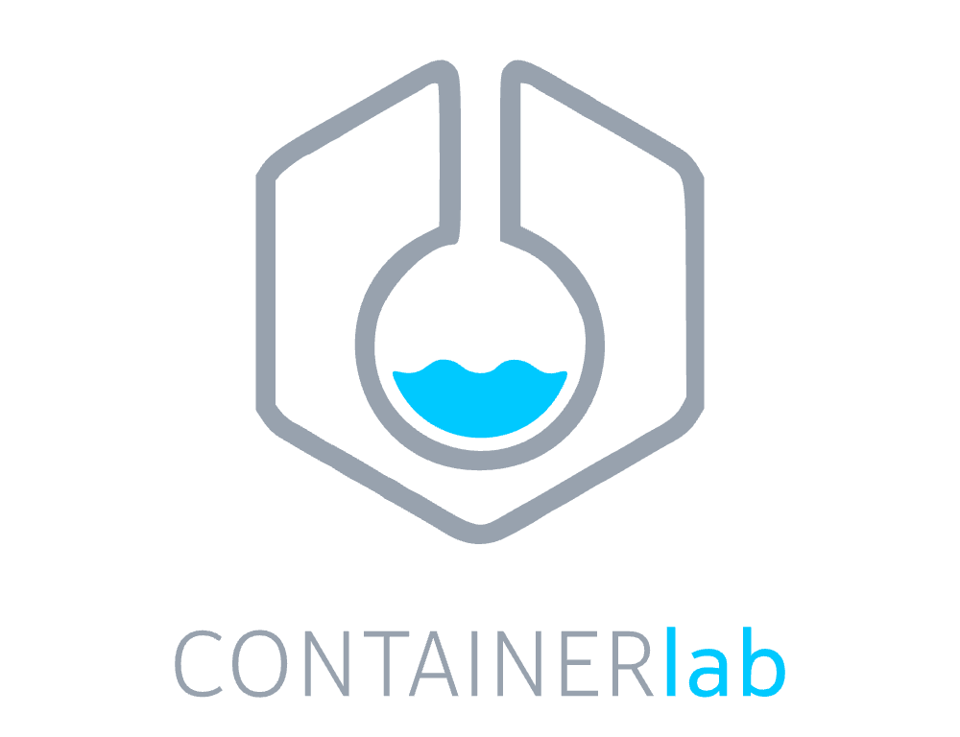
Claber… What?
Start at the… start: Containerlab
Declarative, Repeatable, Share-able network labs
Containerized NOS support, but *also* VMs¹
FOSS, batteries included, very awesome
Big ol’ huge labs? Resource hungry NOS(es)?
Sure, but… containerlab runs on one host
Multi-node topologies supported w/ VxLAN interconnects
Doable, yes, but... tedious/error prone unless fully automated
What if…
There was some sort of scale out compute system we could use for network labs….
1: Package up « non » containerized NOS with hellt/vrnetlab

Slide 4
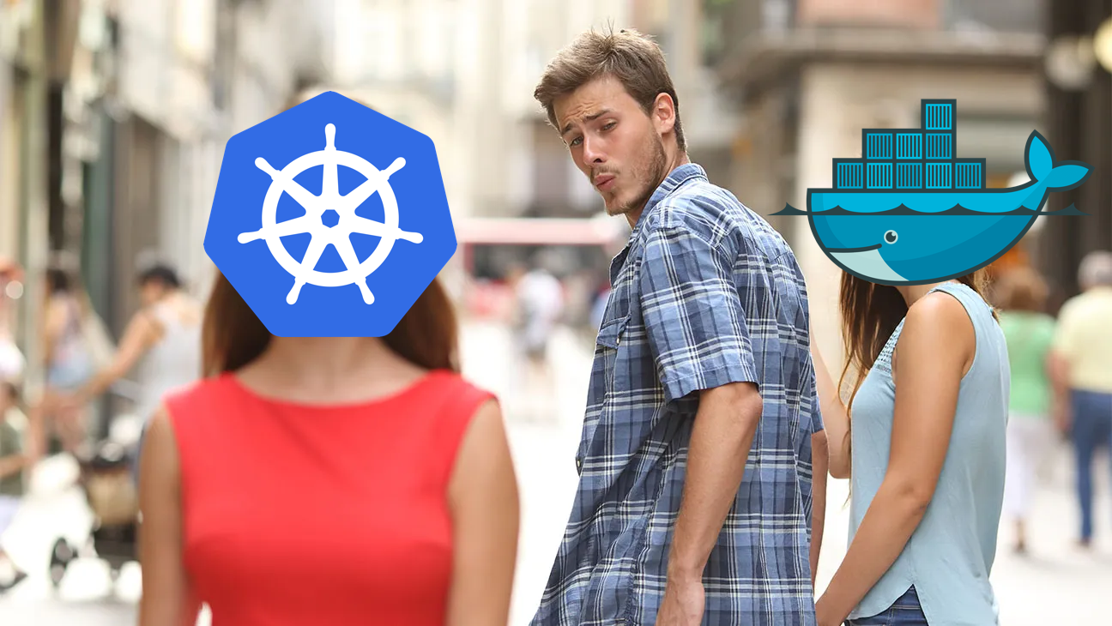
Kubernoodles Enters The Chat
Whats a Kubernetes
Container orchestration platform
Intelligent workload scheduling, scale, and manage software
Extensible by writing *controllers* and *custom resources*
Why Kubernetes
Pervasive, and getting more pervasive
We already have containers, we just need to spread ‘em around
Resource requests help the scheduler decide where to put workloads
Cool points?
Deployment freedom: self-hosted, managed, on-prem, in cloud, anywhere!

Slide 5
Hello, Clabernetes
Goals
Containerlab, just scaled out
Install in any k8s cluster, no drama
No need for k8s PhD
« just works » with existing clab topologies
Design
Be dumb… smartly?
Use containerlab, it already does most of the stuff we need
Standard k8s « things »
Simple helm chart install
Few, simple CRDs
No CNI/cluster requirements

Slide 6
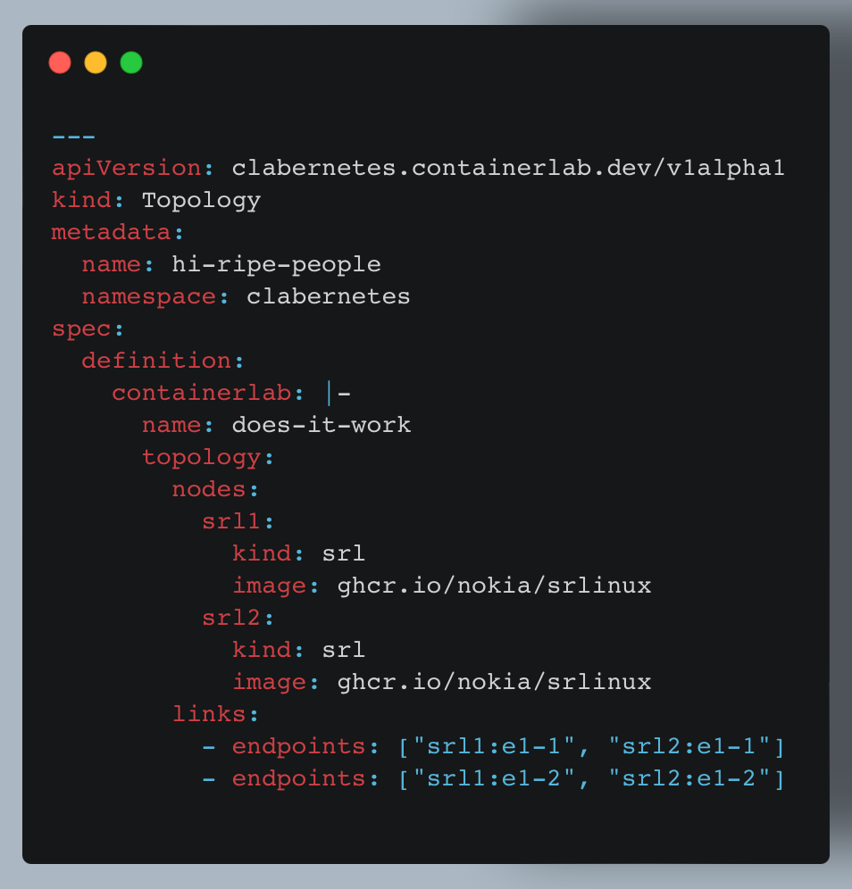
How it Works
TL:DR
Toplogy CRD holds « normal » containerlab topology
And some other goodies
Can get to this by using the « clabverter » tool
K8s pod per containerlab node
Plumbed together with VxLAN tunnels
Nodes exposed via LoadBalancer service
Topology updates cause reconcile event
Only restart nodes that have had things change
???
Profit! J/K its OSS

Slide 7
Clabernetes @OVH: the backstory

Slide 8
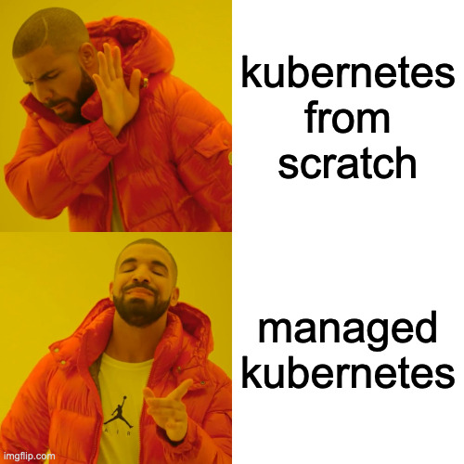
Managed Kubernetes Service

Slide 9
Install clabernetes

Slide 10
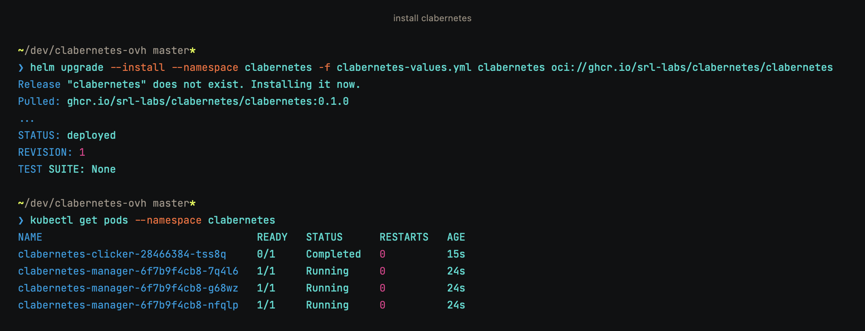
Install clabernetes - command

Slide 11
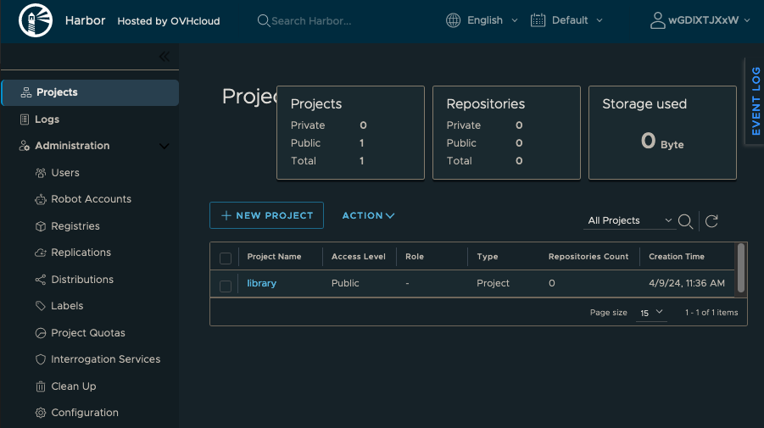
Managed Private Registry

Slide 12
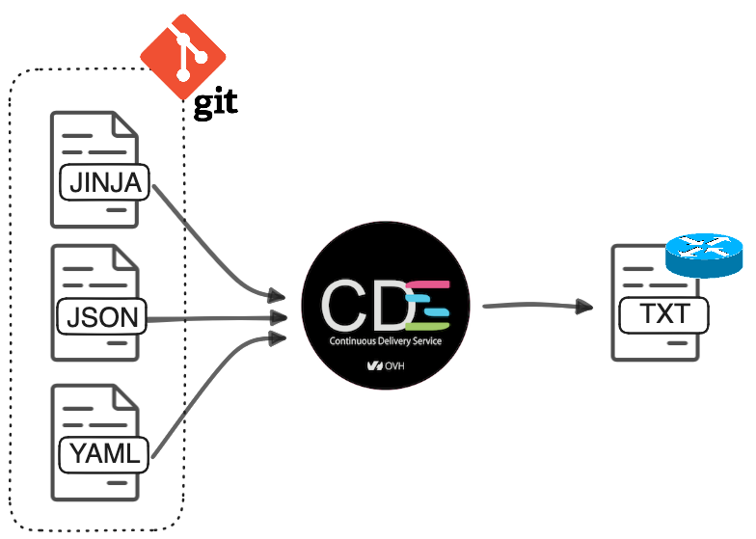
Network configuration
Yes but
… is the configuration syntax valid ?
… am I breaking anything ?

Slide 13
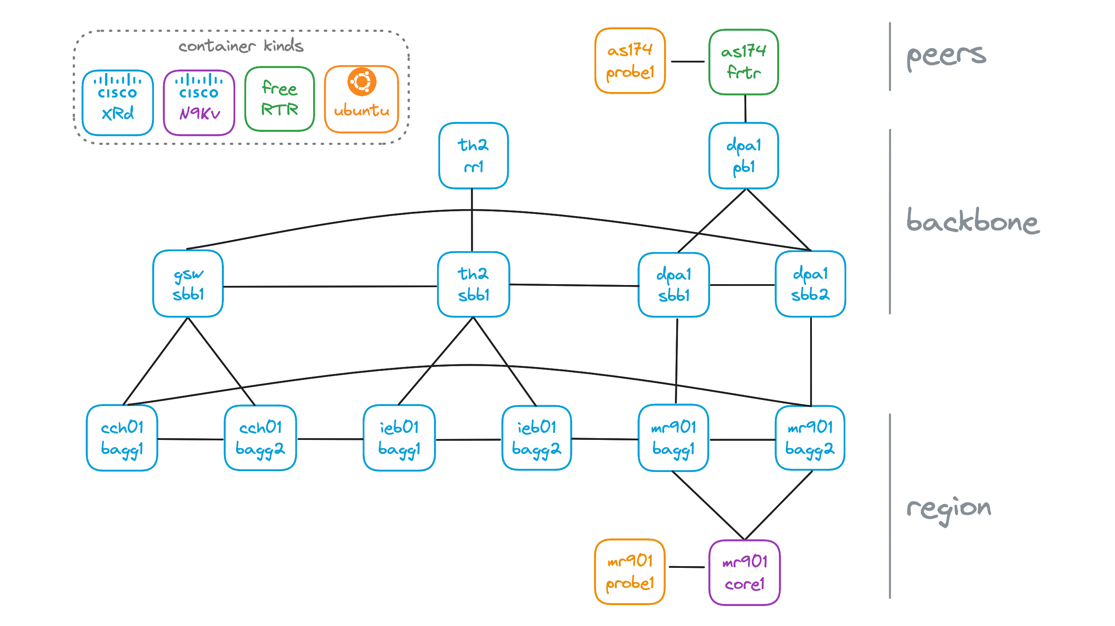
Paris area

Slide 14
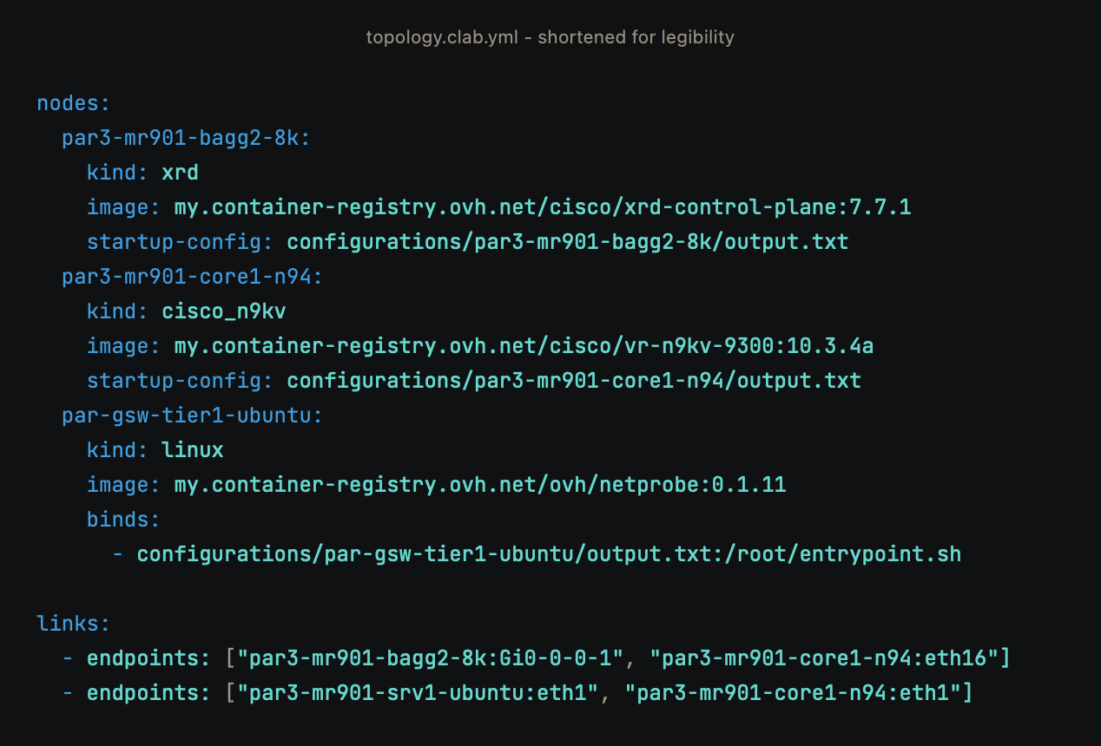
Paris area – topology file

Slide 15
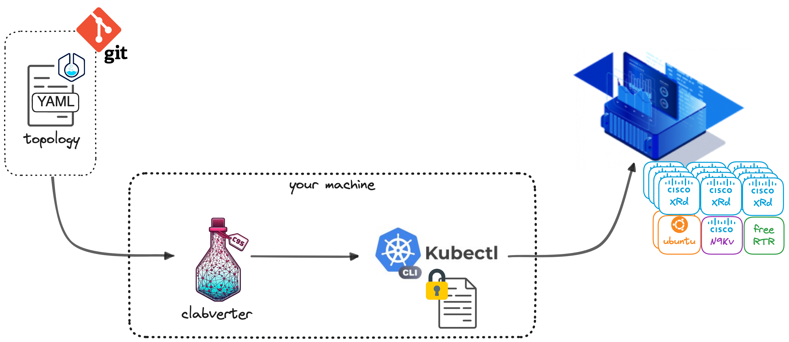
Deploy time

Slide 16
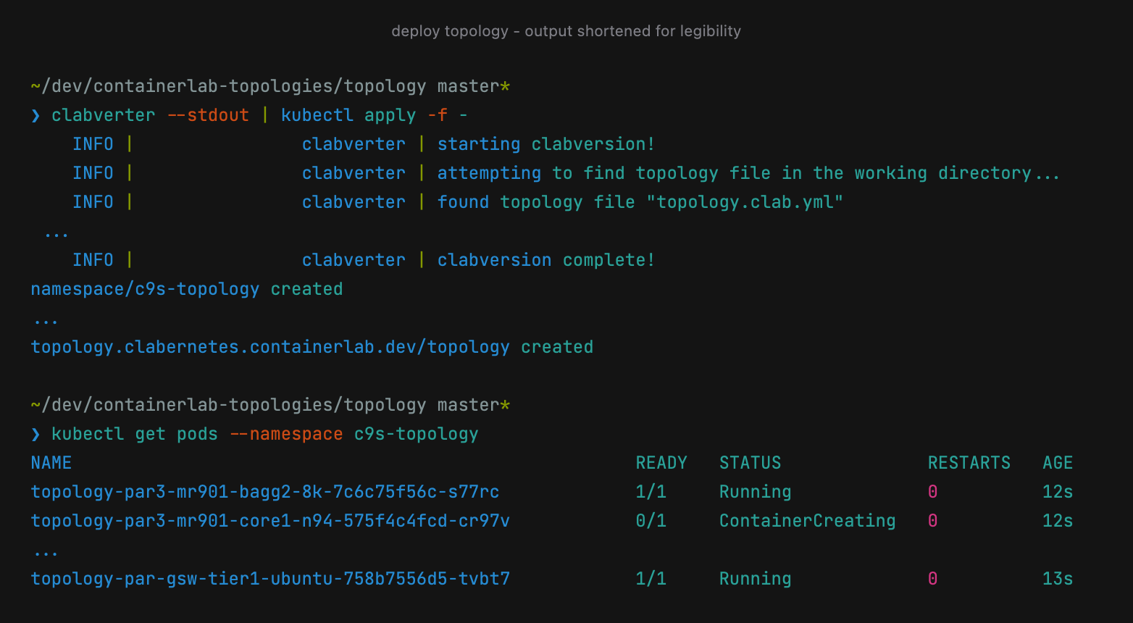
Laying back a bit

Slide 17
Sure but is my design working ?
containerlab automatically provision management interfaces
clabernetes embeds sshin binary to swiftly ssh into the pod container

Slide 18
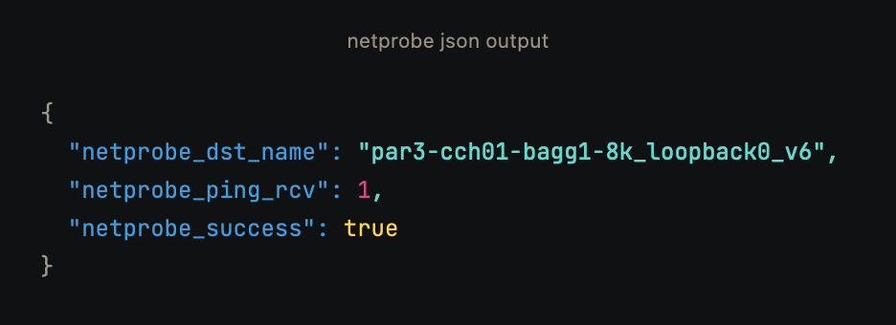
Nicer way
Logs Data Platform

Slide 19
Feedback
We can now run as much production replicates as we like
Clabernetes + cloud-managed kubernetes cluster = virtually no pain
More container-native network OSes would be nice (NX-OS)

Slide 20
Where we’re headed at
Simulate the whole backbone/regions !
CI/CD one-shot labs validation

Slide 21
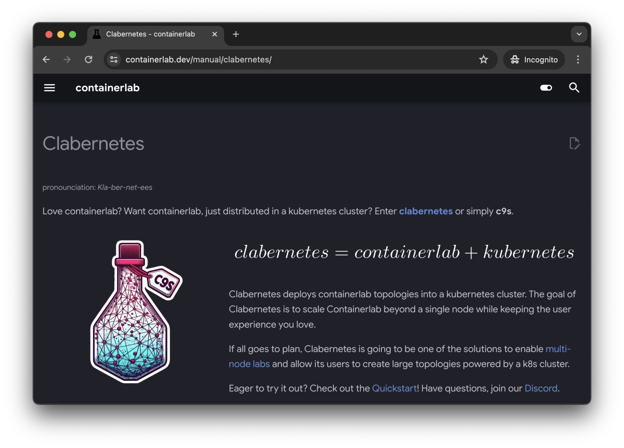
Get started

