Slide 1
Address Policy WG
Agenda
Alex Le Heux, Erik Bais, Leo Vegoda | RIPE 88 | May 2024

Slide 2
Welcome
This is a hybrid session
You can participate over Meetecho and in person
Alex Le Heux, Erik Bais, Leo Vegoda | RIPE 88 | May 2024
‹#›

Slide 3
Code of Conduct
Our Code of Conduct is designed to make everyone feel welcome
Please be polite to others and treat them with respect
Alex Le Heux, Erik Bais, Leo Vegoda | RIPE 88 | May 2024
‹#›

Slide 4
Thanks to Scribes
Thanks to out stenographers and scribes, who’ll keep records of our session
Alex Le Heux, Erik Bais, Leo Vegoda | RIPE 88 | May 2024
‹#›

Slide 5
Minutes from RIPE 87
Published in January
No comments
Can we accept them?
Alex Le Heux, Erik Bais, Leo Vegoda | RIPE 88 | May 2024
‹#›

Slide 6
Agenda – Session 1
Time
Subject / Title
A
Chair selection
B
ASO AC Update
C
Registry Services Update
D
Policy Update
E
IPv6 PI Policy
F
Coffee
Alex Le Heux, Erik Bais, Leo Vegoda | RIPE 88 | May 2024
‹#›

Slide 7
Agenda – Session 2
Time
Subject / Title
G
PI Policy Simplification
H
ASN assignment issues
I
Getting useful input from government adjacent organisations
J
Open Microphone
Alex Le Heux, Erik Bais, Leo Vegoda | RIPE 88 | May 2024
‹#›

Slide 8
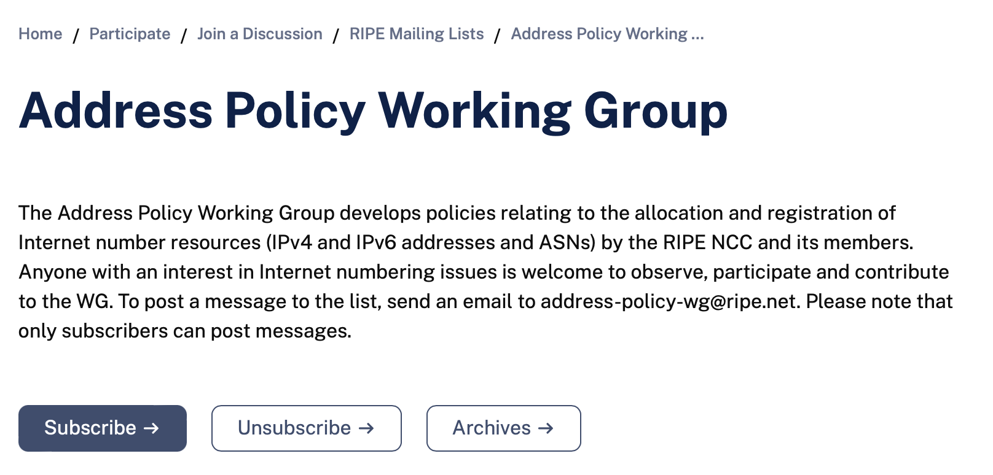
Send it in writing!
Make sure you provide input on policies via the mailing list
address-policy-wg@ripe.net
See you at RIPE 89 in the autumn!
Alex Le Heux, Erik Bais, Leo Vegoda | RIPE 88 | May 2024
‹#›

Slide 9
Questions,
feedback
& dialogue
Alex Le Heux, Erik Bais, Leo Vegoda | RIPE 88 | May 2024

Slide 10
THANK YOU
Alex Le Heux, Erik Bais, Leo Vegoda | RIPE 88 | May 2024

