Slide 1
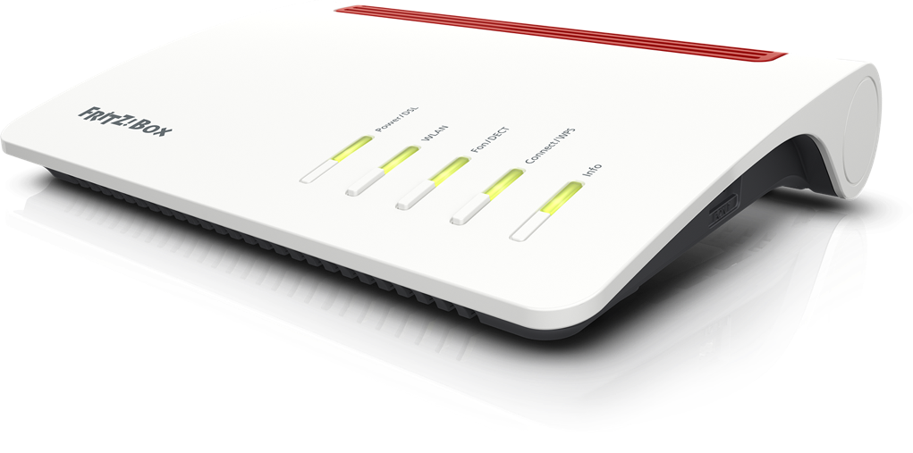
Your freedom. Your home.
Your FRITZ!
BBF IoT Operator Activities
RIPE 88 Kraków AVM: AS203965
Eric van Uden
Eric van Uden

Slide 2
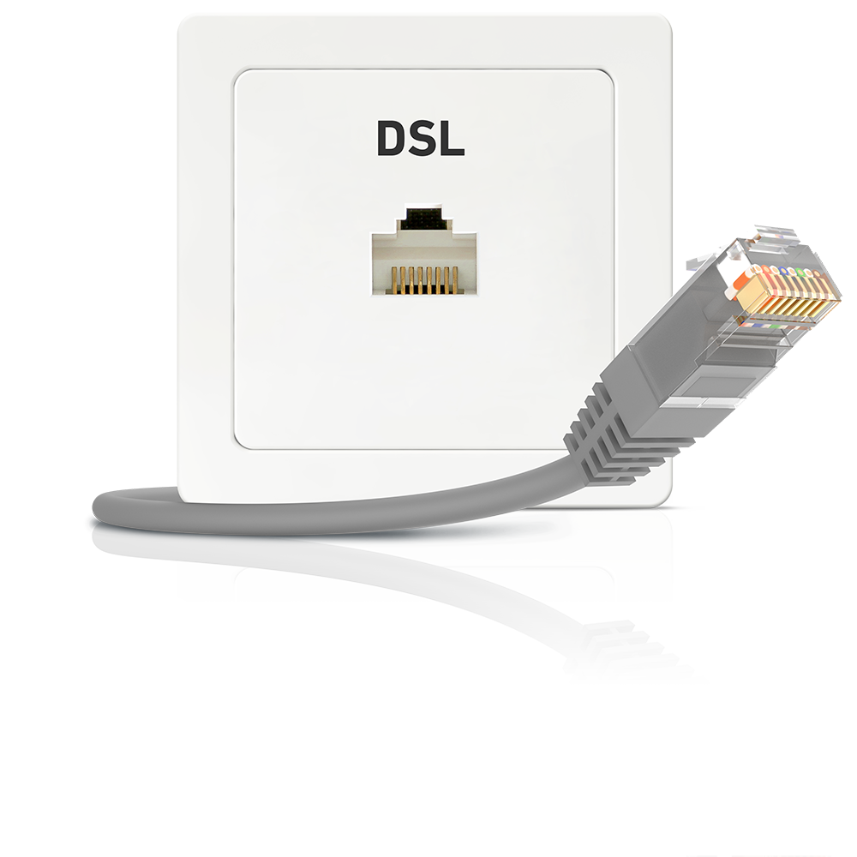
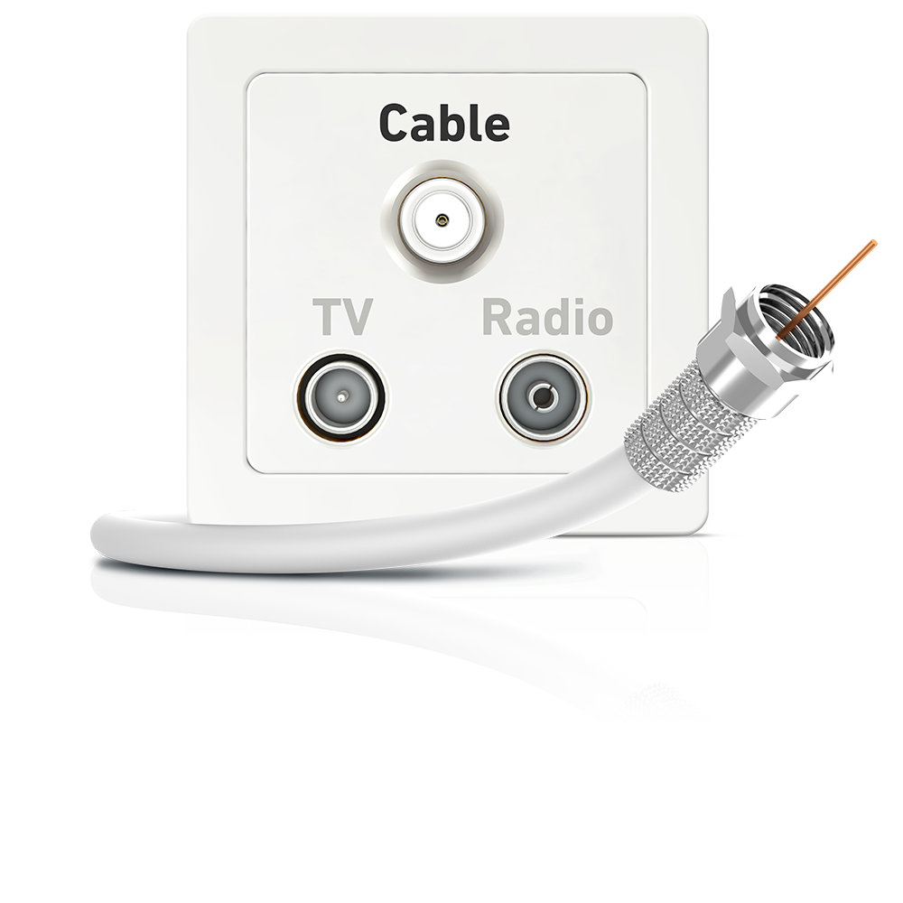
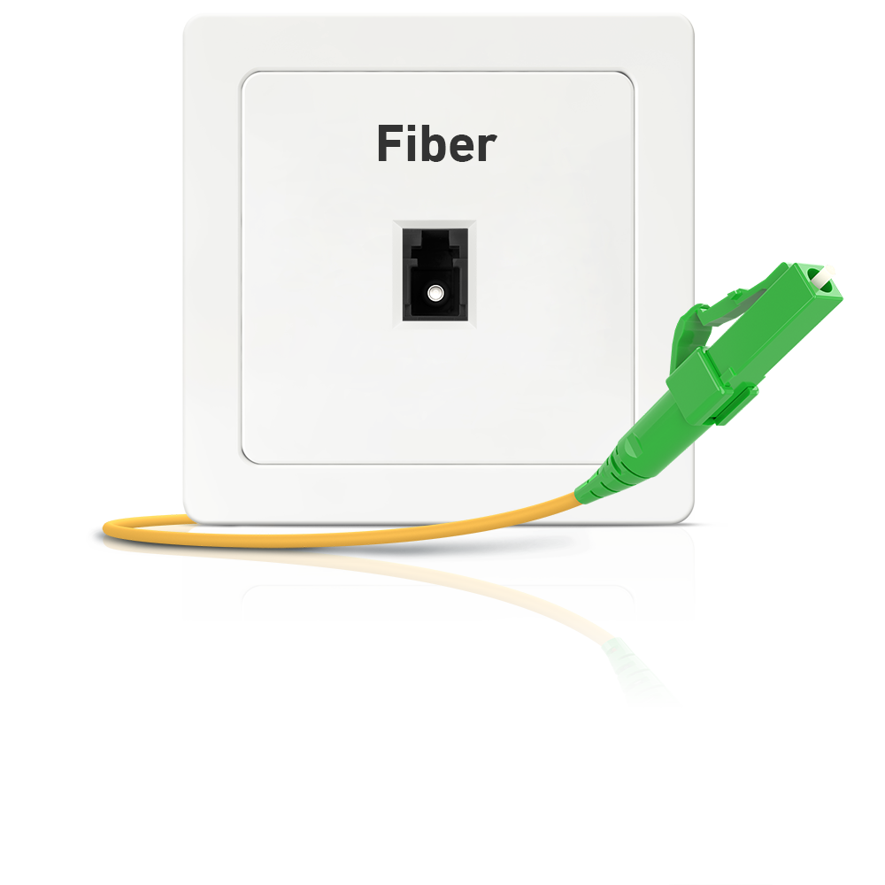
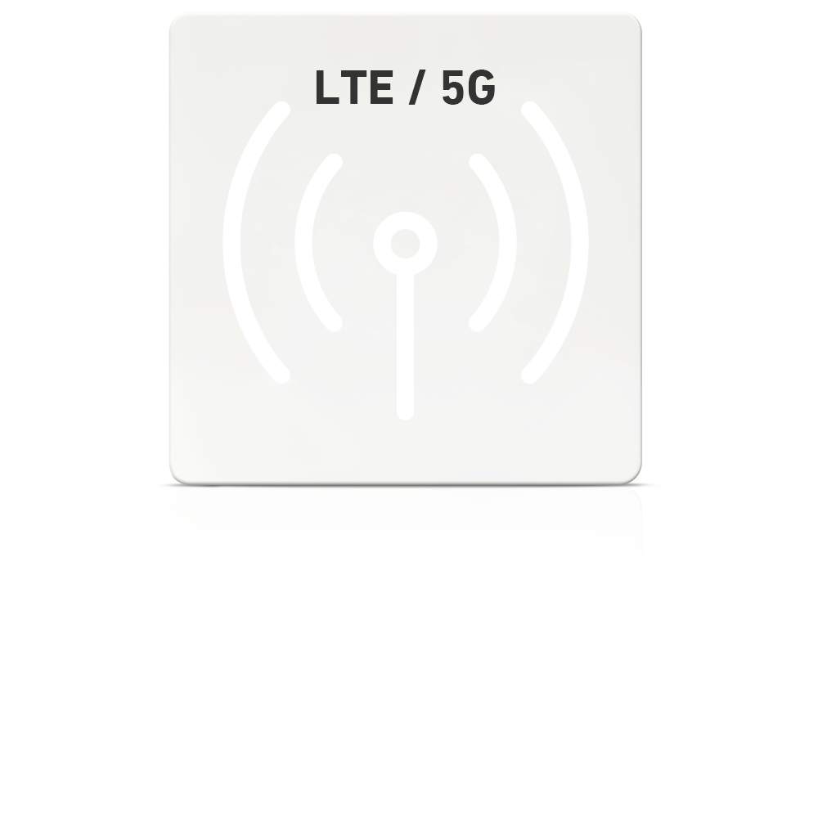
FRITZ!Box for every connection

Slide 3
Why I´m here?
Manager International Portfolio Development @ AVM GmbH for ICT
Member of EAB @ BBF
AVM Build Integrated devices, including IoT
Launch Matter at short notice
TR-69 and TR-369 (TR-181)

Slide 4
How we work best with other groups
Contributions and feedback to standards and Open Broadband projects
Member companies of both organizations
Publication and consumption of new specs/versions
And vice-versa…

Slide 5
What makes up the User Services Platform?
TR-181 Issue 2
Device:2 Data Model
TR-369
User Services Platform
KPIs
Controls
Commands
Configuration
Service Management
Software Modules
Standards
Multi-controller design
Efficient messaging
Flexible deployment
Secure exchange
Bulk telemetry
Northbound REST interface
Testing
Open-source
BBF.369 Certification
Self-certification program (TP-469)
https://usp.technology/
OB-USP-Agent
Open-source reference implementation (if desired)
Complemented by:
Wi-Fi Data Elements Certification
QuickTrack certification method
https://www.wi-fi.org/discover-wi-fi/Wi-Fi-Data-Elements

Slide 6
USP enables all uses to coexist within single ecosystem
USP Controllers and USP Agents have:
Persistent connections to reduce handshakes
Clear trust relationship establishment
Optional end-to-end application layer TLS session context
Rule-based access control to service elements for privacy and security
Flexible transport that can be cloud independent or not
Local end-user with app on computing device
USP messages
Non-USP Device
Modeled proxy device
USP Controller as ACS, or co-existence with TR-069
Device and application capabilities managed and controlled with standard TR-181 data model, directly or by proxy
USP messages
Data collector
Broadband Network
JSON bulk data over HTTP, MQTT, or over USP Notify messages
USP messages
USP Agents
Internet
Network setup and config
Network, security and privacy control
Software container management
Wi-Fi management
Firmware and software upgrades
Diagnostic commands
Bulk data telemetry
Custom commands & events
IoT sensors and controls
USP messages
USP messages
TR-181/Device:2 Data Model Capabilities
Third party MSP, vendor, or application provider
Mobile end-user with app on computing device

Slide 7
Smart Home Project Stream
Needs for an operator grade Smart Home
Smart Home in the context of TR-181 and USP (TR-369)
Device requirements
Security requirements and Theory of Operations
Test plan
Additional related work
Network topology mapping
Quality of experience delivered (QED)
Application services gateway (ASG)

Slide 8
The New Smart Home Protocol

Slide 9
What is Matter?
A new smart home protocol
Developed by Amazon, Apple, Google, IKEA, Samsung, and more
Aims to simplify the use of smart home devices
Matter also works without the Internet, but cloud services are required for remote control

Slide 10
Benefits of Matter
Unity: Matter devices work together, regardless of manufacturer
Security: Matter is based on secure standards, such as WPA3 and TLS 1.3
Energy efficiency: Matter is energy-efficient
Matter is designed to be interoperable with existing smart home devices.
Matter is expected to be widely adopted by smart home manufacturers in the coming years.

Slide 11
Technical
Source: CSA Matter Components Technical Introduction

Slide 12
Matter and USP (TR-369)
A standard for the configuration of Matter devices
Defines a set of APIs that developers can use to configure Matter devices
Working progress between BBF and CSA
Modelling Matter lightening endpoints and capabilities into the SP data model
Matter controller object (that is normally in the home) versus a proxied controller approach
Recognizing a matter device just like USP recognizes other managed smart home devices

Slide 13
Incorporating Matter - Initial Plans
Ability to install and onboard Matter functionality in the home
Matter as an ASG service
Ability to map, monitor, and control Matter fabrics and nodes
Current thinking: making Matter interface its own space in the data model
Adding additional network interface objects where needed, i.e. Thread
Continuing IoT Capabilities data model for other use cases/extensibility

Slide 14
Since then…
Primary work around adding Matter interface and related dependencies to the TR-181 data model
Adding Thread interface and a few other wireless technologies not currently modeled
“Modeling Matter as Matter is Modeled”: working to make sure that the data model can be readily understood and correlates with the Matter Data Model, possibly with programmatic updates in the future
Additional work on non-Matter use cases and allowing the configuration of data paths between IoT devices and services, and onboarding
Working closely with prpl Foundation

Slide 15
What about Matter and the Northbound Interface?
No big consensus at CSA about how to interface with Matter networks
Fragmentation of control applications
USP is well suited to solving this problem, as an open standard cloud interface for Matter
Working with joint members of CSA/BBF, mainly through Home Router working group (many operators)

Slide 16
Upcoming opportunities
Come to the Summer BBF meeting in Incheon, South Korea!
Guest passes available
Submissions still open for Smart Home Town Hall Innovation Series session Monday

Slide 17
More info:
https://csa-iot.org/wp-content/uploads/2022/11/22-27349-001_Matter-1.0-Core-Specification.pdf
https://developers.home.google.com/matter/primer
https://www.broadband-forum.org/testing-and-certification-programs/usp-tr-369-training-sessions
https://device-data-model.broadband-forum.org/
https://avm.de/service/schnittstellen/
AVM GmbH for ICT
E.vanuden@avm.de

