Slide 1
OS WG Chair Selection
What happened at RIPE87?
How to proceed in the future?
Open Source WG RIPE 88
Martin Winter – Co-Chair

Slide 2
Current WG Chair Selection Procedure
[1] The Open Source WG will have two co-chairs.
[2] WG may decide to increase a number of co-chairs to three.
[3] Two months before every autumn meeting there will be a call for co-chair candidates. The nomination period will be 14 days.
[4] If there is no application, the current co-chairs continue.
[5] Just one co-chair can be replaced every year.
[6] If there is one (or more) application, the current co-chair and the new candidate start to discuss about among themselves who will be serving next terms. If no consensus is reached until 14 days before RIPE, then we'll have a voting at the RIPE meeting. The voting system must respect rule number 5.
[7] Any issues relating to the selection or replacement of a co-chair which are not covered by the above will be decided by WG consensus during the RIPE meeting. When the WG is unable to reach consensus, the matter will be referred to the RIPE Chair (or their deputy) whose decision shall be final.
Published on https://www.ripe.net/community/wg/active-wg/os/open-source-wg-chair-selection-process/

Slide 3
Call for WG Chairs: 3 Candidates
Before RIPE 87 we had 2 chairs: Martin Winter and Marcos Sanz
We were looking for a 3rd chair
3 Candidates during the call for co-chairs:
Christian Scheele
Sasha Romijn
Luka Perkov
First time where we have a choice! (and a real selection) since the beginning of the WG (at RIPE 67, 10yrs ago)

Slide 4
Discussion with Candidates (Step 6)
We failed to get any meeting coordinated before Meeting.
At RIPE (before the WG), we got confirmation from all candidates that they wanted to run just for the open seat – not against the 2 existing chairs
--> 3 Candidates for one open seat
Last minute change of rules: Statements of support on mailing list for 14 days after meeting.

Slide 5
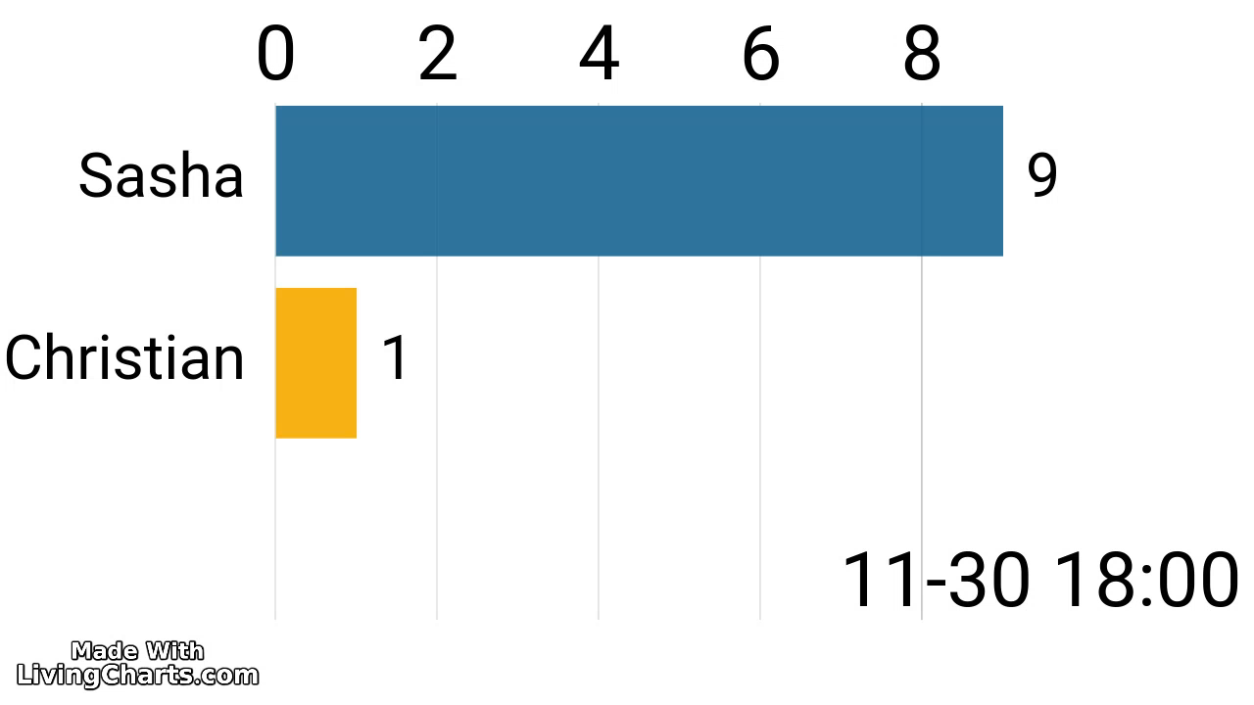

Slide 6
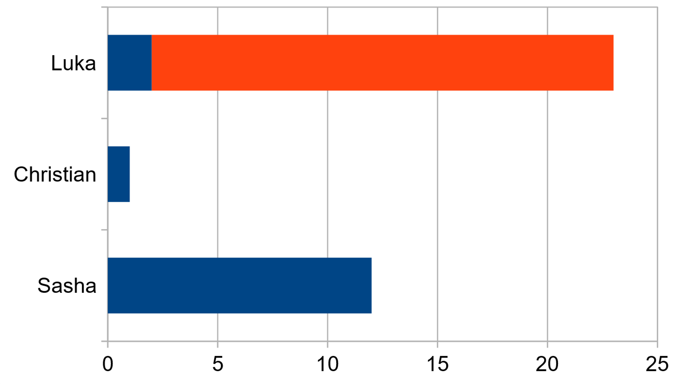
Who submitted a support statement?
Regular RIPE Attendees (attended Meetings before)
New Mailing list signups (after meeting), not attended a RIPE for at least 10 years
The current chairs did not vote "in public". We had our favorites, but abstained from mention them in public to avoid influencing the votes

Slide 7
Decision
This is not a strict voting with strict rules. This is to get input for support from the community. The goal is to find the best candidate with input from the WG
Decided to disqualify the new WG list members which were not on the list at the time of the meeting and didn't attend any RIPE meeting in the past 10 years in person or virtual
As expected
Protest from a few newcomers whose vote didn't get counted
Agreement from long-term community members

Slide 8
Future
Mirjam Kühne working on some ideas for a unified working group selection process.
We will most likely do future voting only during the meeting in a way to allow onsite and remote participants.
Adds an indirect requirement to have attended a RIPE meeting to vote
Should there be some additional qualifications needed for chair candidates? I.e. attended at least 2 meetings in person in the previous 3 years?
At this time there is no requirement for the candidates and it's up to the community and chairs to accept/reject candidates
Should existing WG Chairs show their support the same way?
Mainly important in public voting. Might influence others
Questions ?

